Slide 1
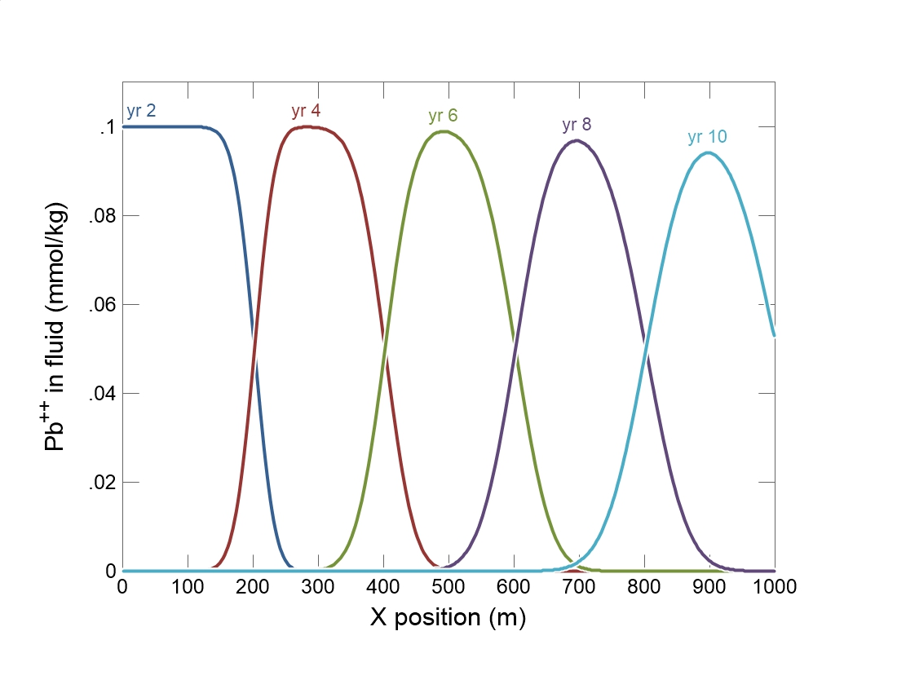

Slide 2
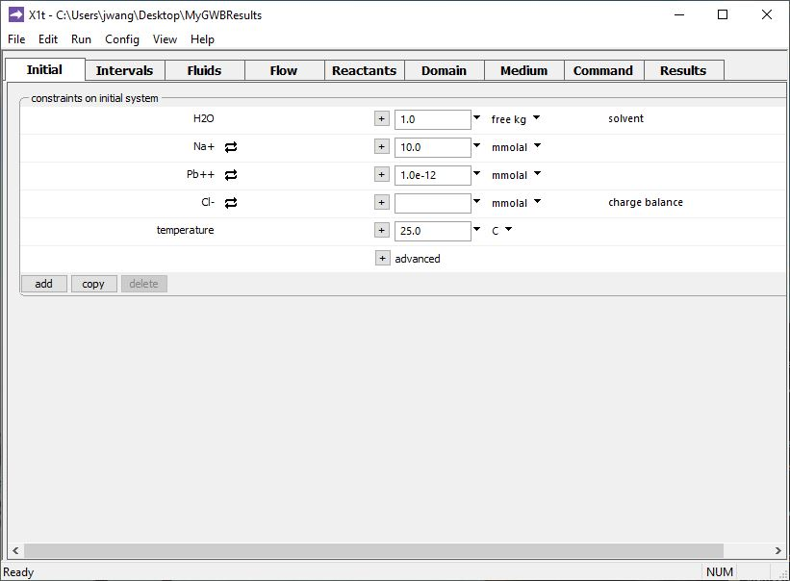
Specify domain’s starting fluid composition on the Initial pane
Clean water

Slide 3
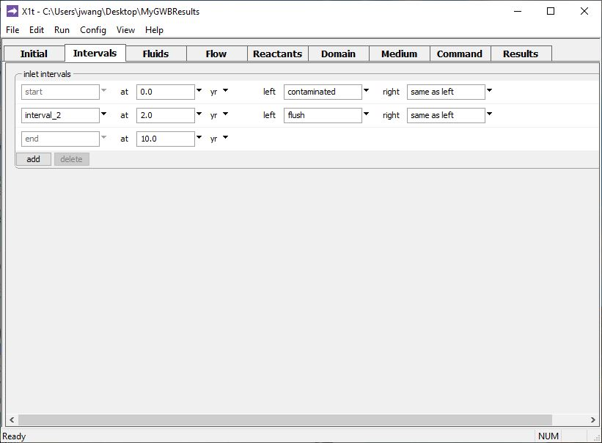
Define the reaction intervals. Specify what fluids flow into the domain, and when.
Inlet fluid “contaminated” enters the domain from t = 0 to 2 years
Inlet fluid “flush” enters the domain from t = 2 to 10 years
Click to add a new reaction interval

Slide 4
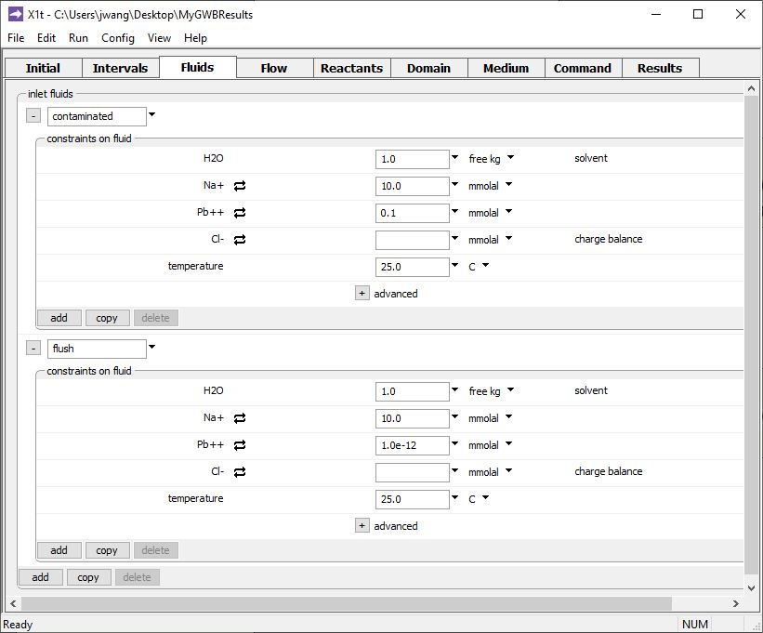
The various inlet fluids are defined on the Fluids pane
Inlet fluid named “contaminated” carries Pb⁺⁺ pulse into the domain
Clean rinse water: negligible Pb⁺⁺ in the “flush” inlet fluid
Click to add a new fluid

Slide 5
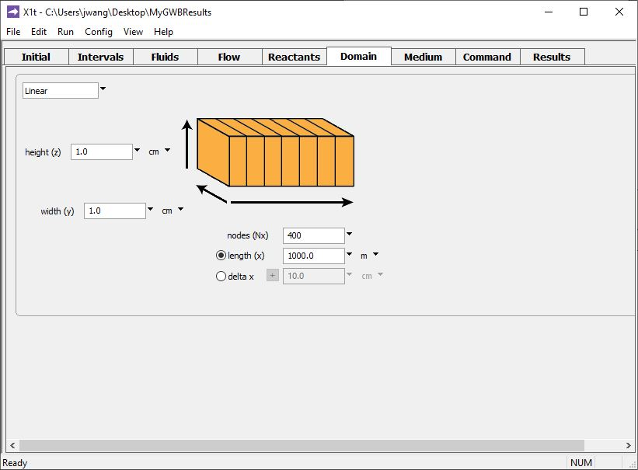
Specify domain size and gridding on the Domain pane.
Domain is 1 km long, divided into 400 nodal blocks

Slide 6
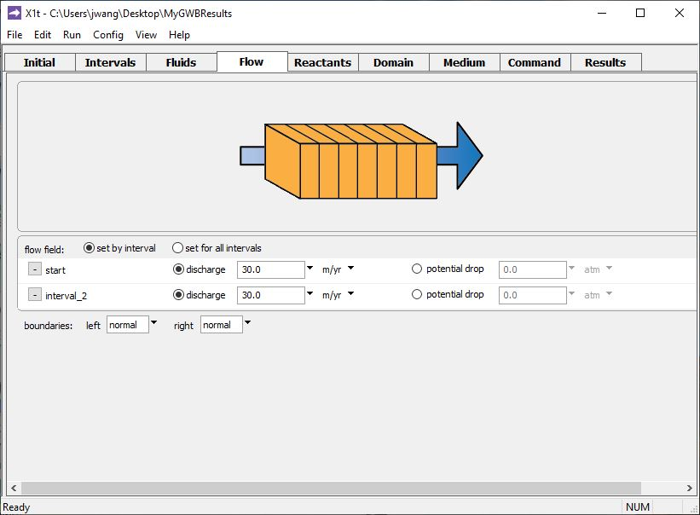
Specify flow rate on the Flow pane.
Set flowrate for 1st and 2nd reaction intervals individually, or set one flowrate for all intervals
Set specific discharge or hydraulic head/ potential drop

Slide 7
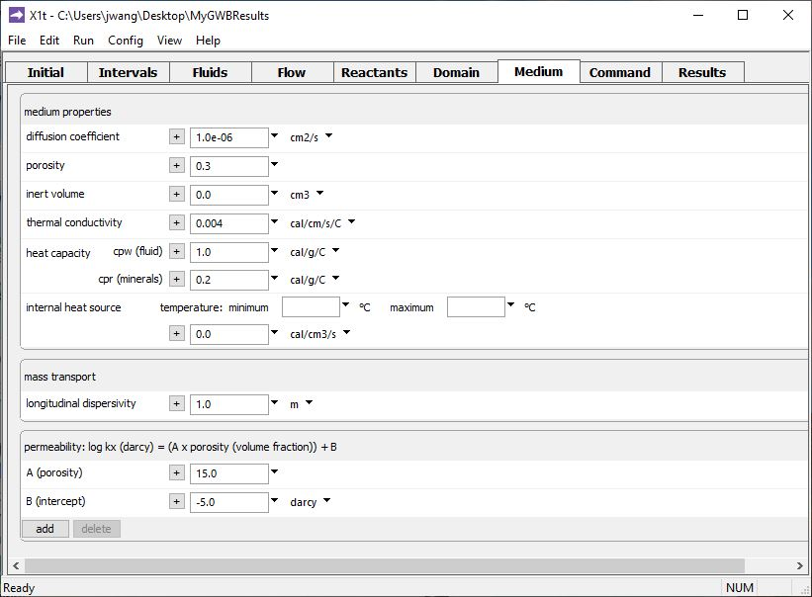
Set various mass transport properties on the Medium pane.
Porosity affects groundwater velocity.
Used to calculate coefficient of hydrodynamic dispersion.
Run → Go
traces the model

Slide 8
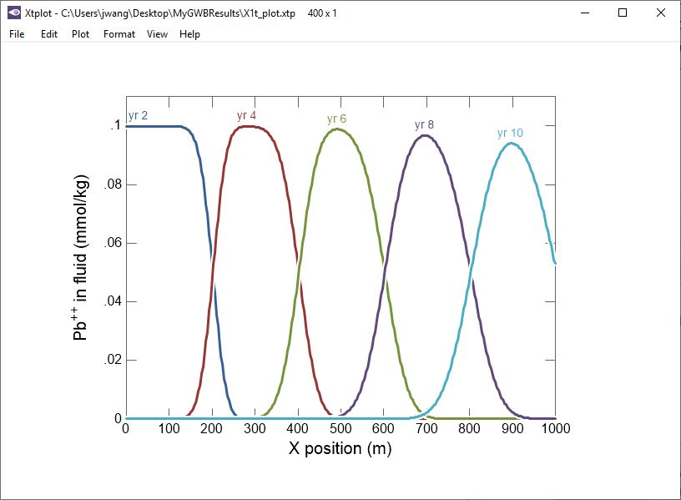
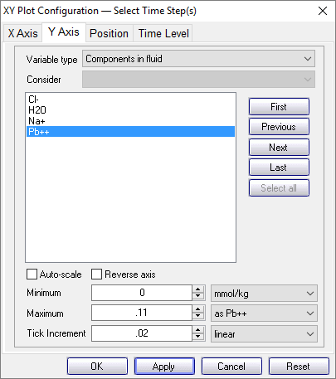
Pb⁺⁺ pulse transported through the domain by advection, dispersion, and diffusion.

