Slide 2
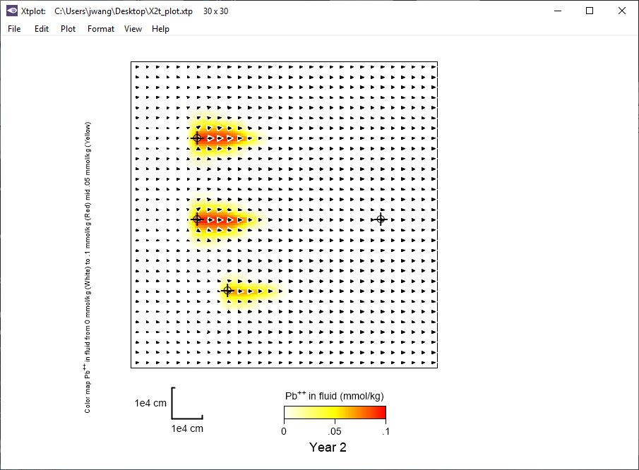
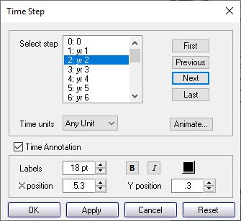
You can choose a time step to plot each variable in map view…
Format → Time Step…
Pb++ contamination after two years of injection

Slide 3
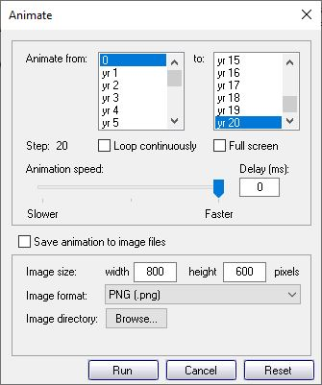
… or animate through a range of time steps
Format → Animate…
Select start and end time for animation.
Adjust animation speed

Slide 4
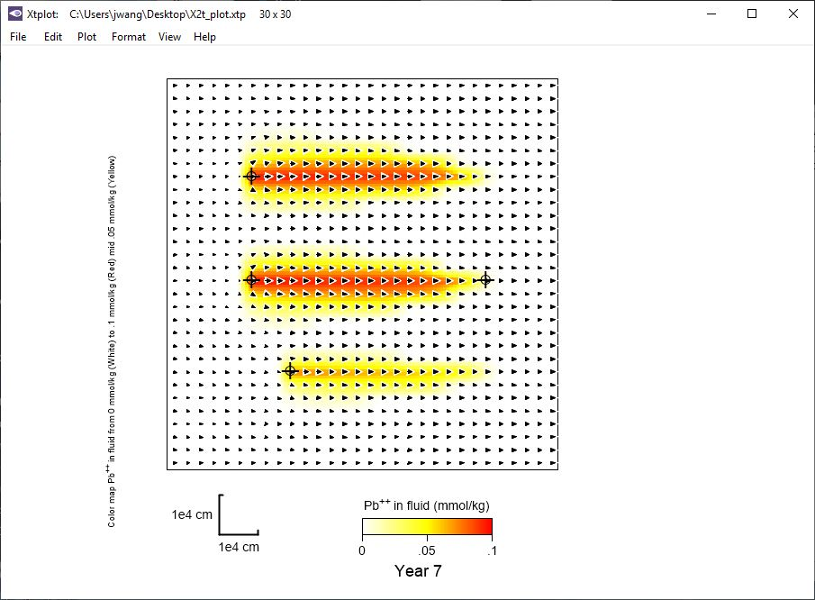
Color map shows three point sources of lead contamination entering the aquifer.

Slide 5
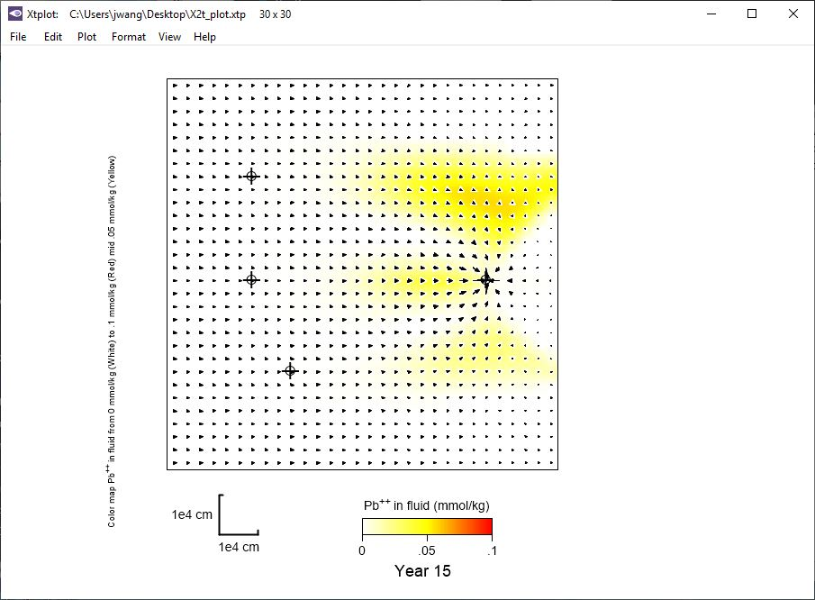
Pumping well has been turned on and is capturing contaminated water.

Slide 6
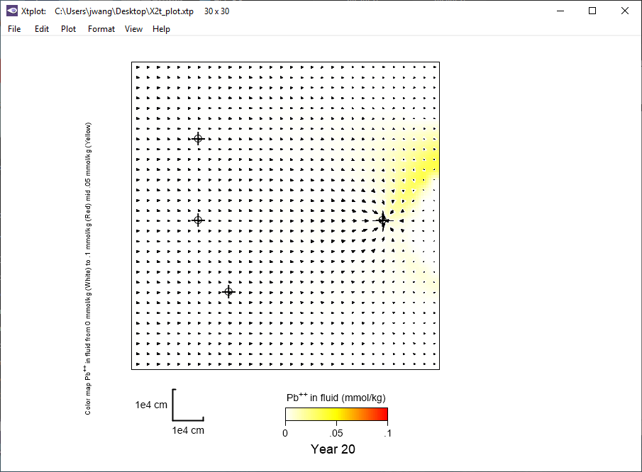
After 20 years a large percentage of the initial contamination is gone.

