Slide 2
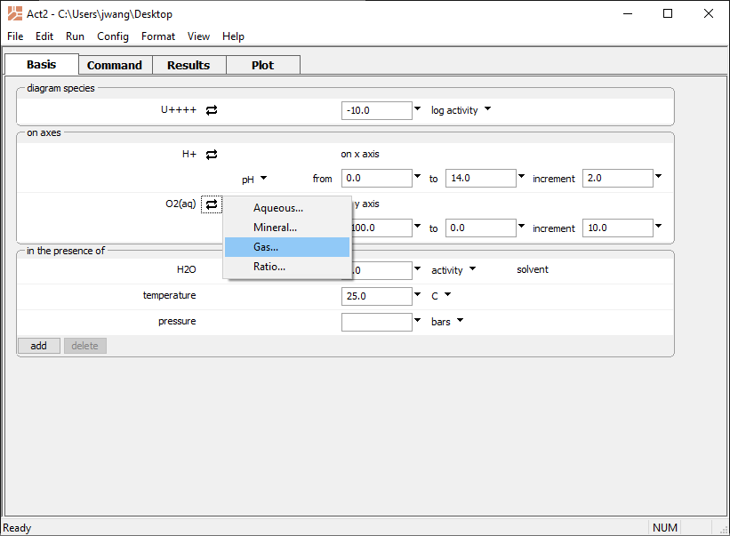
You can set a variety of axis types for your stability diagrams
Swap out O₂(aq) for Gas… → O₂(g)

Slide 3
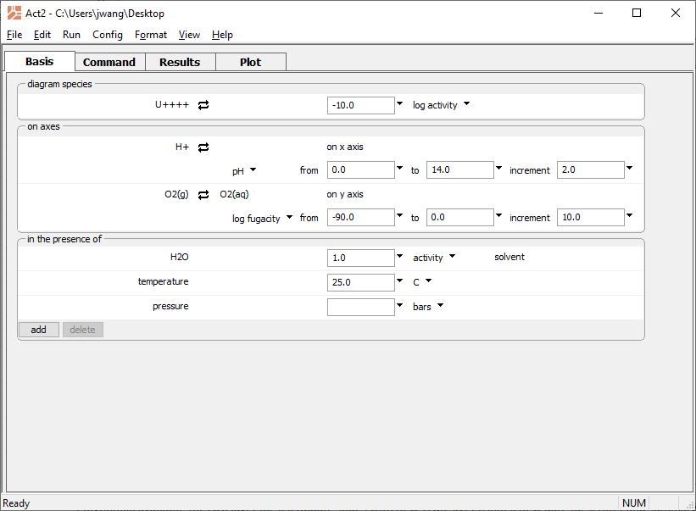
Set the fugacity range
Run → Go
draws the diagram

Slide 4
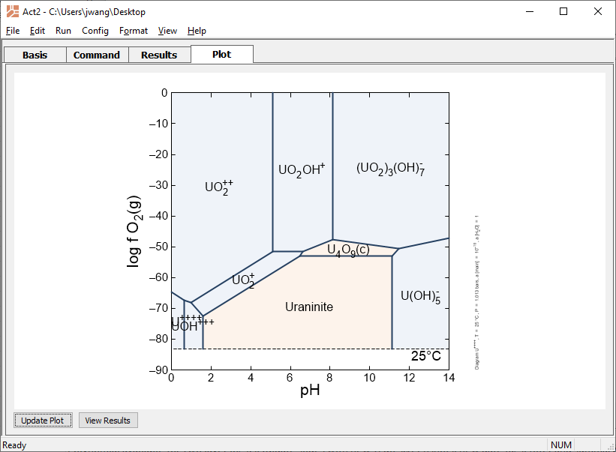
f O₂-pH diagram for Uranium

