Slide 1
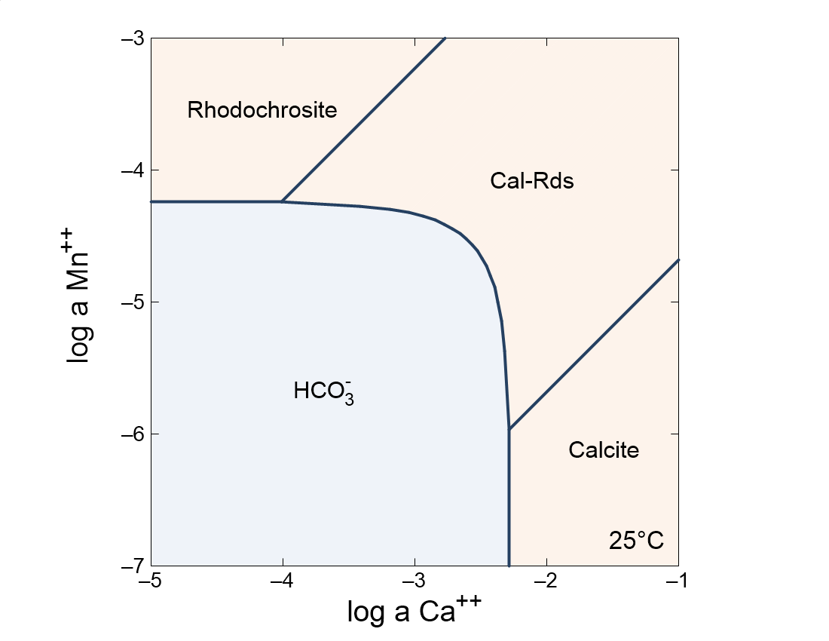

Slide 2

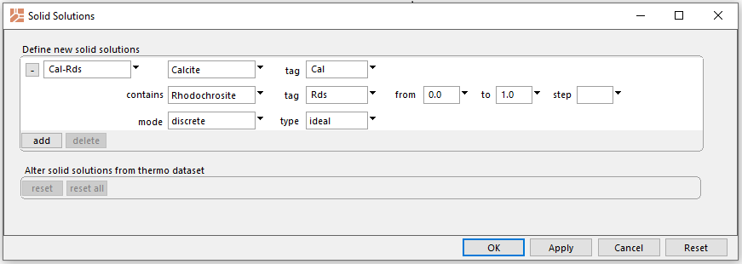
Config → Solid Solutions
Assign a name, end members, and tags (abbreviations)
Set activity model to ideal

Slide 3
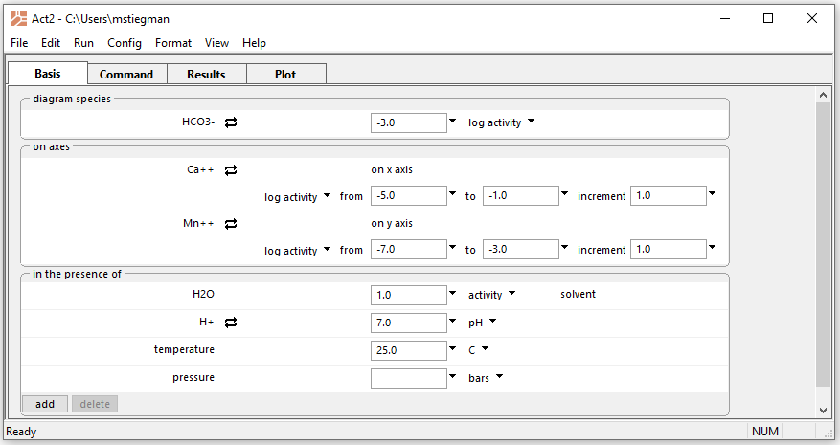
Ca++ and Mn++ substitute for each other in the solid solution
Go to the Plot pane

Slide 4
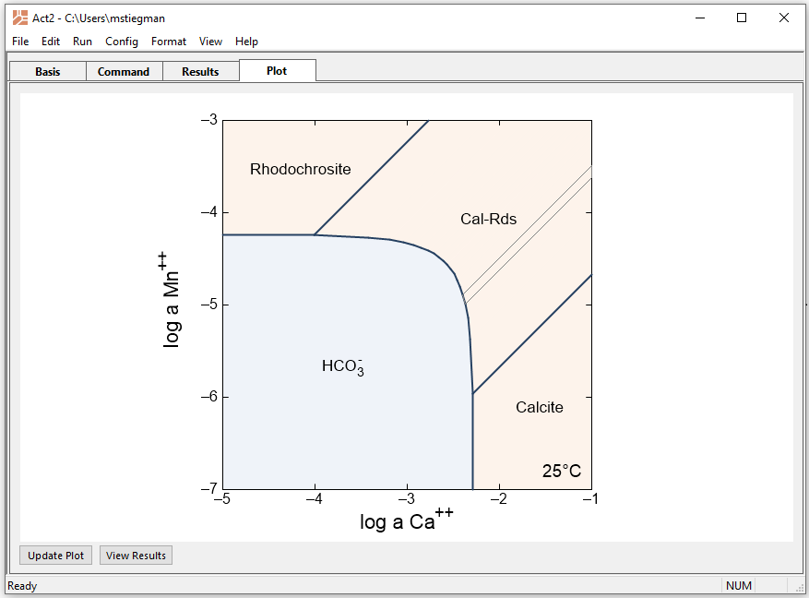
Cal-Rds field represents series of tranches between end members
Click within field to highlight individual tranches

Slide 5
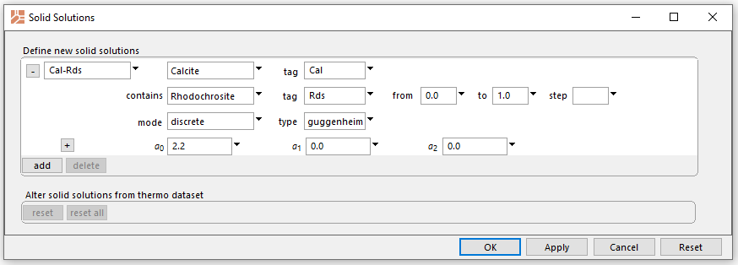
Comparison using non-ideal model
Set Guggenheim parameter a0
Go to the Plot pane

Slide 6
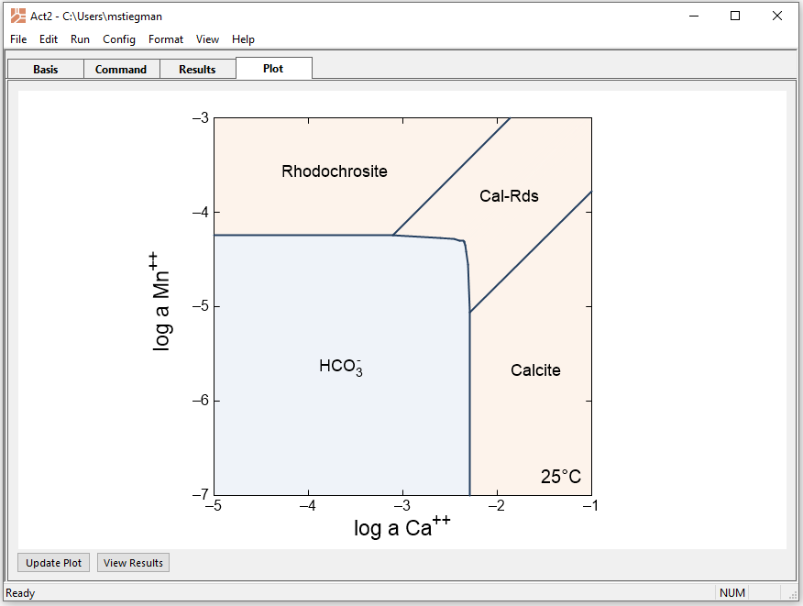
This solid solution is less stable than the ideal version and exhibits a miscibility gap

