Slide 1
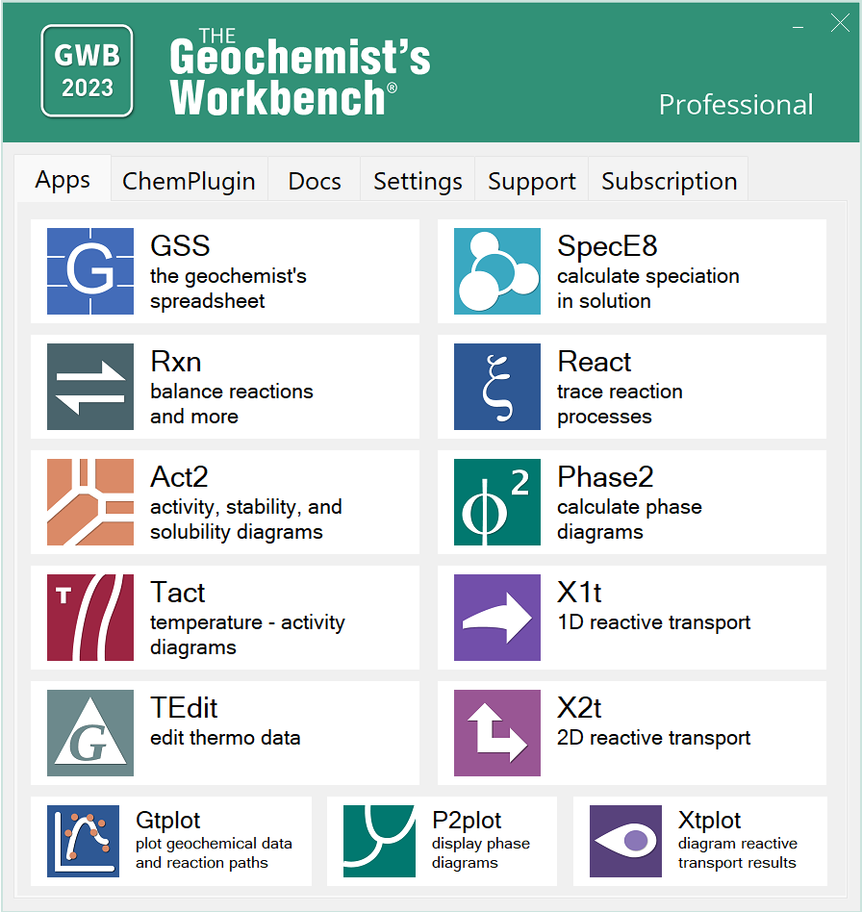
All the GWB programs in one place

Slide 2
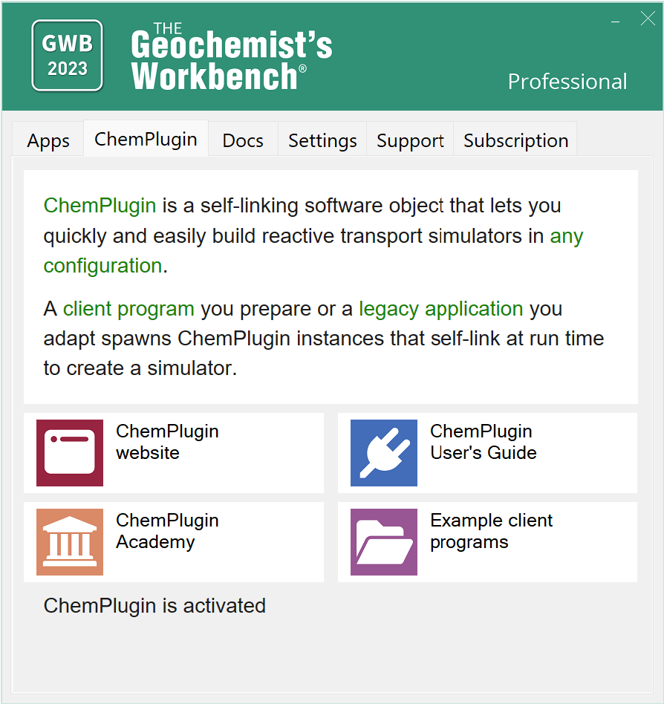
Access ChemPlugin clients, website, and User’s Guide

Slide 3
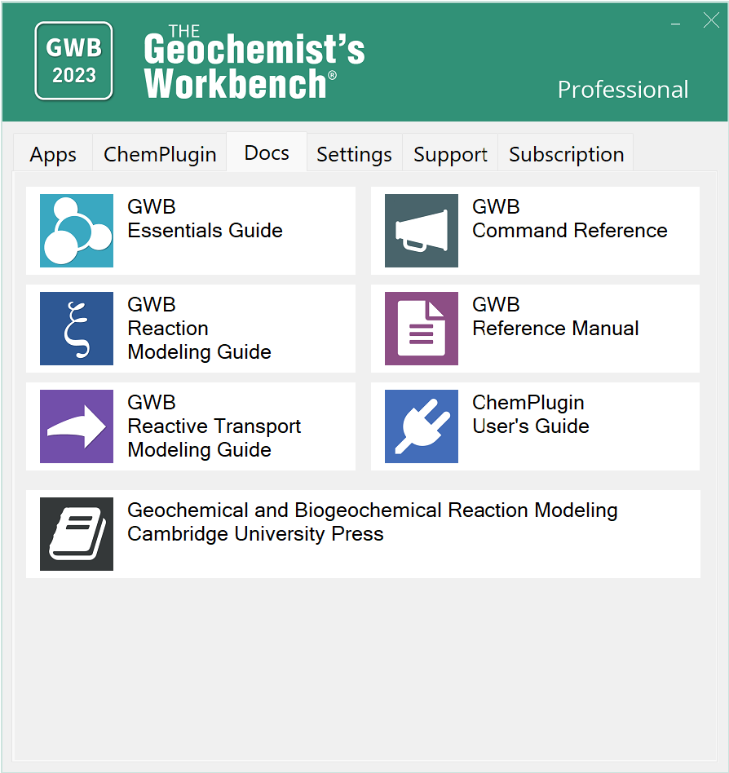
Read the User’s Guides
Theory and fully-worked GWB examples

Slide 4
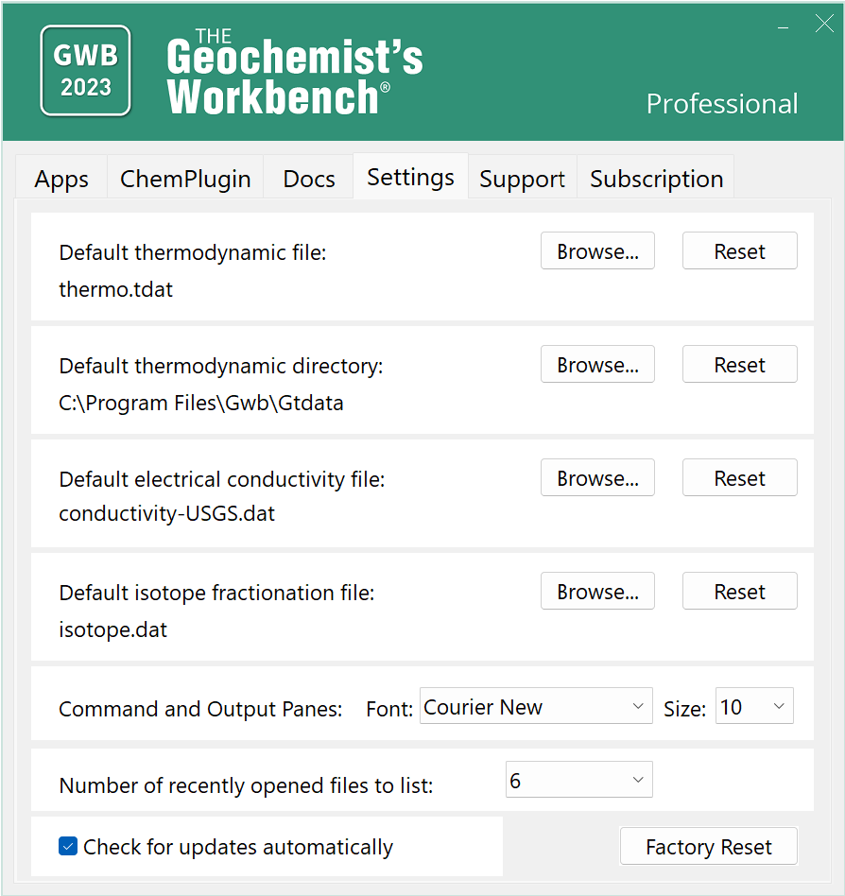
Configure your settings in one place

Slide 5
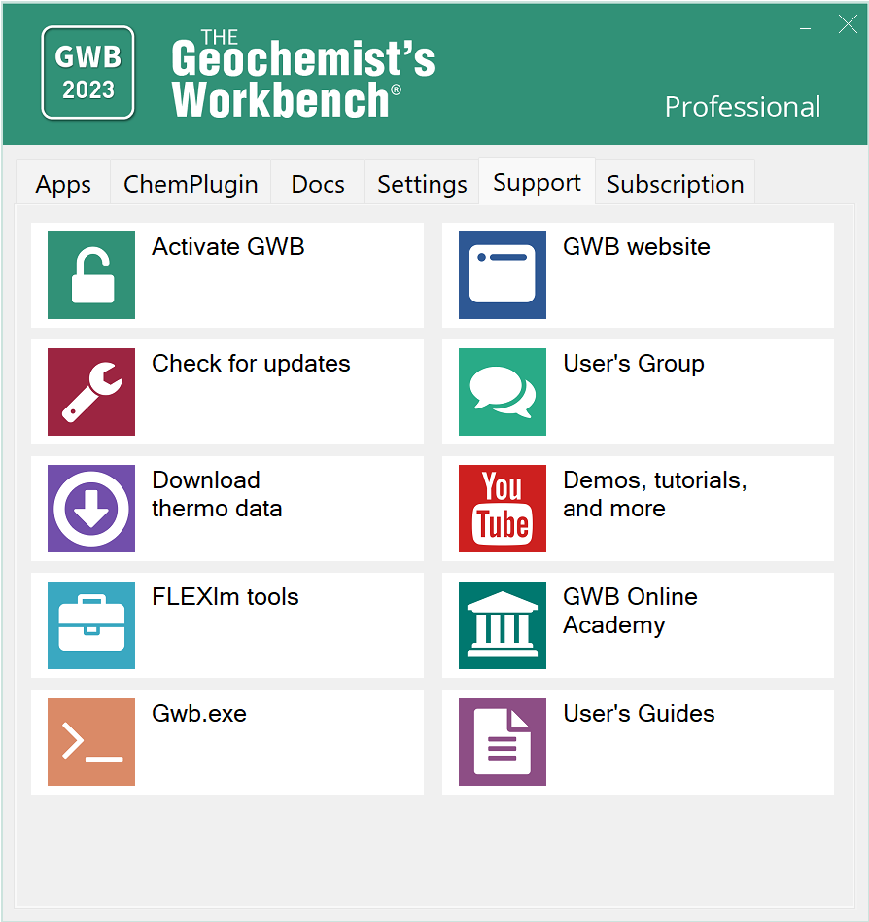
Activate GWB, download datasets, GWB.com, YouTube, Updates, and more

Slide 6
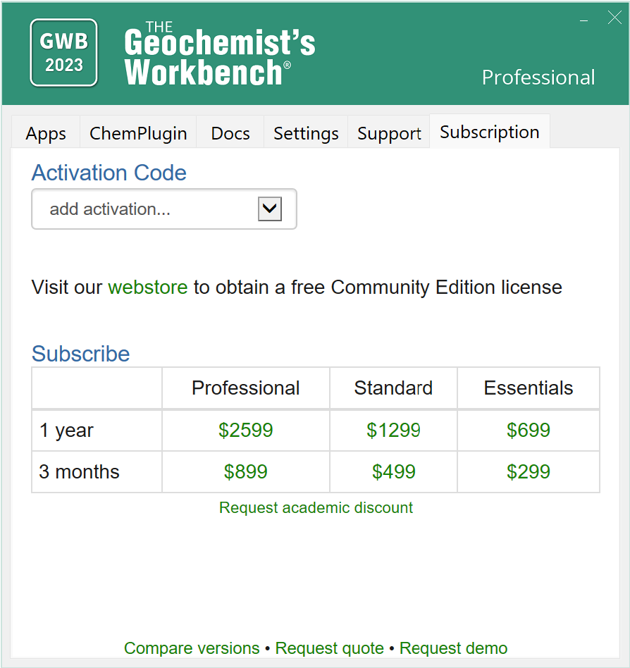
Subscribe to GWB, Upgrade options, request academic discount

