Slide 1
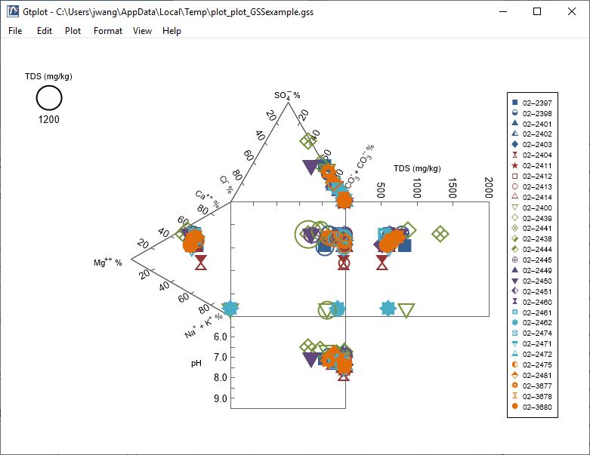
Durov Diagrams

Slide 2
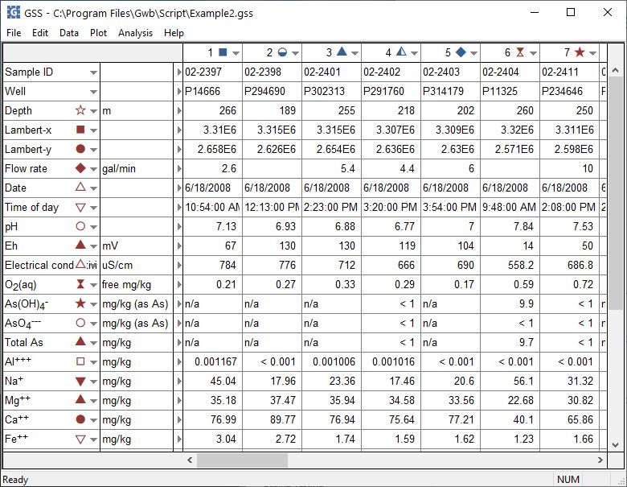
You can launch Gtplot from GSS to create Durov diagrams, cross-plots, time series graphs, and more.
Plot → Durov Diagram…
You can set the color, shape, or size of markers representing individual samples or analytes.

Slide 3
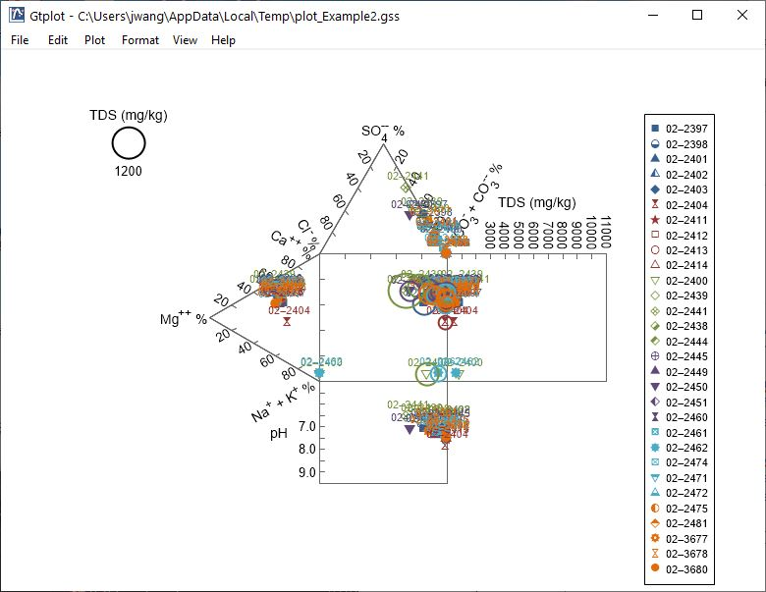
The Durov Diagram shows the fluid’s major ion composition, TDS, and pH.
Right-click on labels or axes to change color, font, size, etc.
Double-click outside the plot to open the Quick Toggle dialog. Toggle gridlines, sample labels, legend, and more.

Slide 4
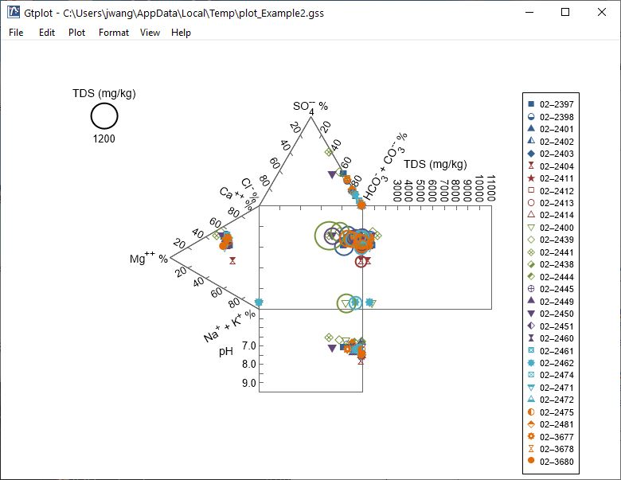
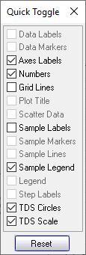
The Durov Diagram shows the fluid’s major ion composition, TDS, and pH.
Double-click on plot to bring up the Durov Diagram configuration dialog.
Toggle Sample Labels on and off

Slide 5
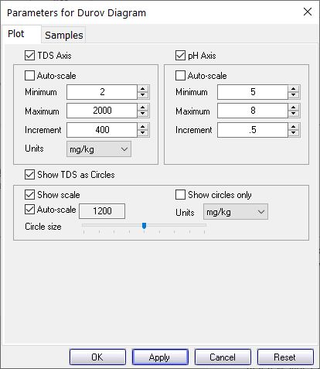
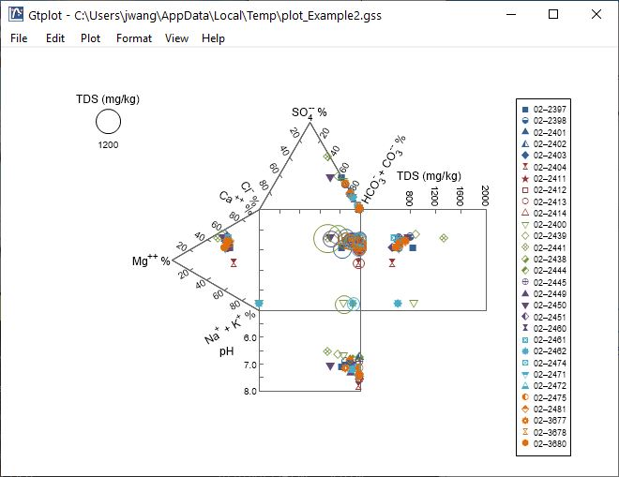
Adjust TDS and pH axes
You control details of the Durov Diagram from the Plot pane.
Toggle TDS circles, scale, units, display, etc.

Slide 6
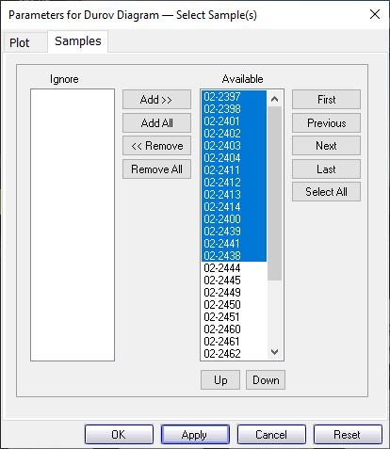
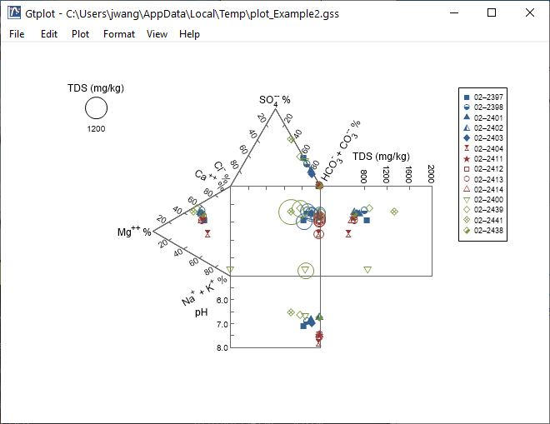
You control which samples are displayed from the Samples pane.
Only selected samples in the Available list plot.
You can cycle through samples one at a time.
Plot all samples together.

