Slide 1
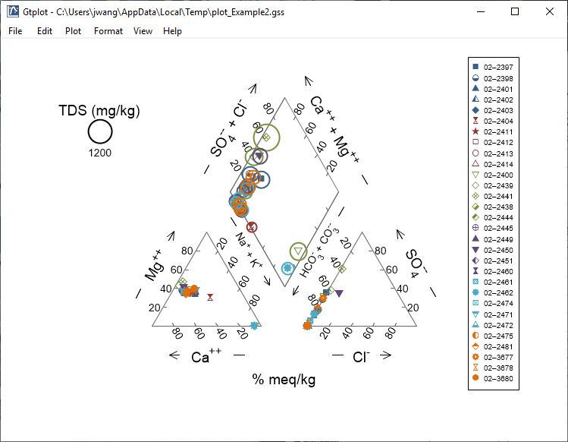
Piper Diagrams

Slide 2
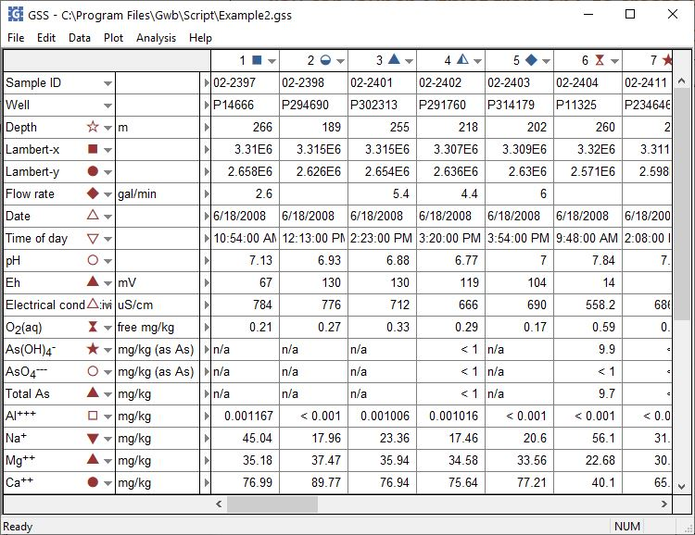
You can launch Gtplot from GSS to create Piper Diagrams, cross-plots, time series graphs, and more.
Plot → Piper Diagram…
Click to set the color, shape, or size of markers representing individual samples or analytes.

Slide 3
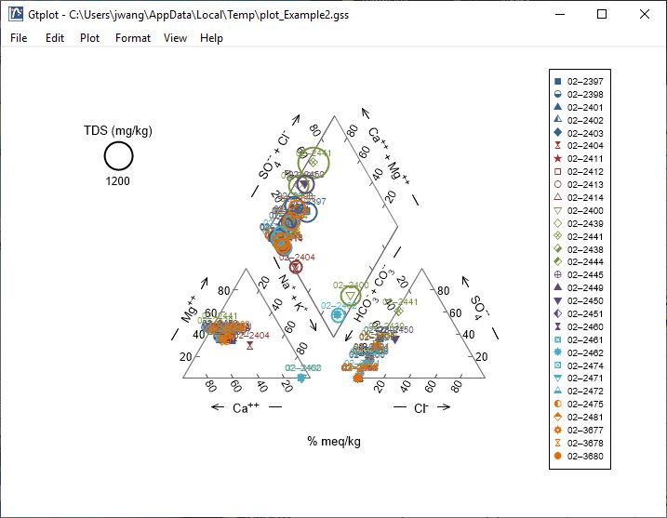
The Piper Diagram shows the fluid’s major ion composition.
Double-click on plot to bring up the Piper Diagram configuration dialog.
Double-click outside the plot to open the Quick Toggle dialog. Toggle gridlines, sample labels, legend, and more.
Right-click on labels or axes to change color, font, size, etc.

Slide 4
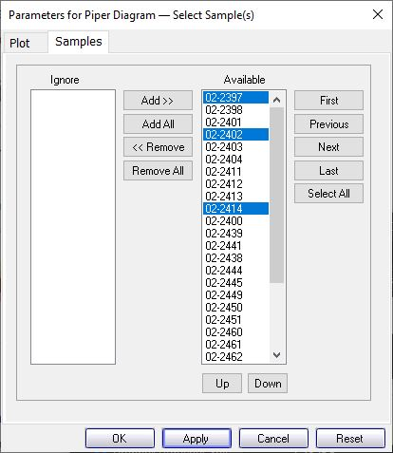
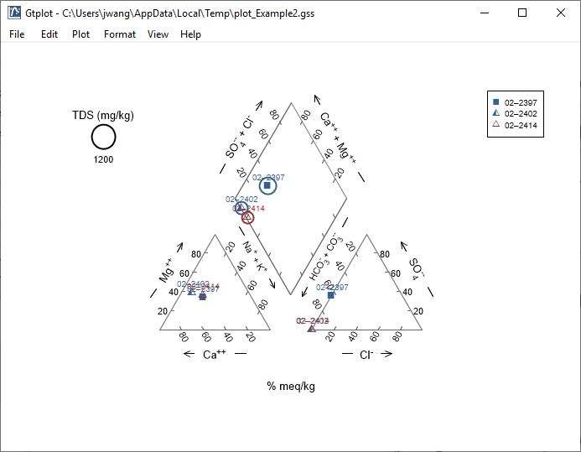
You control which samples are displayed from the Samples pane.
You can cycle through samples one at a time.
Only selected samples in the Available list plot.
Plot all samples together.

Slide 5
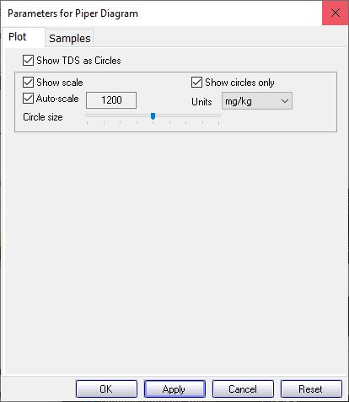
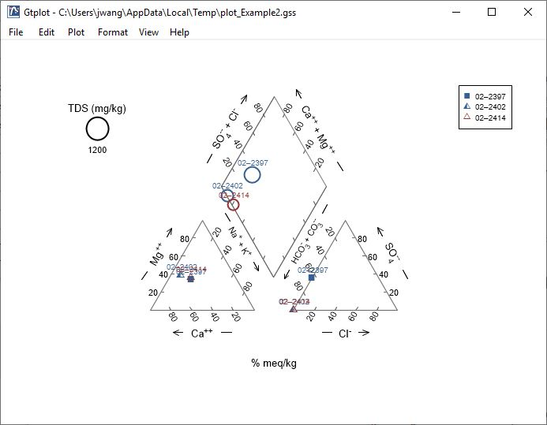
You control details of the Piper Diagram from the Plot pane.
Toggle TDS circles, scale, units, display, etc.

