Slide 1
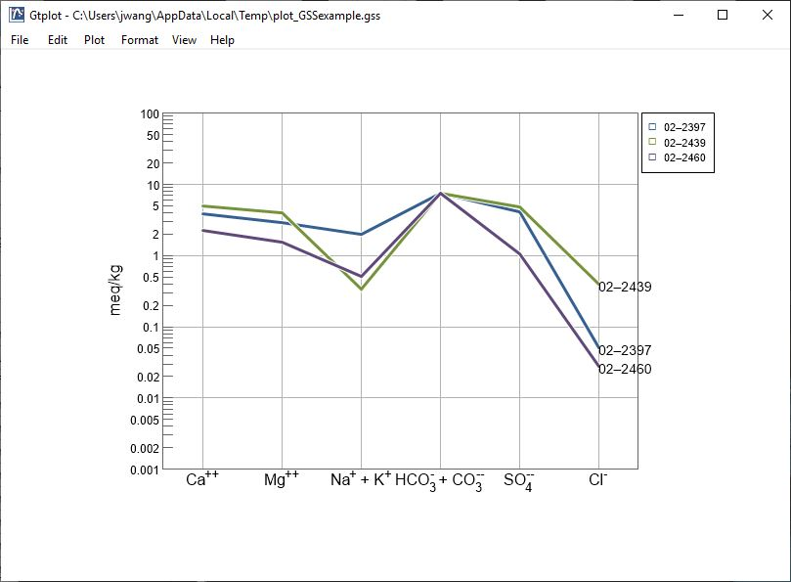
Schoeller Diagrams

Slide 2
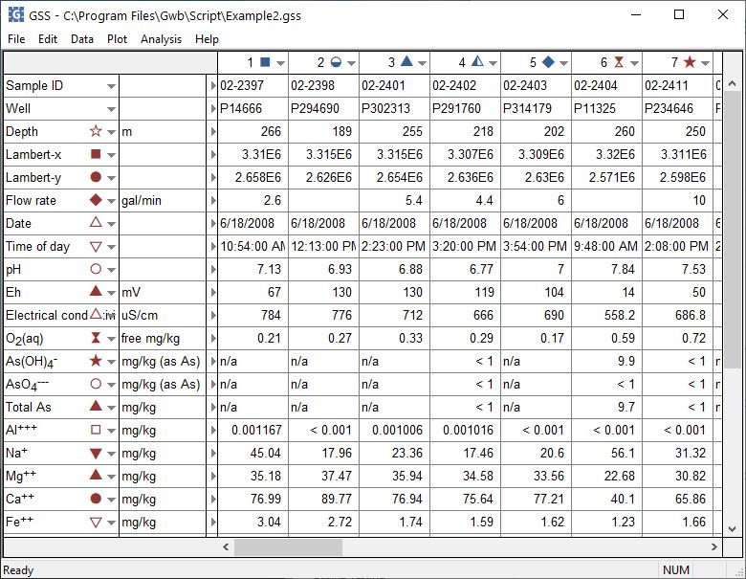
You can launch Gtplot from GSS to create Schoeller Diagrams and other specialty plots.
Plot →
Schoeller Diagram…
You can set the color, shape, or size of markers representing individual samples or analytes.

Slide 3
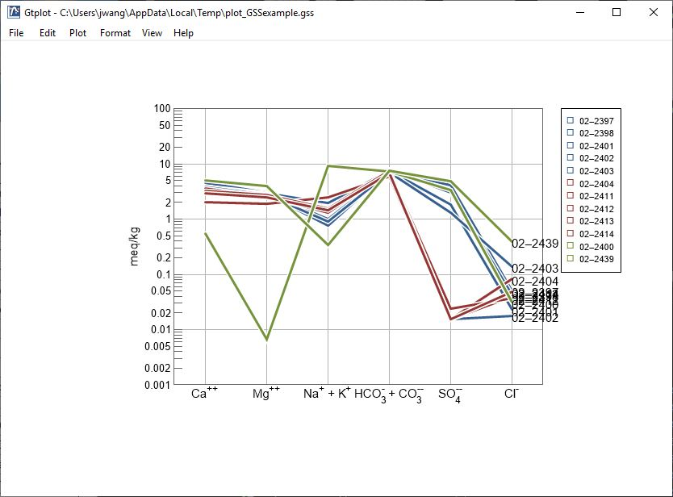
The Schoeller diagram shows concentration of fluid components on a log scale.
Right-click to change line width, style, color, etc.
Double-click on plot to bring up the Schoeller diagram configuration dialog.
Double-click outside the plot to open the Quick Toggle dialog. Toggle gridlines, sample labels, legend, and more.

Slide 4
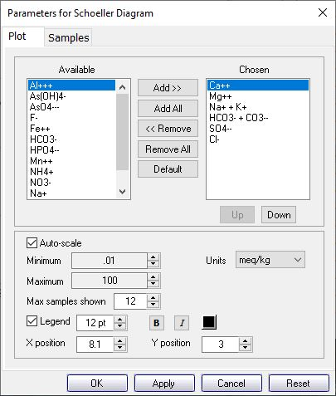
You control details of the Schoeller Diagram from the Plot pane.
You can Add or Remove analytes from the Chosen box.
Choose max and min values.
Choose max samples to display when cycling through Blocks
Left-drag past another analyte to reorder.

Slide 5
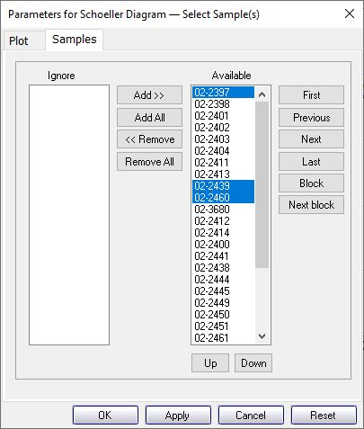
You control which samples are displayed from the Samples pane.
You can cycle through samples one at a time…
Select the samples to plot.
… or through groups of samples.

