Slide 1
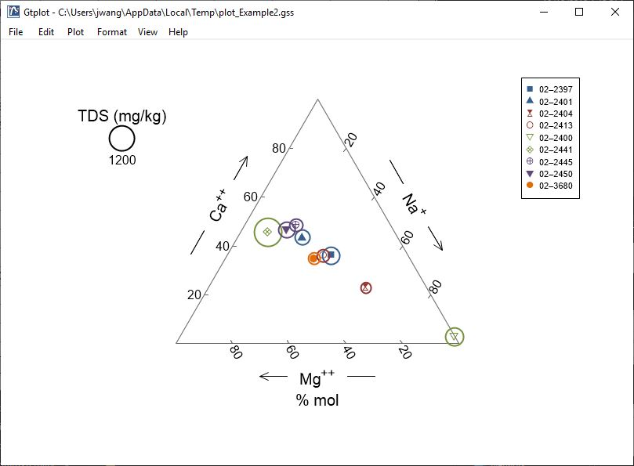
Ternary Diagrams

Slide 2
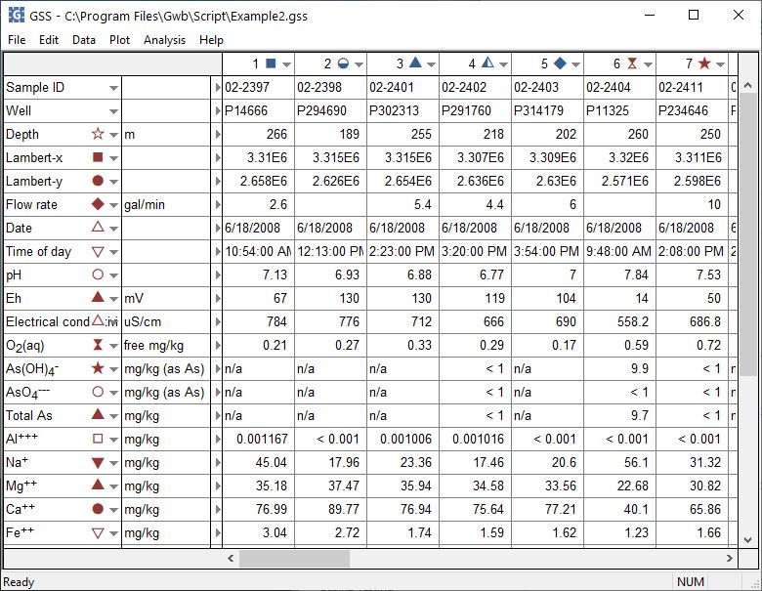
You can launch Gtplot from GSS to create Ternary diagrams, cross-plots, time series graphs, and more.
Plot → Ternary Diagram
You can set the color, shape, or size of markers representing individual samples or analytes.

Slide 3
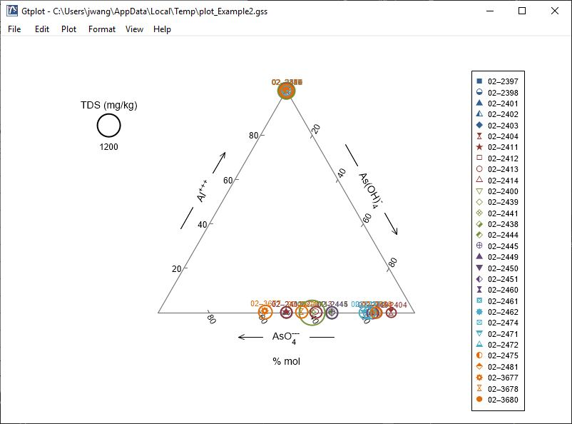
The Ternary diagram shows fluid composition on a tri-linear plot.
Double-click on plot to bring up the Ternary diagram configuration dialog.
Double-click outside the plot to open the Quick Toggle dialog. Toggle gridlines, sample labels, legend, and more.
Right-click on labels or axes to change color, font, size, etc.

Slide 4
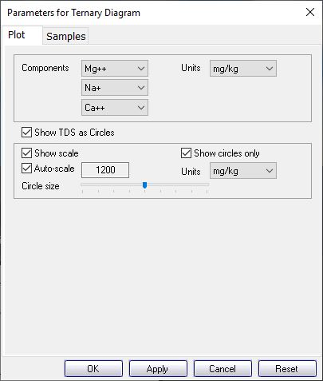
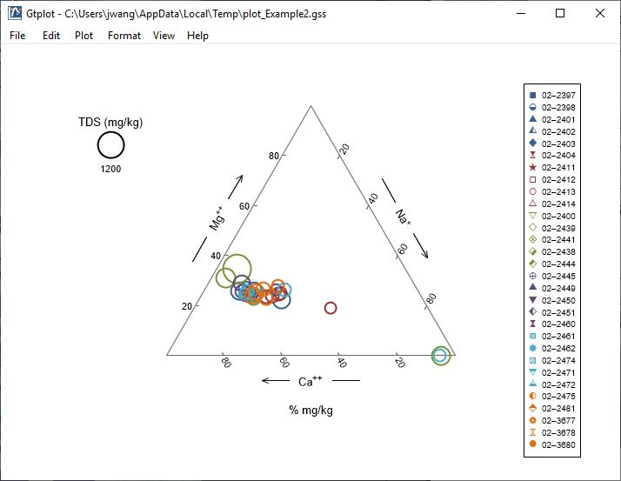
Choose components for the diagram.
You control details of the Ternary diagram from the Plot pane.
Units expressed as fractions.
Toggle TDS circles, scale, units, display, etc.

Slide 5
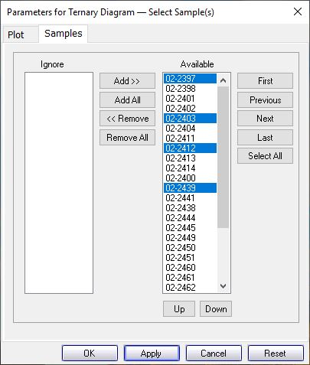
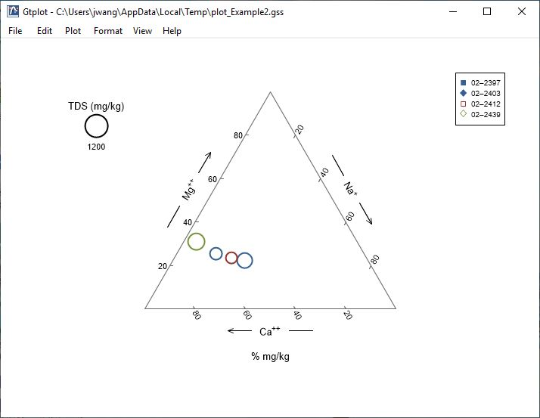
You control which samples are displayed from the Samples pane.
You can cycle through samples one at a time.
Only selected samples in the Available list plot.
Plot all samples together.

