Slide 1
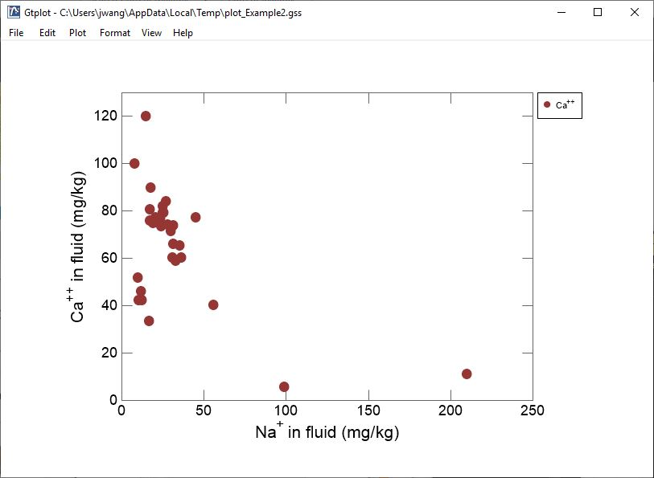
XY Plots

Slide 2
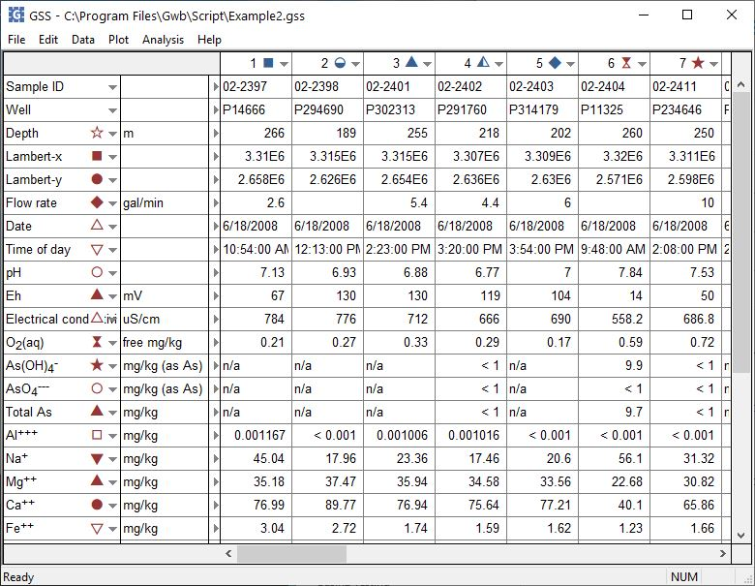
You can launch Gtplot from GSS to create XY plots, time series graphs, Piper and Stiff Diagrams, and more.
Plot → XY Plot
You can set the color, symbol, and size of data markers for each sample...
... or for each analyte.

Slide 3
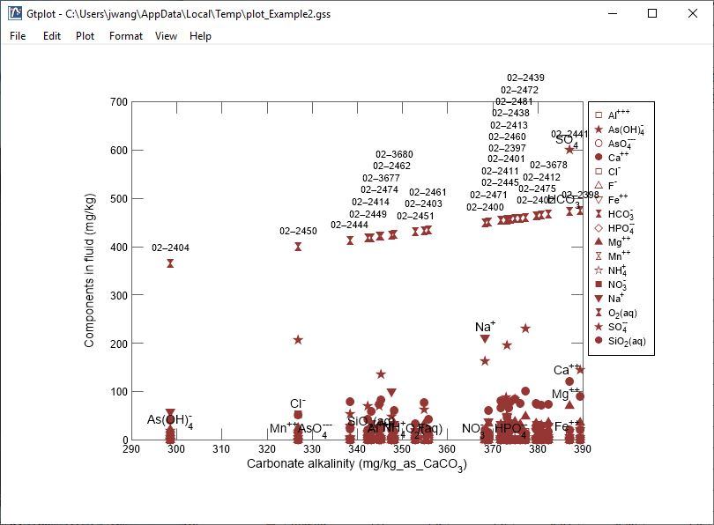
The XY Plot shows one variable on the x axis and one or more variables on the y axis.
Double-click on plot to bring up the XY Plot configuration dialog.
Double-click outside the plot to open the Quick Toggle dialog. Toggle gridlines, sample labels, legend, and more.
Right-click on labels or axes to change color, font, size, etc.

Slide 4
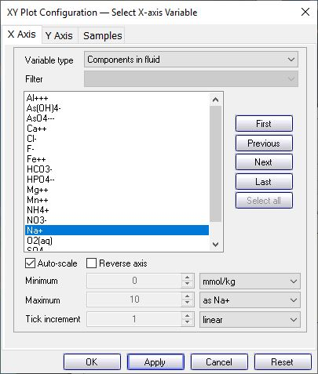
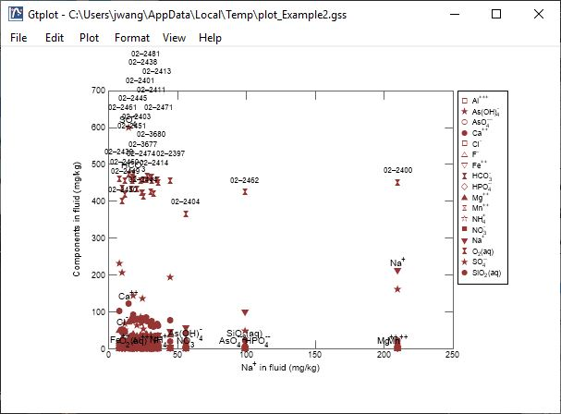
Variable type
You control details of XY Plots from the X Axis and Y Axis panes.
Plot one variable on X Axis
Set units, linear or log scale
Right-click on a sample label, then select “Hide”

Slide 5
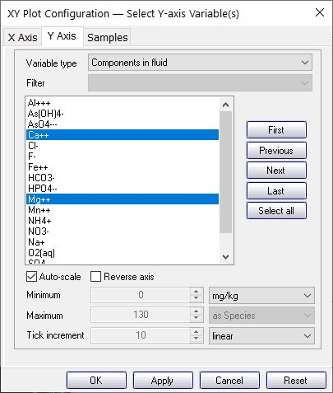
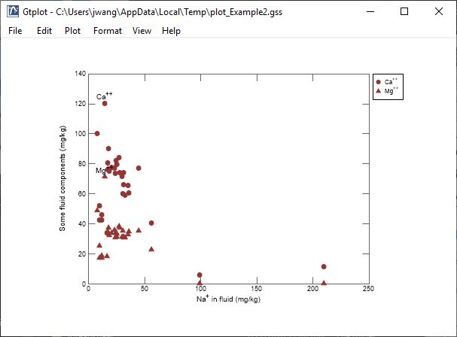
You control details of XY Plots from the X Axis and Y Axis panes.
Plot one or more variables on Y Axis

Slide 6
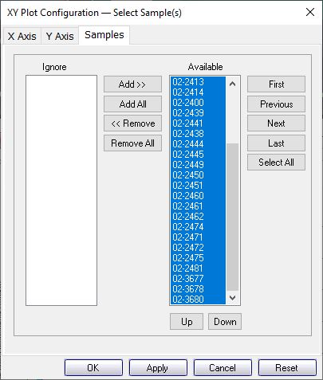
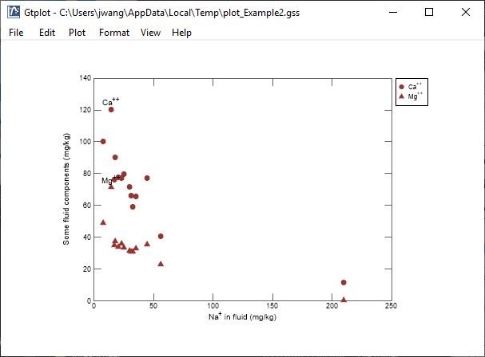
Select the samples to display from the Sample pane.
You can cycle through samples one at a time.
Only selected samples in the Available list plot.
Plot all samples together.
Right-click on a data marker, then change marker Symbol, Color, and Size from “By Analyte” to “By Sample”.

Slide 7
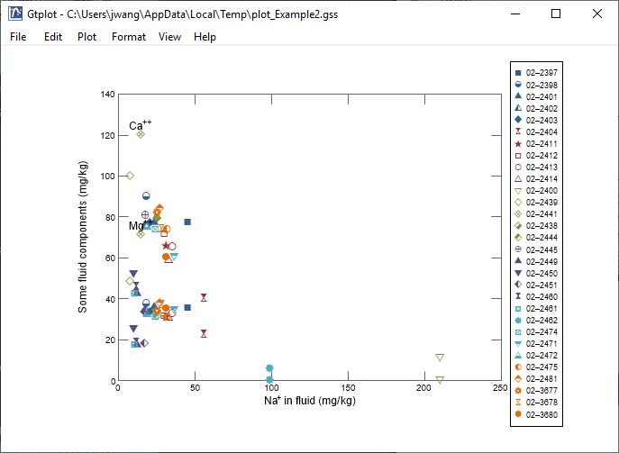
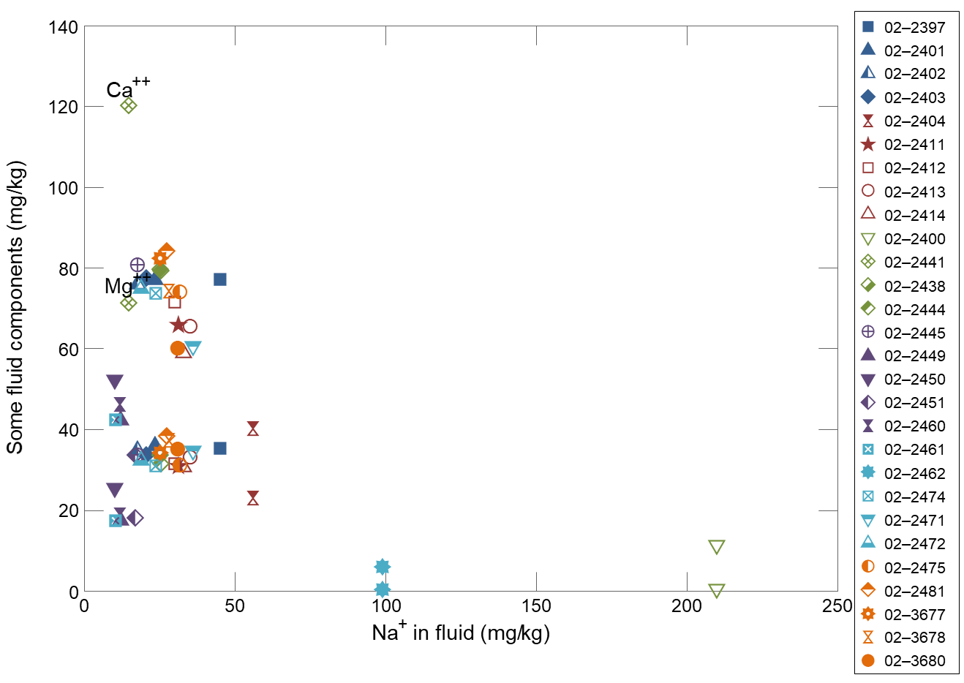
Right-click on a data marker, then select “Hide This Sample”
Sample hidden from plot.

