Slide 1
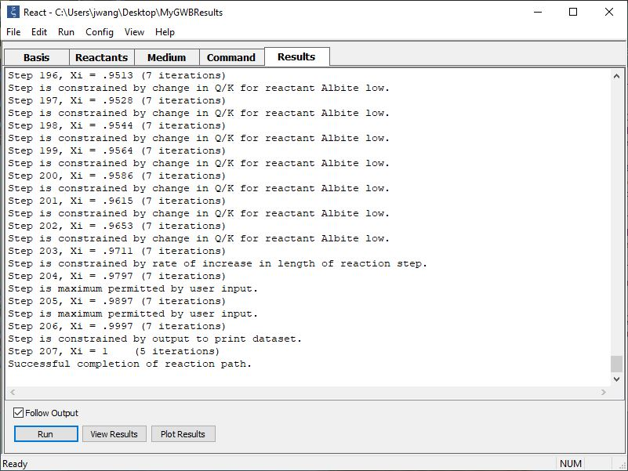
Report limiting factor

Slide 2
In taking a time step, React, Phase2, X1t, and X2t automatically select the time step length ∆t according to a number of criteria:
Stability of mass and heat transport equations
Intensity of kinetic reactions
Not stepping past specified points for writing results to output files
Stability limits imposed by dual porosity model
Initial and maximum step size, and maximum increase, as set by user

Slide 3
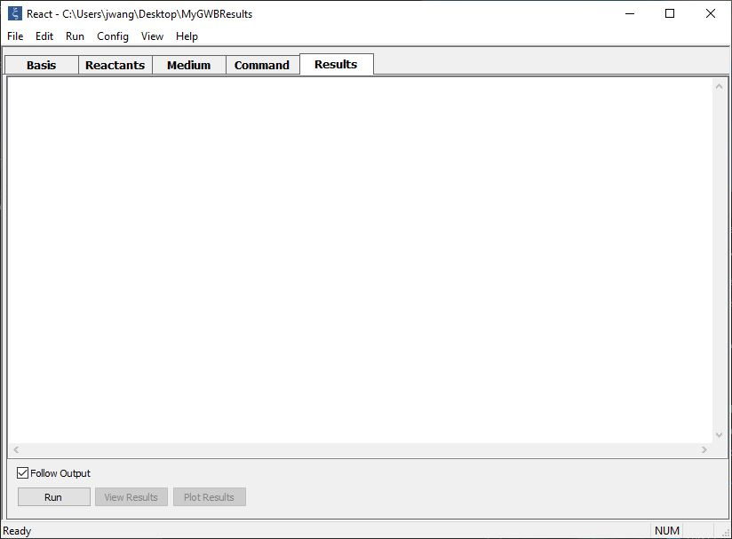
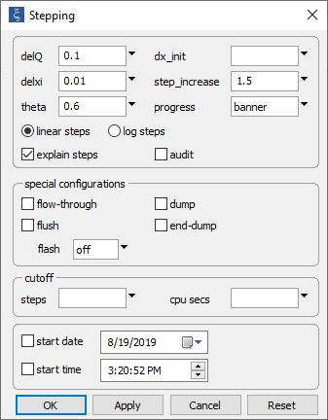
The programs can report at each step the factor limiting the time step length ∆t.
Config → Stepping…
Check “explain steps”

Slide 4
Check “Follow Output”
Click Run to begin solving the model.

Slide 5
Reaction progress ranges from 0 to 1
Step #
∆t limited by intensity of kinetic reaction
∆t limited by maximum proportional increase in ∆t
∆t limited by user-set maximum
∆t limited by dataset output

