Slide 1
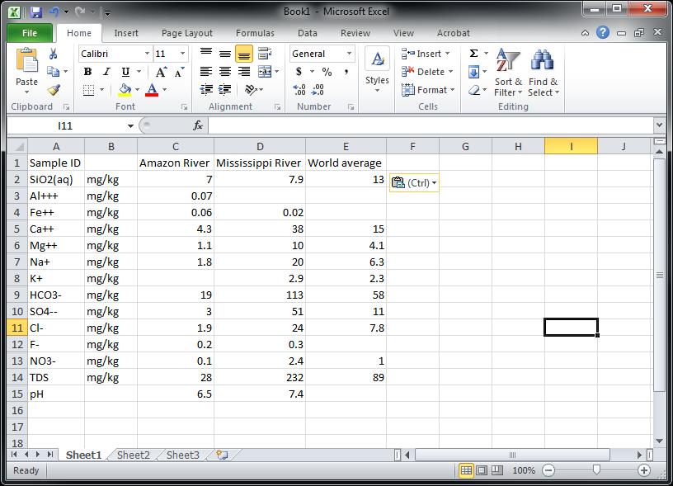
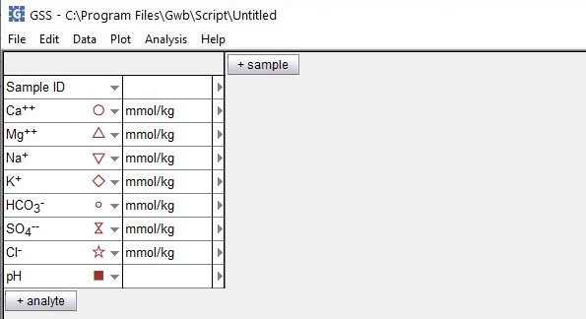
Transfer data from Excel to GSS

Slide 2
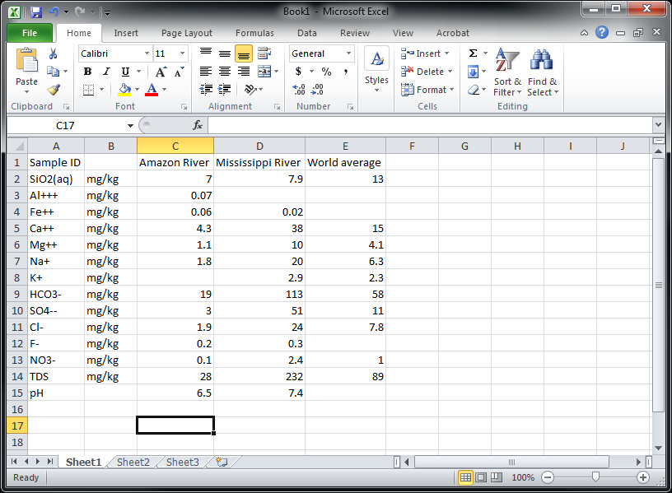
You can move your geochemical data from Excel to GSS

Slide 3
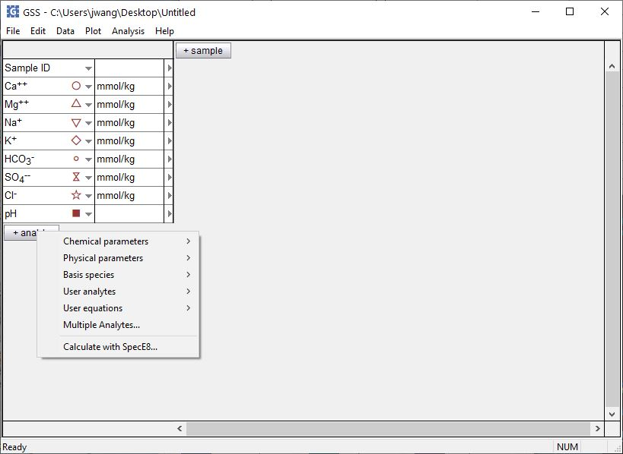
Start by setting up your analytes in a new GSS spreadsheet
You can add Chemical parameters like temperature, pH, Eh, date, etc…
… or Physical parameters like density, x and y position, etc…
…or Basis species representing chemical components like Ca⁺⁺, Mg⁺⁺, Na⁺, etc.
… or choose User analytes to define and add custom analytes.
… or choose User equations to define and add equations.

Slide 4
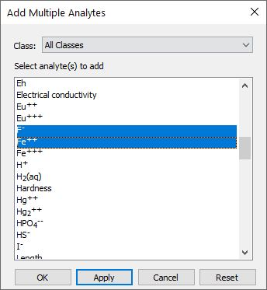
The Add Analytes dialog lets you add several analytes at once
Choose from the Chemical parameters, Physical parameters, Basis species, User analytes, or User equations
+ analyte → Multiple Analytes… to open the dialog
… then select your analytes and click Apply

Slide 5
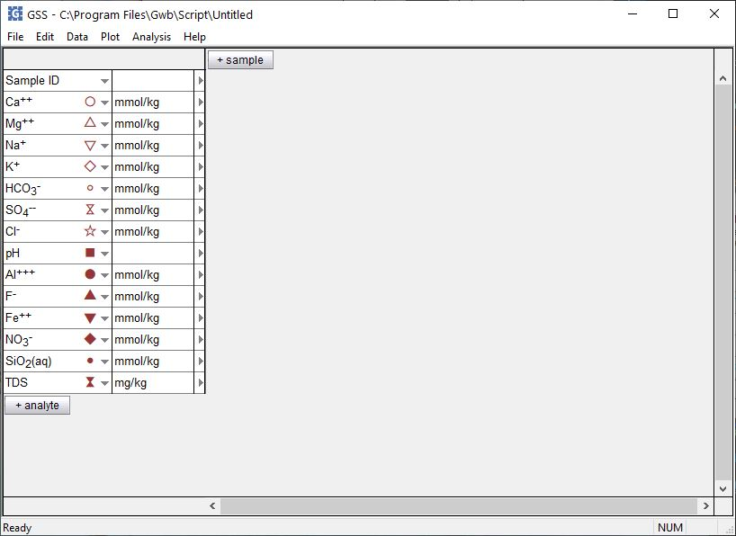
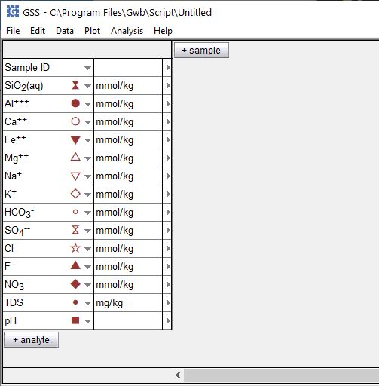
Rearrange the order of analytes to match your Excel spreadsheet
Left-drag to reorder your analytes

Slide 6
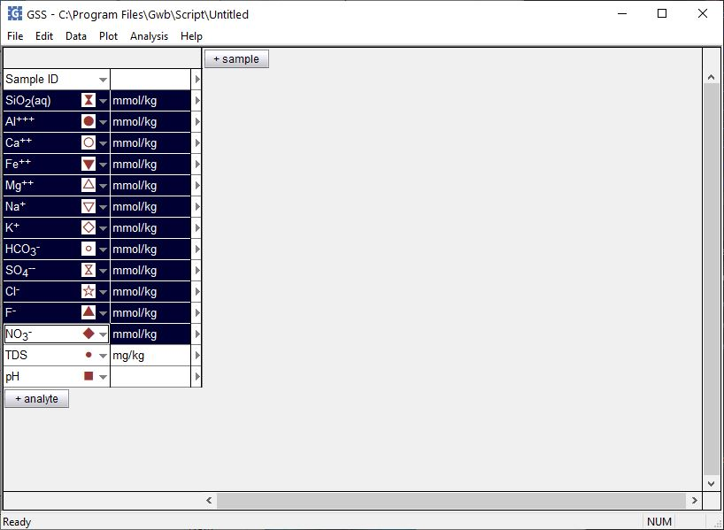
Change the units to match your Excel spreadsheet
Select analytes, right-click on unit field, then choose Units → mg → mg/kg
You can use elemental equivalent units. For mg/kg SO₄⁻⁻ as sulfur, right-click, then choose As → S.

Slide 7
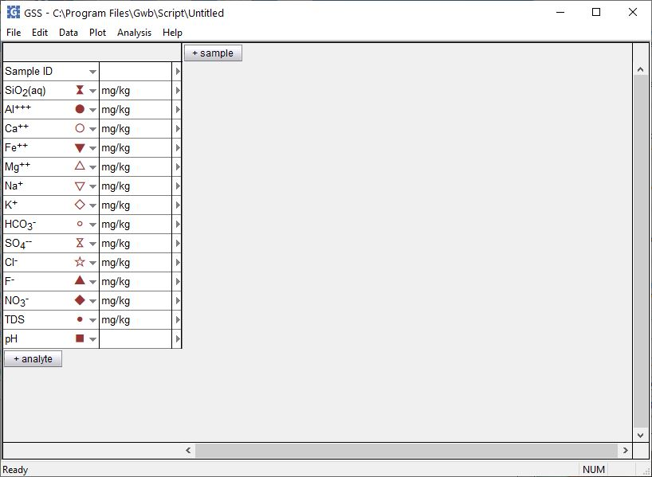
You can transpose the data in your GSS spreadsheet if necessary
Edit →
Transpose Data Sheet

Slide 8
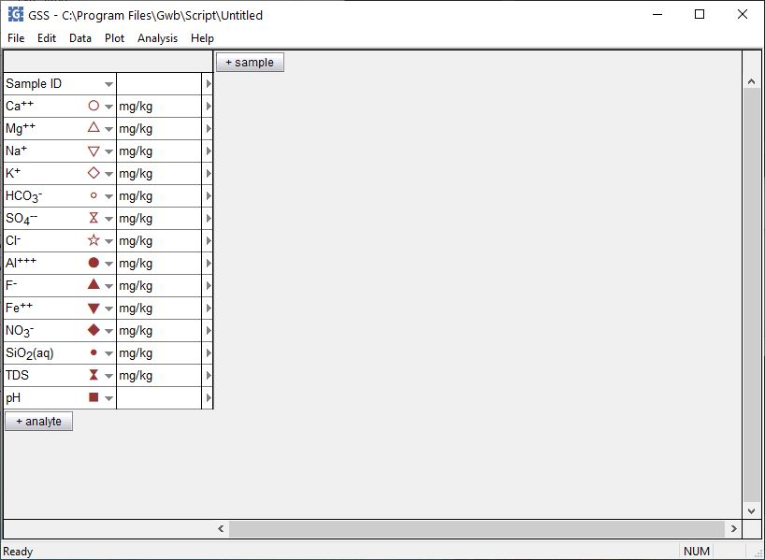
Add one or more columns for samples to GSS
Click + sample

Slide 9
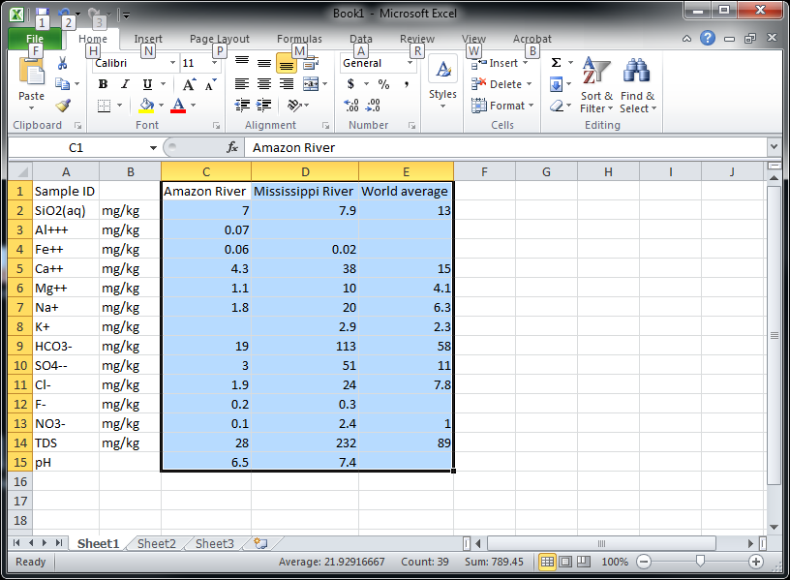
Copy your numerical data and sample names from Excel…
Highlight data then Ctrl + c to copy…

Slide 10
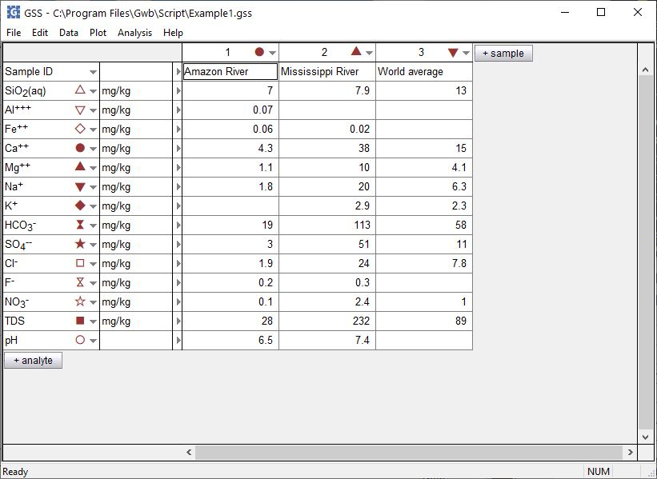
…then paste the values into GSS
Ctrl + v pastes your data.
Now you’re ready to work with your data. Try creating specialty plots, calculating mineral saturation, mixing samples, converting units, and more!

