Slide 2
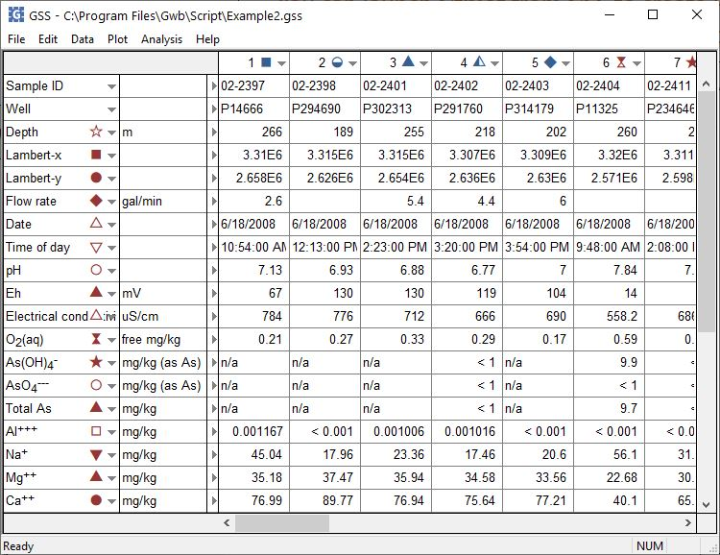
You can launch Gtplot from GSS to create cross-plots, time series plots, Piper diagrams, and more.
Plot → Piper Diagram…
You can set the color, shape, or size of markers representing individual samples or analytes.

Slide 3
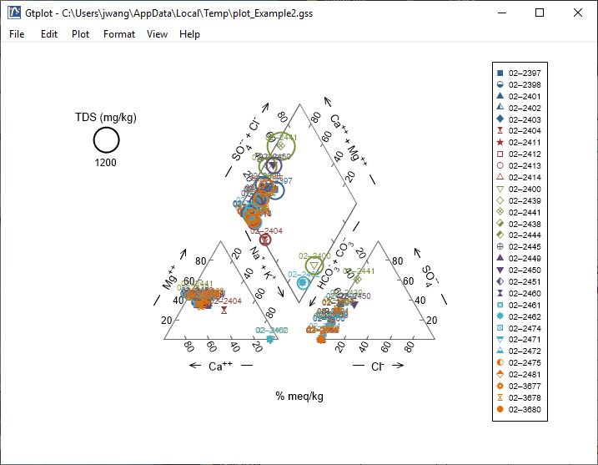
You can change the appearance of the plots produced by Gtplot.
Double-click on plot to bring up the Plot configuration dialog.
Double-click outside the plot to open the Quick dialog. Toggle gridlines, sample labels, legend, and more.
Right-click on labels or axes to change color, font, size, etc.

Slide 4
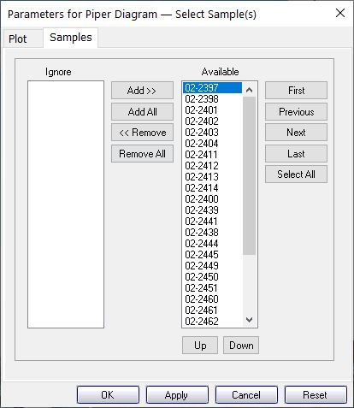
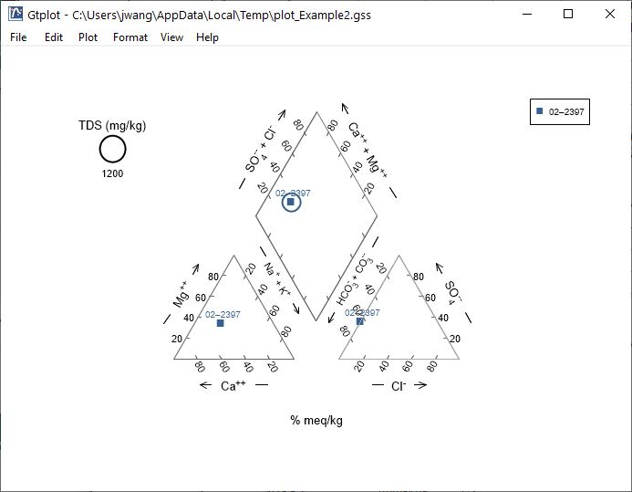
You control which samples are displayed from the Samples pane.
You can cycle through samples one at a time.
Only selected samples in the Available list plot.
Plot all samples together.

Slide 5
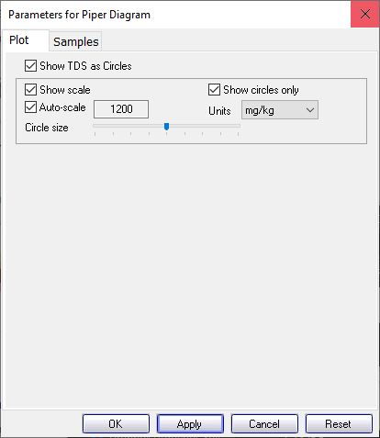
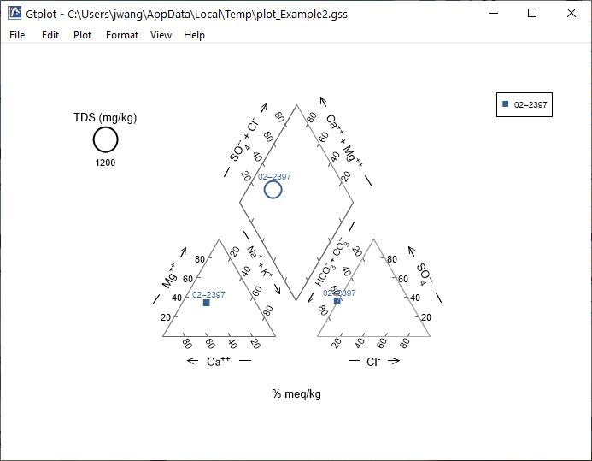
You control details of the Piper Diagram from the Plot pane.
Select show circles only
Toggle TDS circles, scale, units, display, etc.

Slide 6
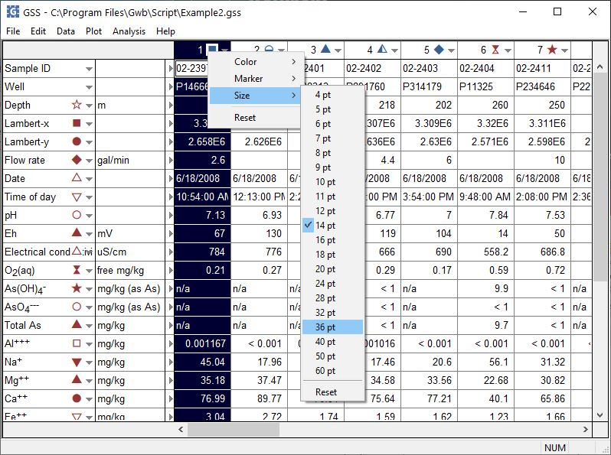
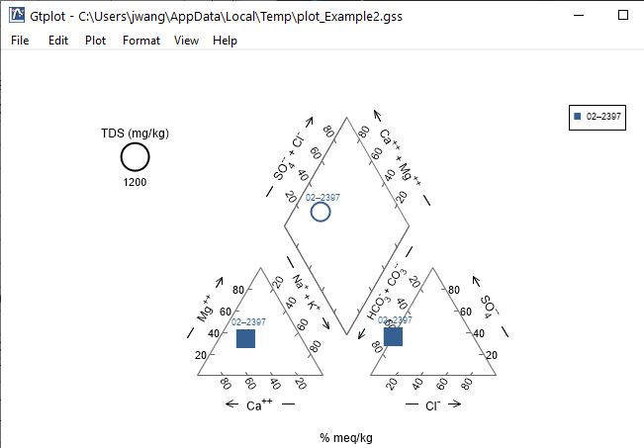
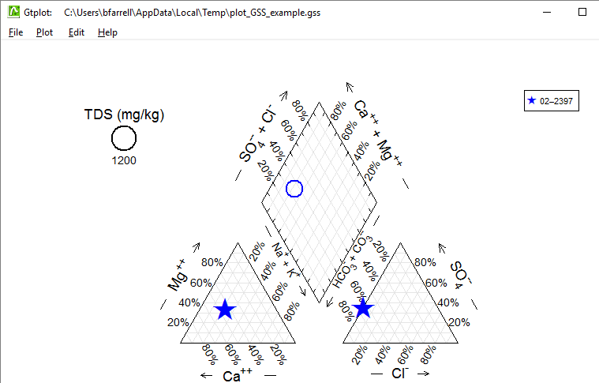
To change data markers, return to GSS to make changes, then Plot → Update Plot(s) to update plot automatically.
Change color, marker, and size for sample 02-2397.

Slide 7
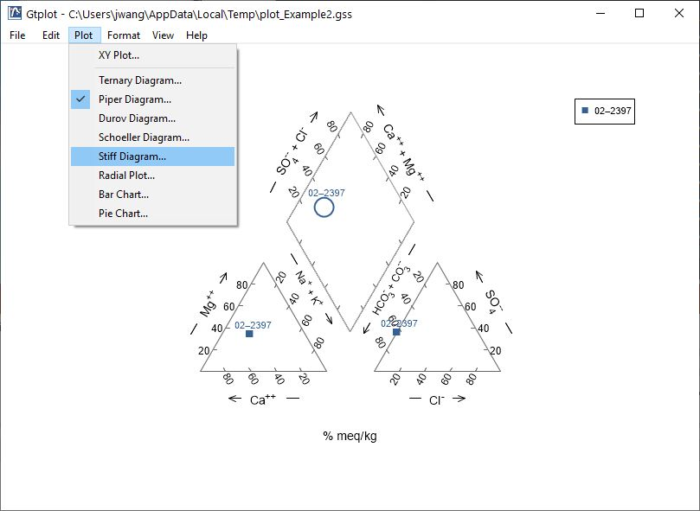
You can change your plot to any of those available from the list.
Plot → Stiff Diagram…

Slide 8
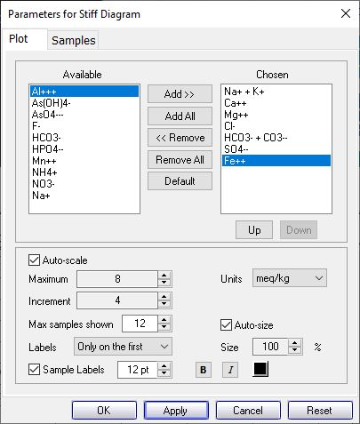
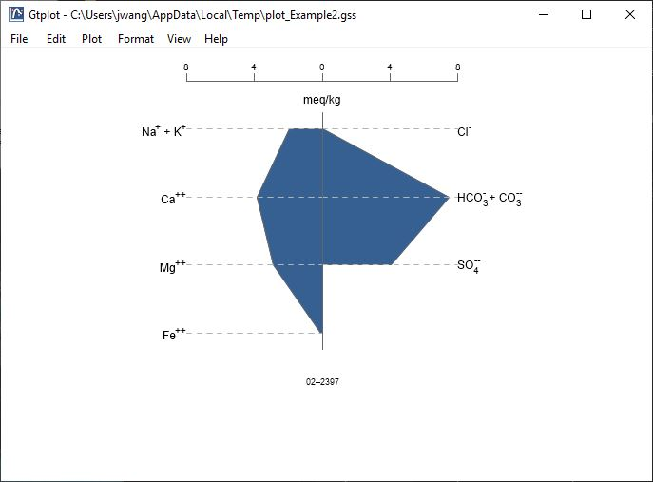
You control details of the Stiff Diagram from the Plot pane.
You can add cations, like Fe⁺⁺, or anions to the default plot. Use Up/ Down to reorder.
Choose max samples to display when cycling through Blocks
When plotting multiple samples, label axes on first plot, all plots, or no plots.

Slide 9
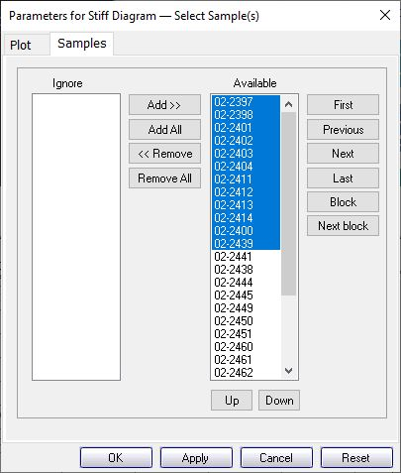
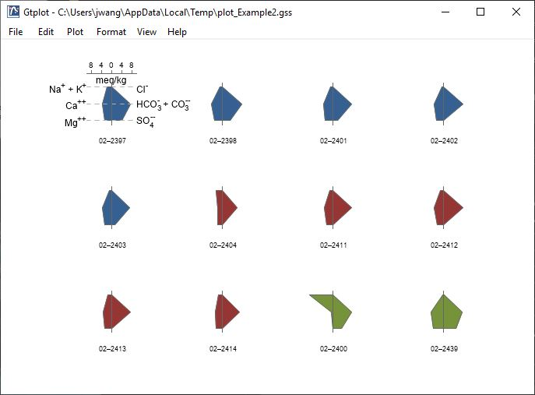
You control which samples are displayed from the Samples pane.
You can also cycle through samples one at a time…
Use Block, Next block to cycle through groups of samples.
Select the samples to plot.

