Slide 1
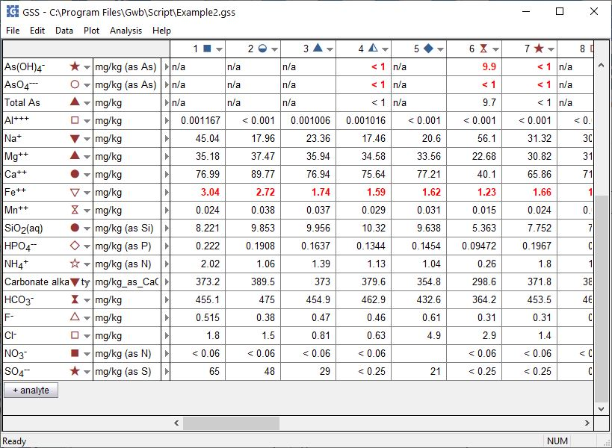
Flag non-compliances

Slide 2
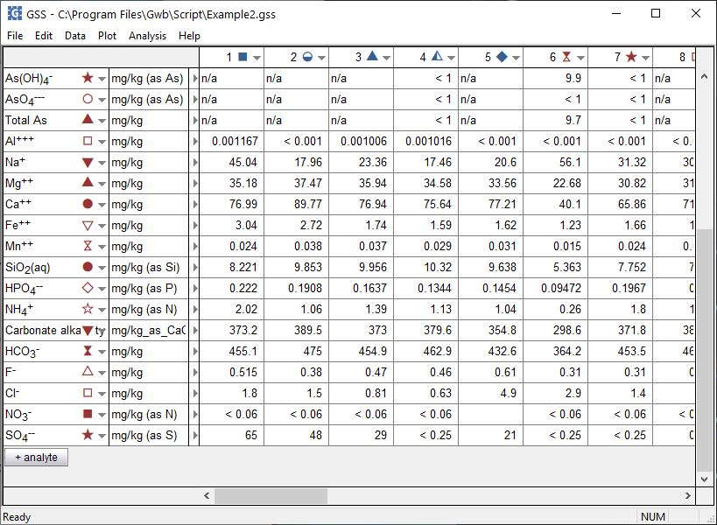
GSS can flag analyses violating regulatory limits or remedial objectives.
Analysis →
Check Regulatory Limits

Slide 3
As(III), As(V), and Fe(II) concentrations in these samples exceed limit defined in Water Quality Regulatory Standard file.

Slide 4
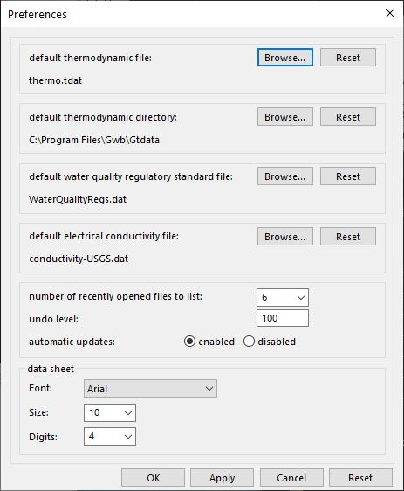
File → Preferences
You can set the water quality regulations dataset to use.

Slide 5
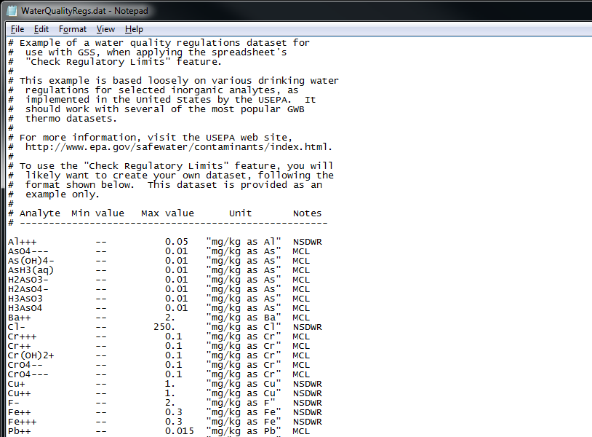
You can create a dataset of standards in a text editor like Notepad.

