Slide 2
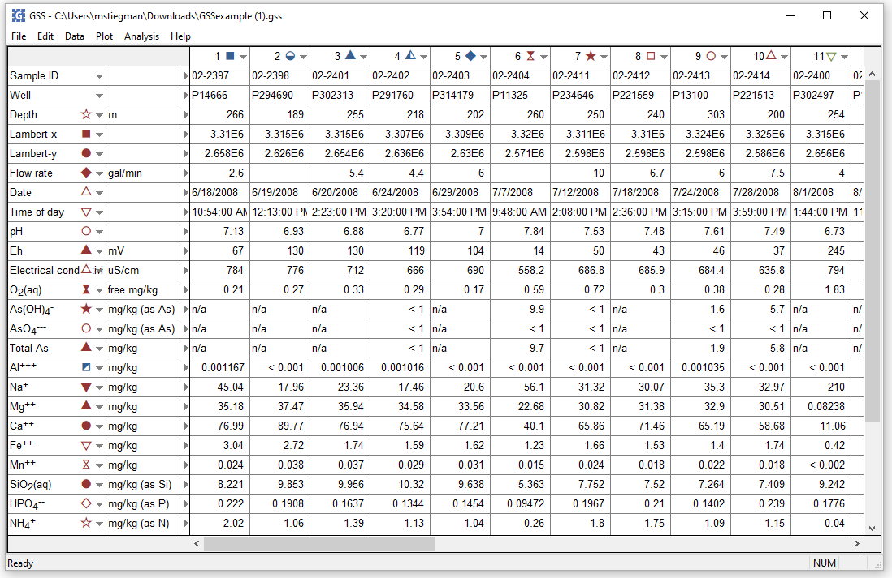
Starting GSS spreadsheet
Plot → XY Plot → Series Plot…
Creating the plot opens a new window in Gtplot.

Slide 3
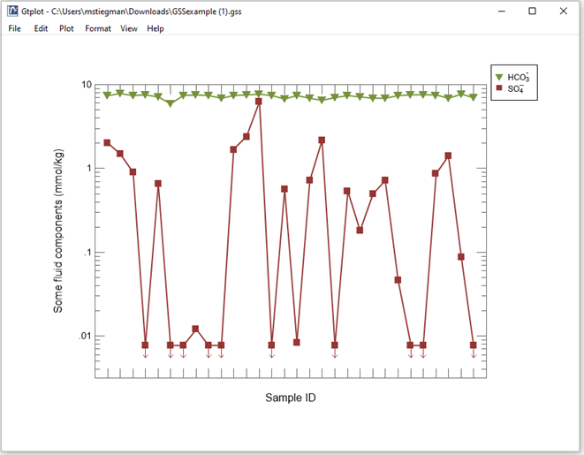
Series Plot
Samples are arranged on x-axis in the order they appear on the GSS spreadsheet.

Slide 4
Plot → XY Plot → Time Series Plot → Time and date…
A Time Series plot requires that “Date” and “Time” or “Time Elapsed” appears as an analyte.

Slide 5
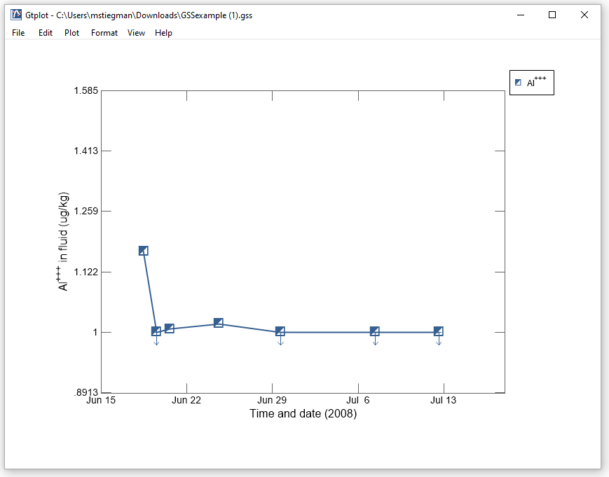
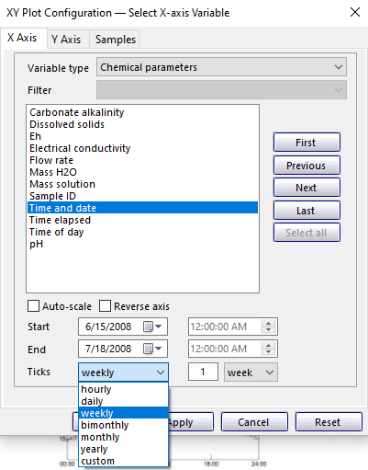
Time and Date Plot
Interval of time displayed can be changed in XY Plot Configuration window

Slide 6
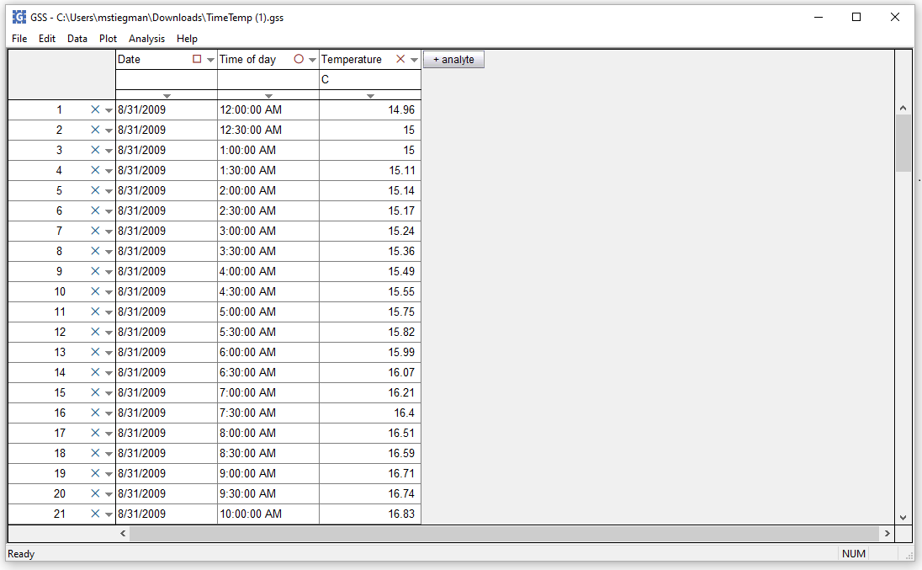
Plot → XY Plot → Time Series Plot → Time of day…
Time of day plots can be created instead of Time and date plots

Slide 7
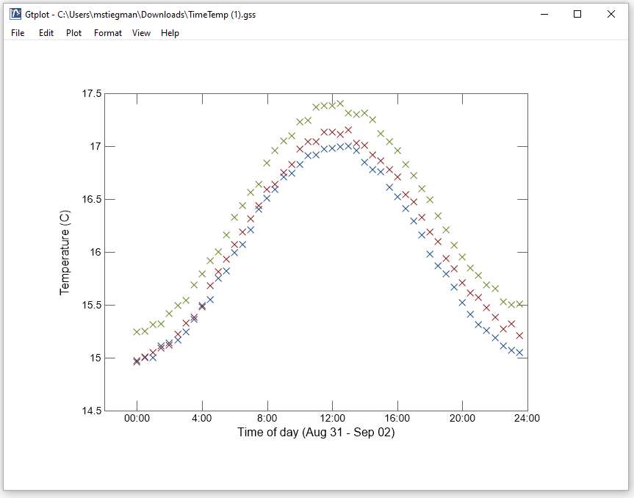
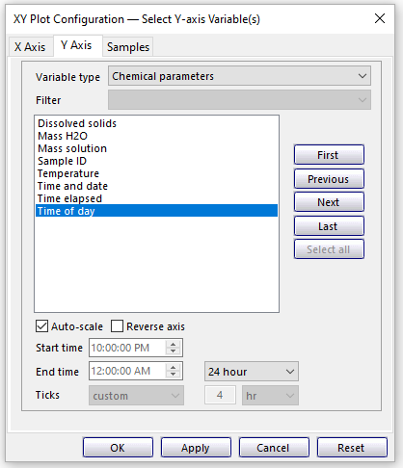
Time of Day Plot
Interval of time displayed can be changed in XY Plot Configuration window

