Slide 1
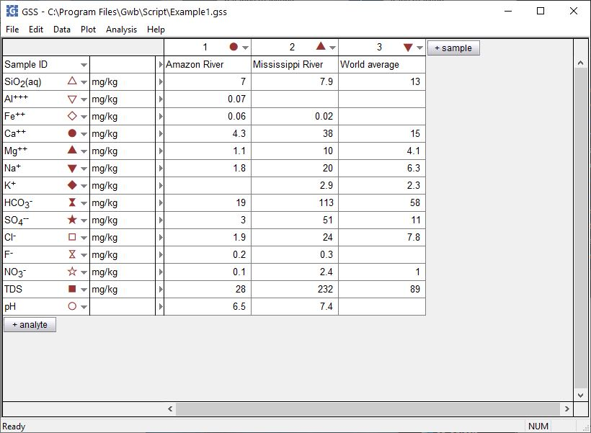
TDS, charge balance, and other properties

Slide 2
You can calculate the TDS, charge imbalance, and many more fluid properties of the samples in a GSS spreadsheet.
+ analyte → Calculate with SpecE8…

Slide 3
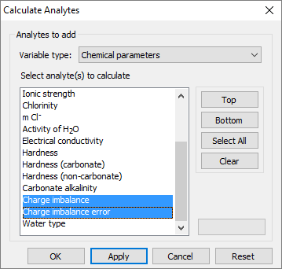
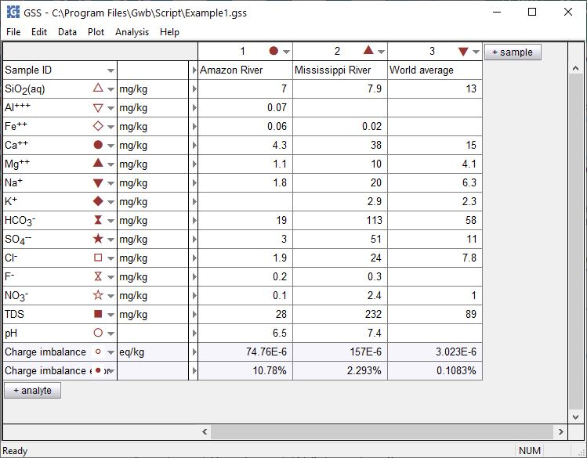
For variable type, choose Chemical parameters
Select analytes then click Apply
Calculated analytes appear below your original data

