Slide 1
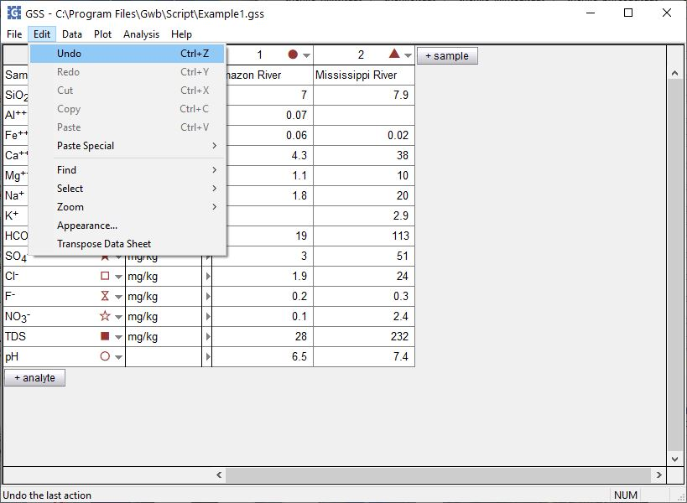
Undo - Redo

Slide 2
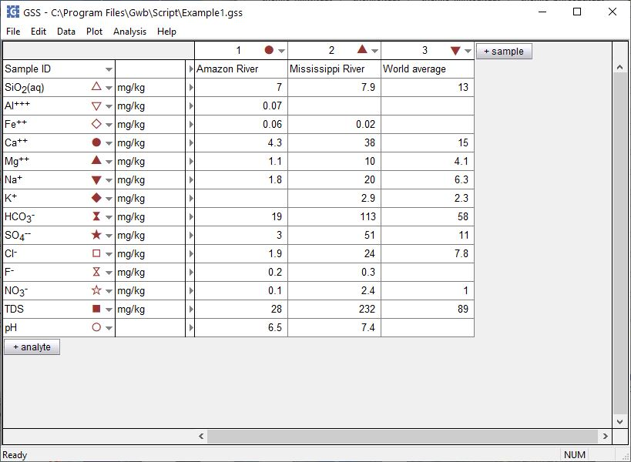
You can execute a number of tasks in GSS:
-Add or delete samples or analytes
-Convert units
-Compare replicates, check standards
-Check against regulatory limits
-Speciation, mineral saturation, gas fugacities
-Quick fluid mixing
You can undo and redo these changes.

Slide 3
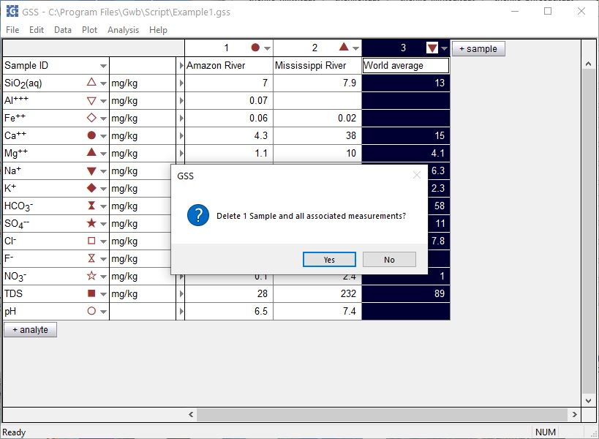
Accidentally delete “World average” sample

Slide 4
Edit → Undo
You can undo your actions in GSS

Slide 5
“World average” sample is restored
You can redo actions if you change your mind

