Slide 1
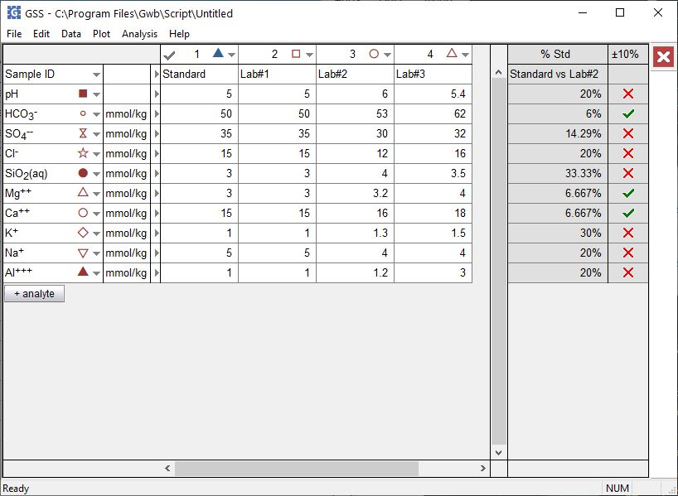
Compare replicates
And standards

Slide 2
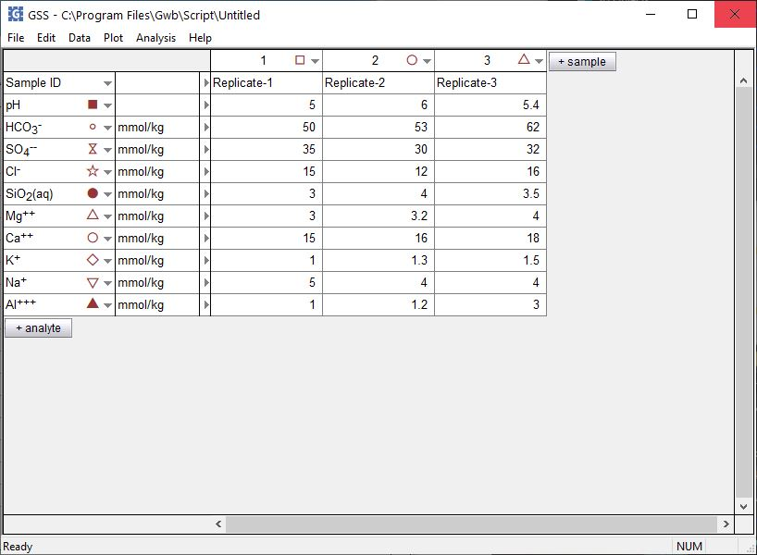
GSS can compare replicate analyses to verify the results agree to within an error tolerance.
Analysis →
Compare Replicates…
Replicate analyses or splits of a single sample

Slide 3
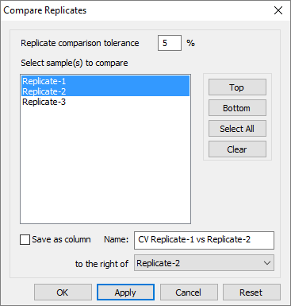
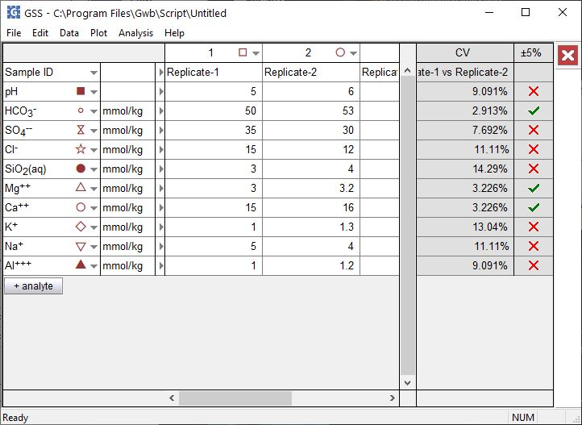
Set an error tolerance
Select samples to compare then click Apply
Check marks indicate an acceptable coefficient of variance between replicates.
X’s appear where the error tolerance is exceeded.

Slide 4
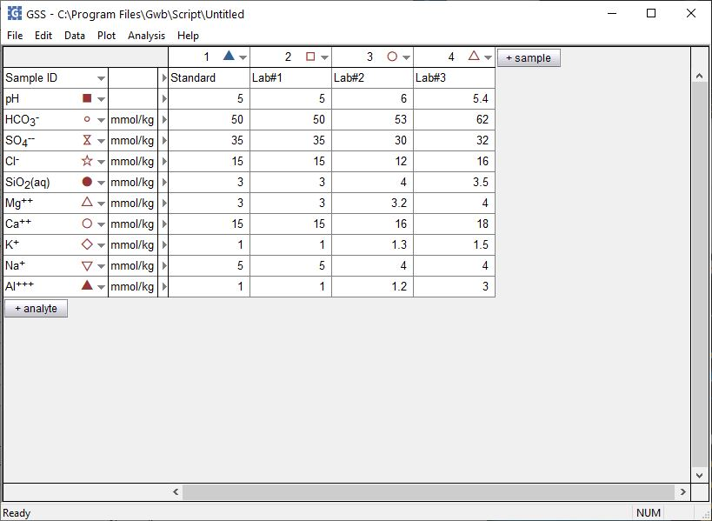
GSS can check analyses of standards, samples of well-known composition, for accuracy.
Analysis →
Compare To Standard…
Enter the standard’s known composition
Enter one or more analyses of the standard

Slide 5
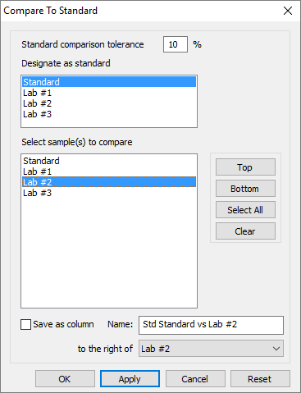
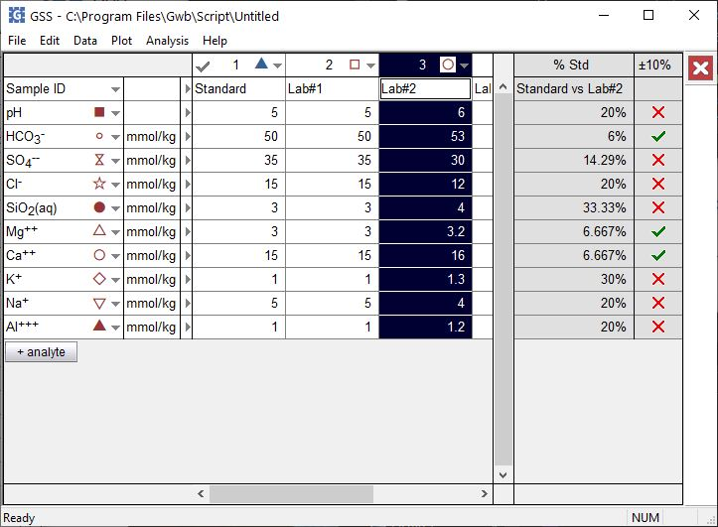
Set an error tolerance
Select the standard sample
Choose analyses for comparison, then click Apply
✓ or X appears depending on whether or not the deviation is within the tolerance indicated.

