Slide 1
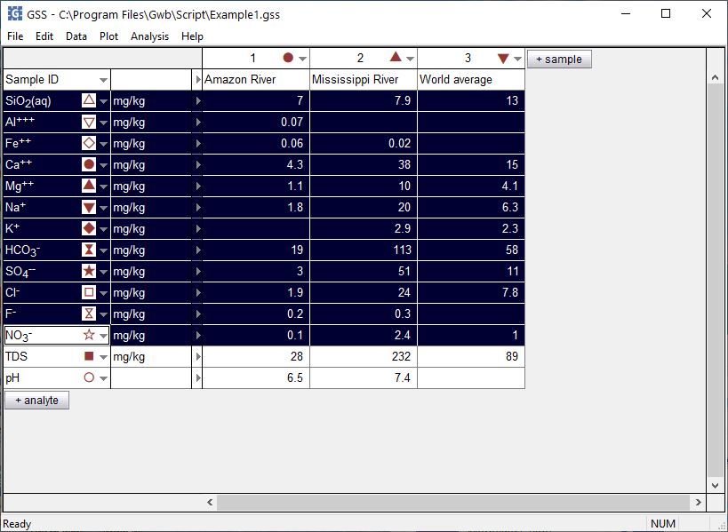
Convert units

Slide 2
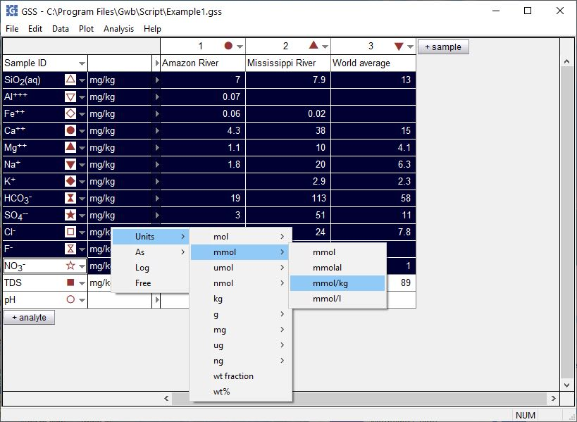
Select analytes using Ctrl+click or Shift+click
Right-click on unit field, then choose Units → mmol → mmol/kg

Slide 3
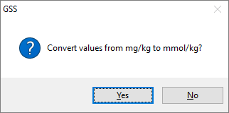
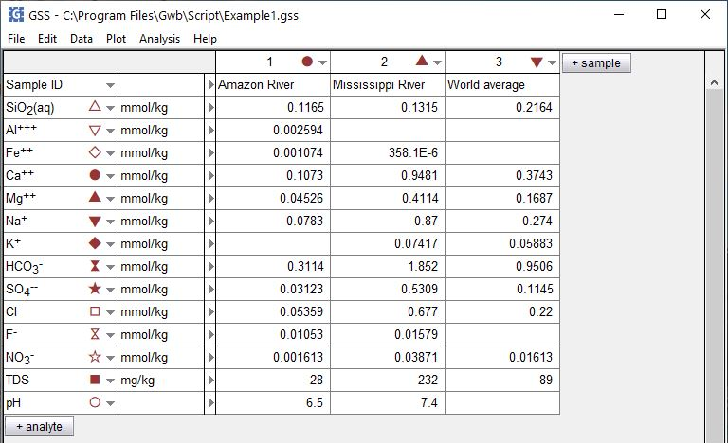
No to change units but preserve values
Yes to convert values

Slide 4
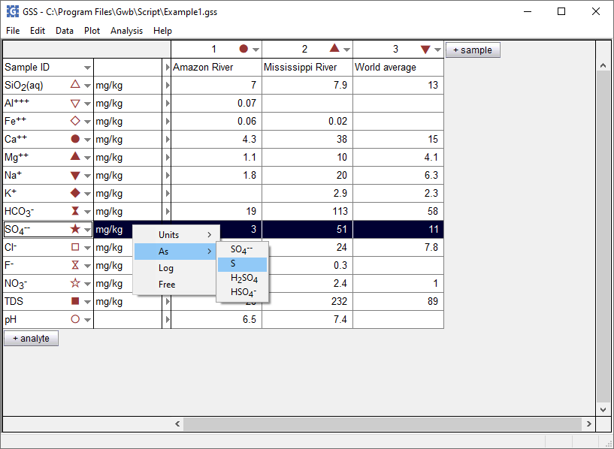
You can also convert to and from elemental equivalents
Right-click on unit field…
…choose As → S for elemental equivalent

Slide 5
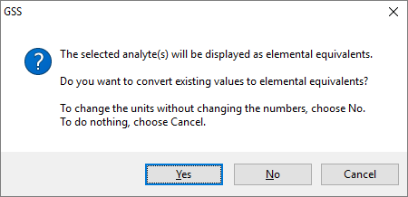
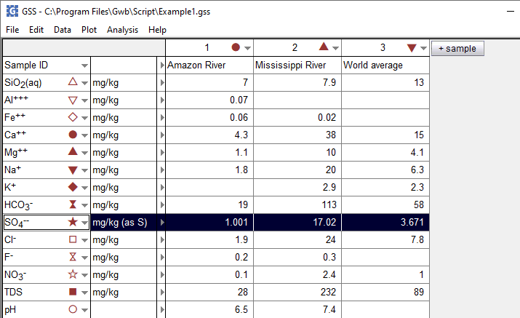
No to change units but preserve values
Yes converts to mg/kg as sulfur
SO₄²⁻ concentration expressed as equivalent concentration of sulfur

Slide 6
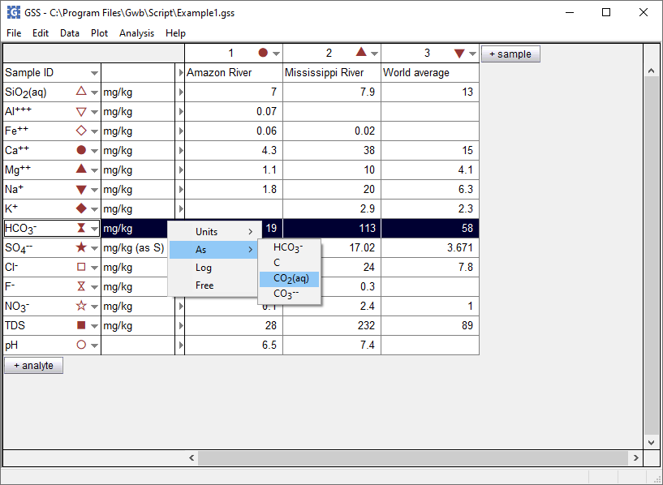
You can also convert to and from protonated and deprotonated species equivalents
Right-click on unit field…
…choose As → and select a protonated or deprotonated form of the HCO₃⁻ component

Slide 7
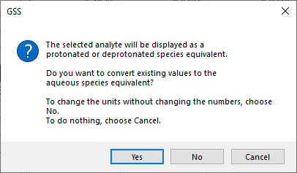
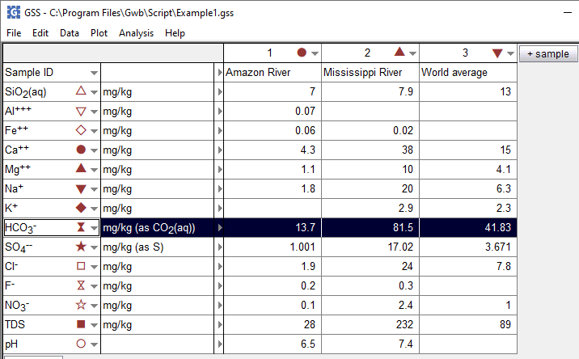
Yes converts to mg/kg as CO₂
No to change units but preserve values
HCO₃⁻ concentration expressed as equivalent concentration of CO₂

