Slide 1
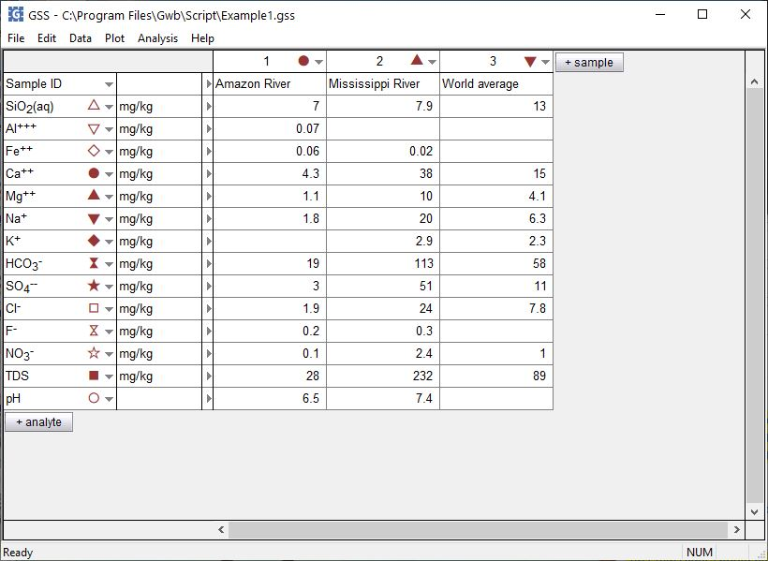
Mineral saturation and gas fugacity

Slide 2
You can calculate the saturation state of minerals or the fugacity of gases for samples in a GSS spreadsheet.
+ analyte → Calculate…

Slide 3
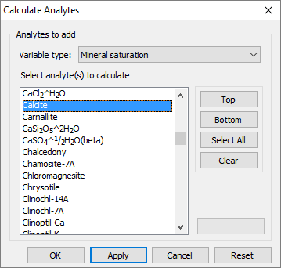
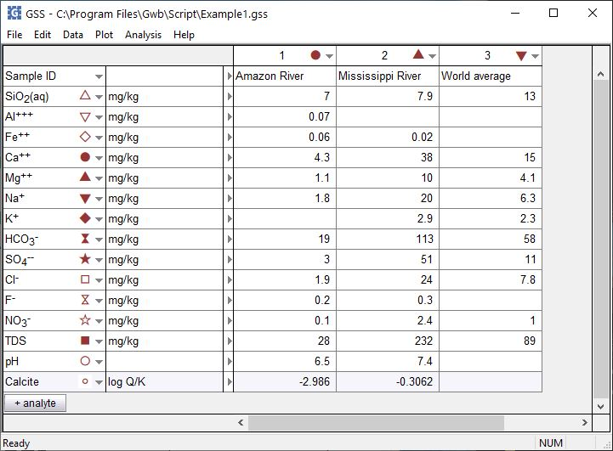
For variable type, choose Mineral saturation
Select a mineral then click Apply
Right-click to convert between log Q/K and Q/K

Slide 4
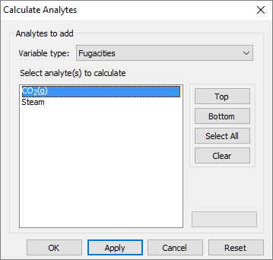
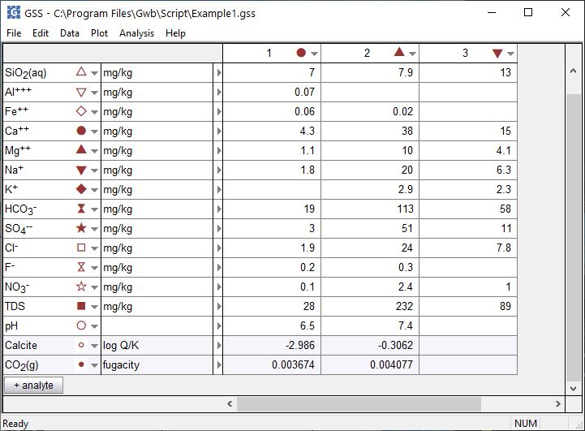
For variable type, choose Fugacities
Select a gas then click Apply
No pH, so can’t calculate log Q/K or CO₂ fugacity

