Slide 1
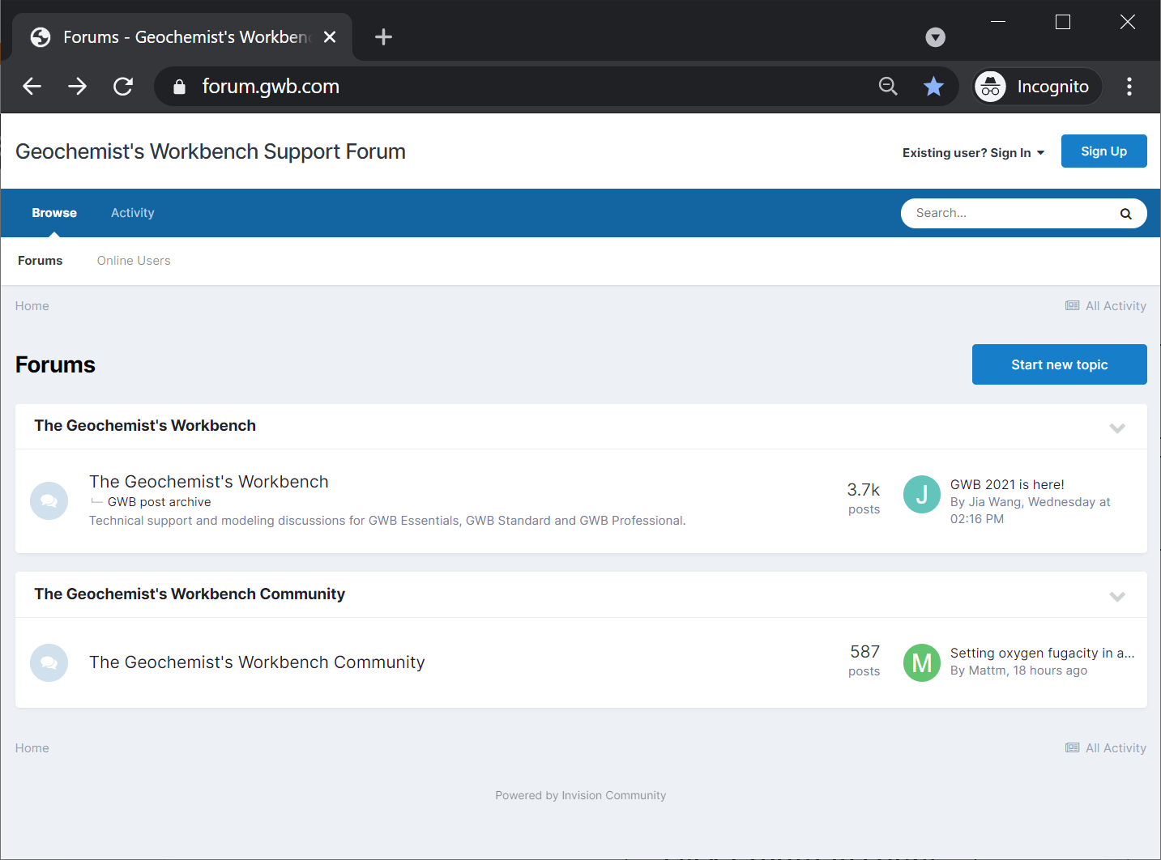

Slide 2
Go to forum.gwb.com
GWB Pro, Standard, and Essentials license holders can post on the main GWB forum and the GWB Community forum.
GWB Community users can read conversations on the main forum, but can only post on the Community forum.

Slide 3
First, create an account.
Click to create an account

Slide 4
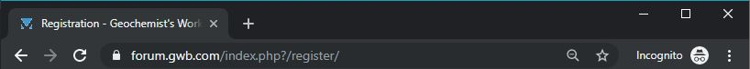
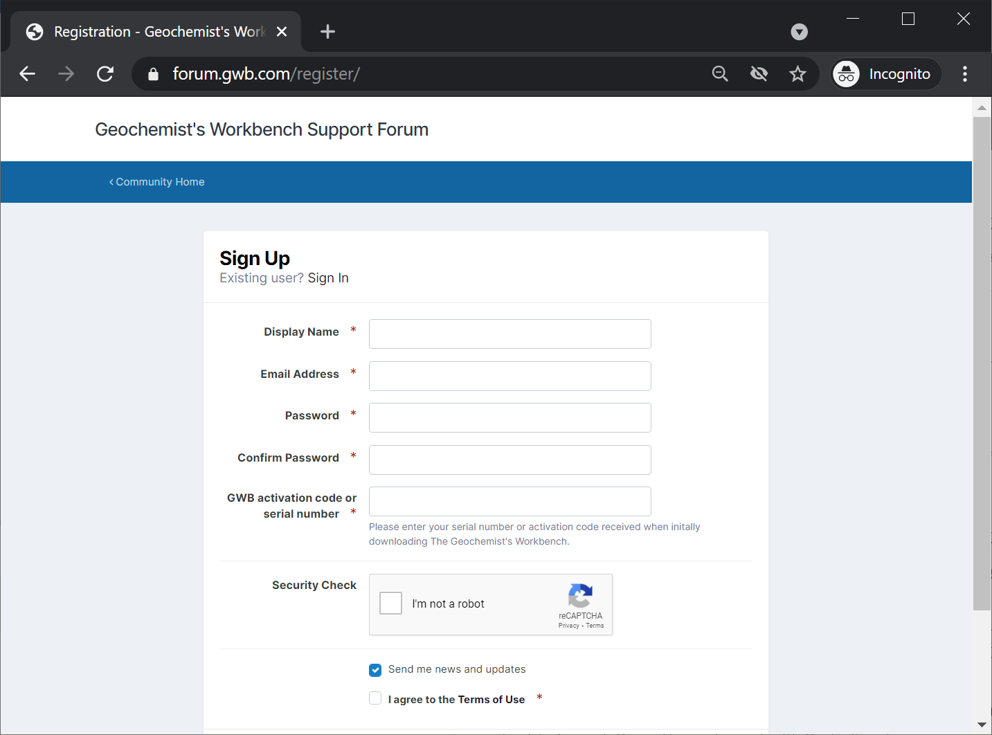
Enter your account details.
Create a unique username
Supply your email address and password
Enter the activation code for your license.
Verify that you’re not a robot.
Agree to the terms and click Create Account

Slide 5
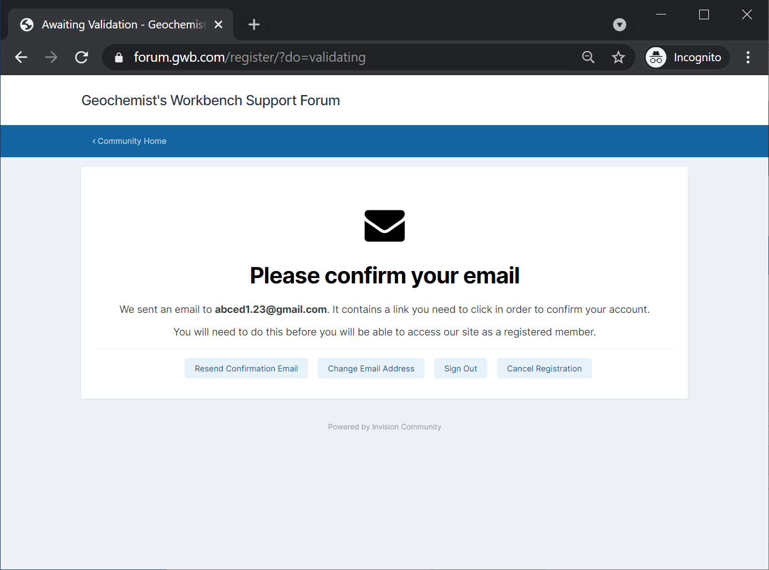
Validate your account.
Check your email inbox (and spam folder) for a validation request from admin@gwb.com. The email will contain a link you can click to activate your account.

Slide 6
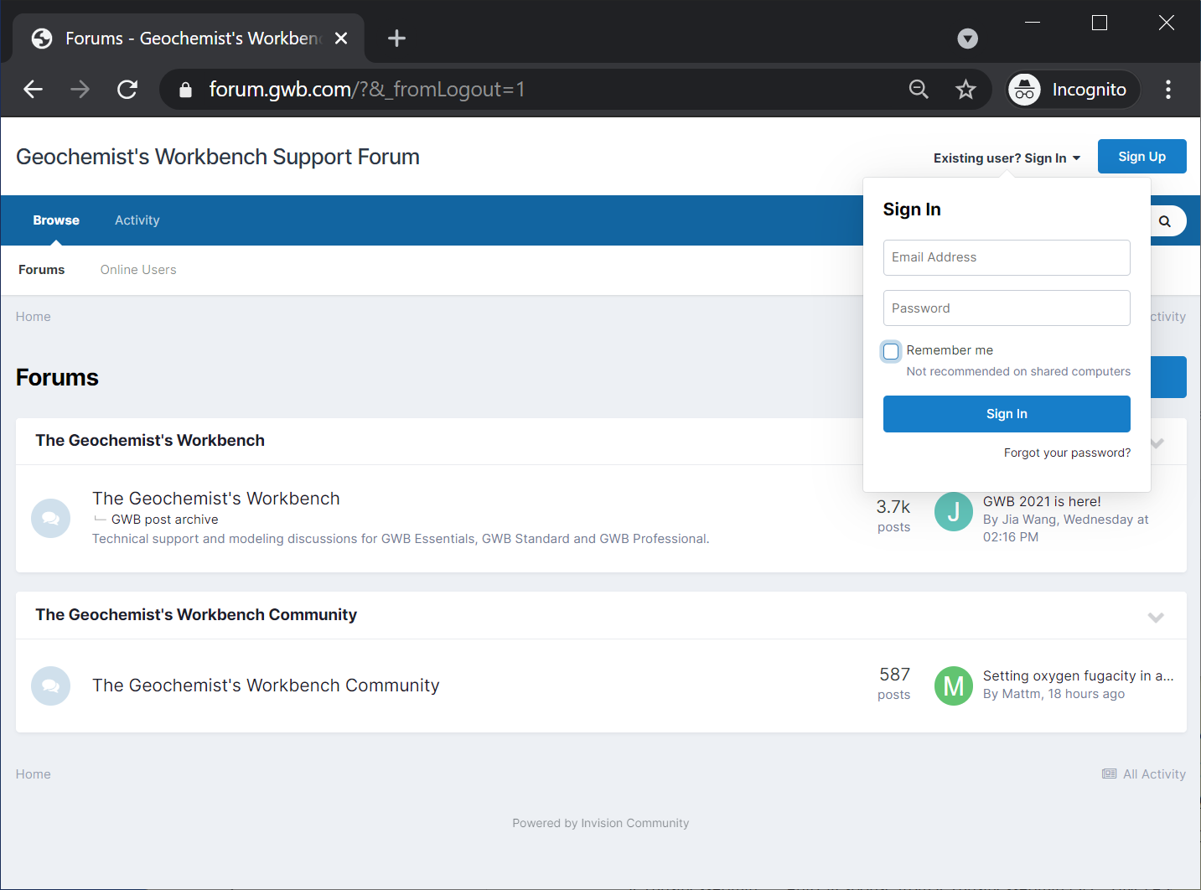
Sign in to your account.
Sign in with your email and password.

Slide 7
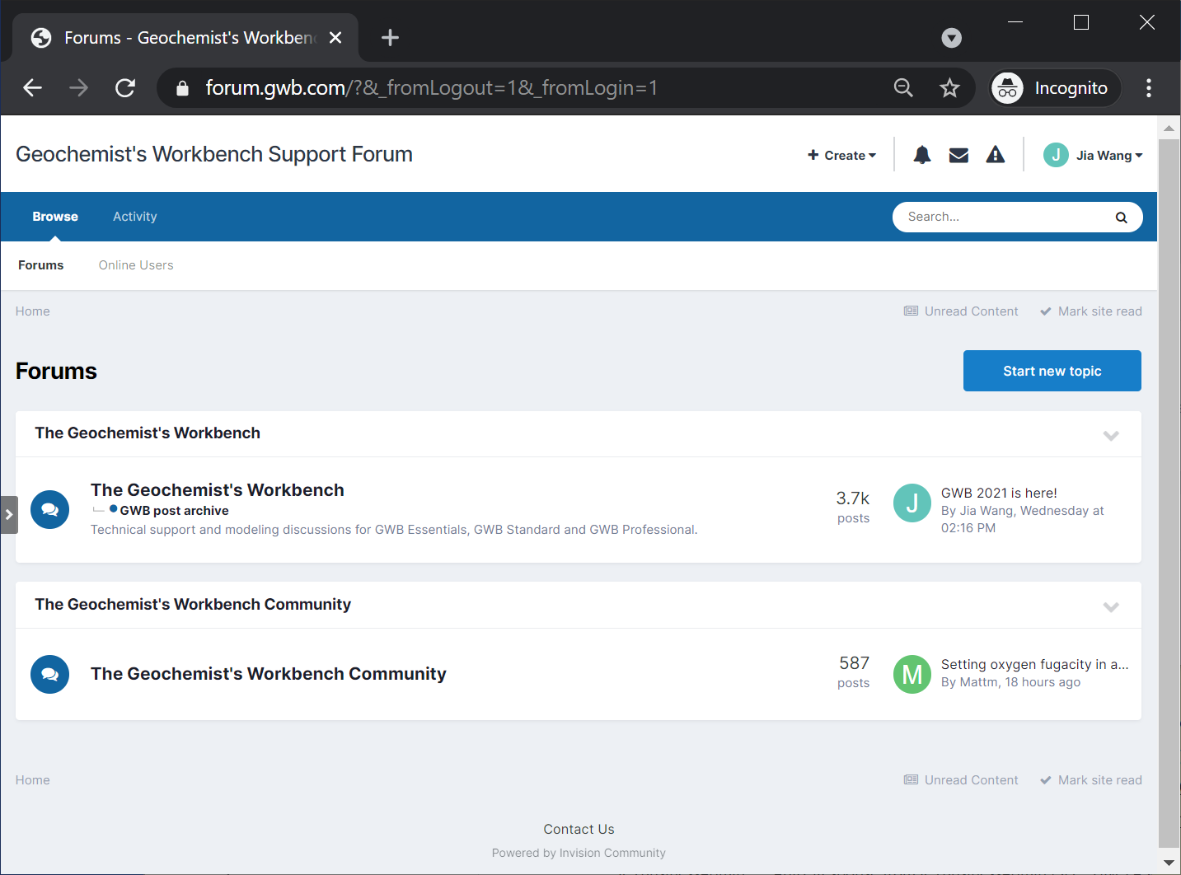
After you sign in you can post on the appropriate forum.
Click to post a new topic.

