Slide 1
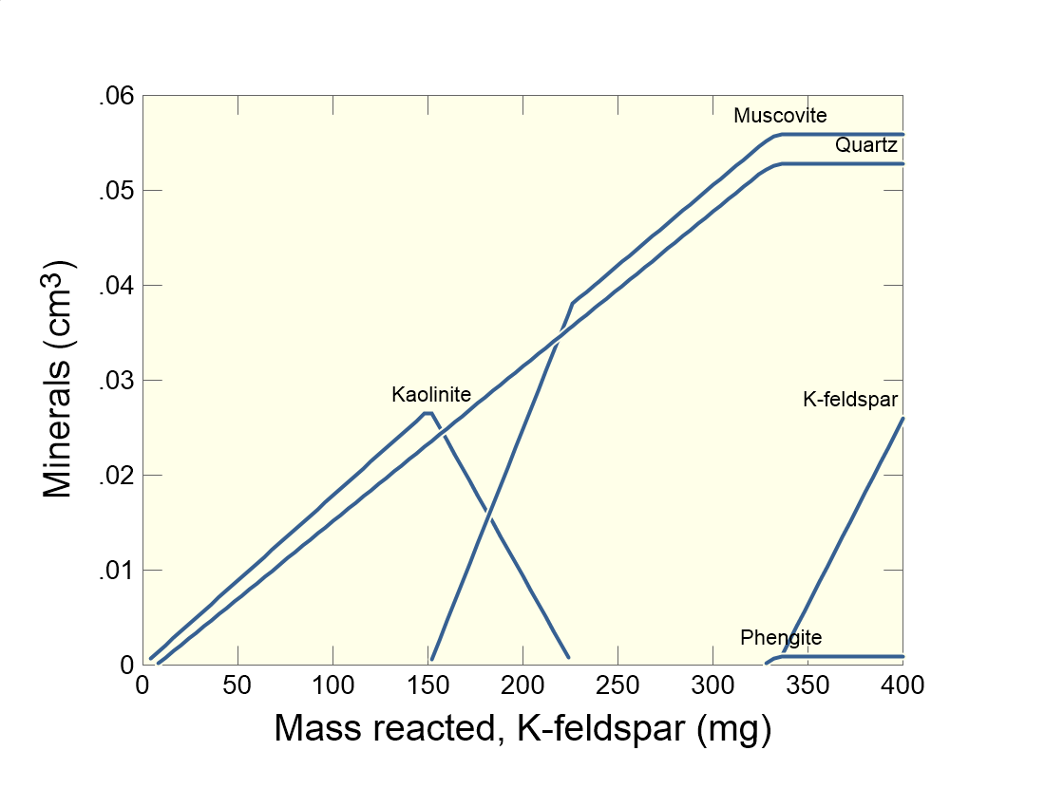

Slide 2
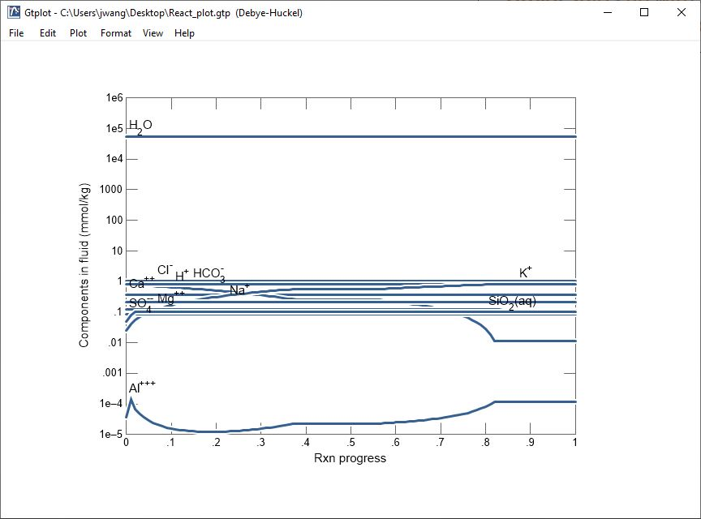
Gtplot starts up with a default plot configuration.
Double-click to bring up the XY plot configuration dialog.

Slide 3
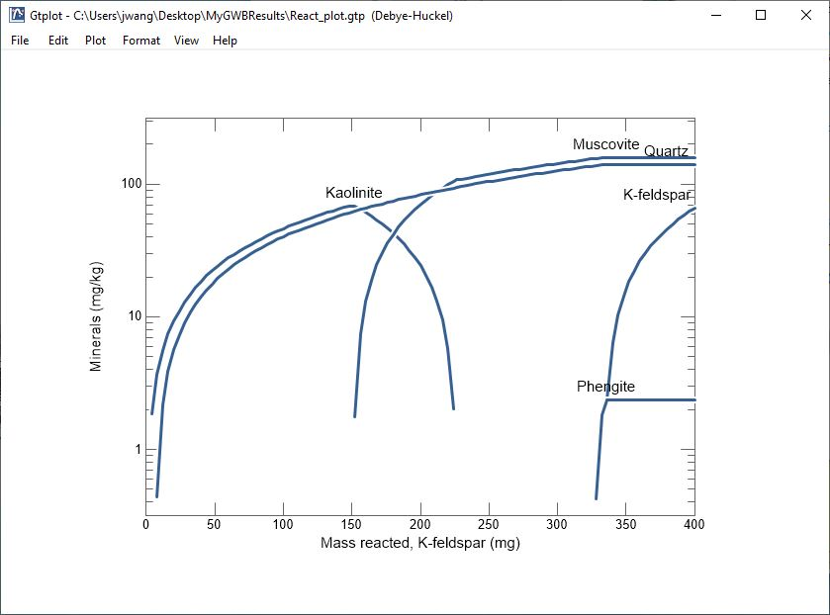
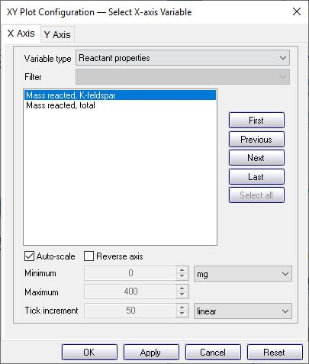
Use X Axis and Y Axis panes to set up your plot. Pick the variable type, variables, units, and scale.
Look in the “Reactant properties” to plot as a function of reactant added
Choose “Minerals” for Y Axis.

Slide 4
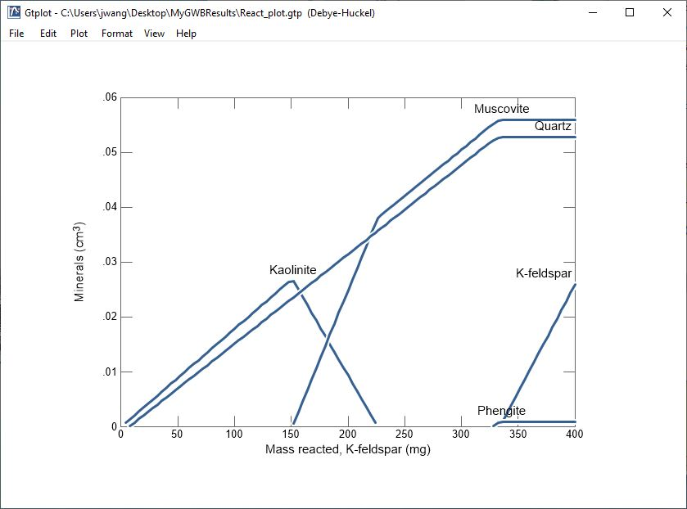
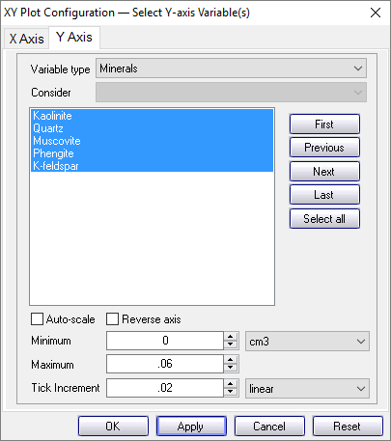
Set linear, log, or delta scale. Choose from a variety of units.
Use autoscale, or uncheck to set min, max, and increment manually.

Slide 5
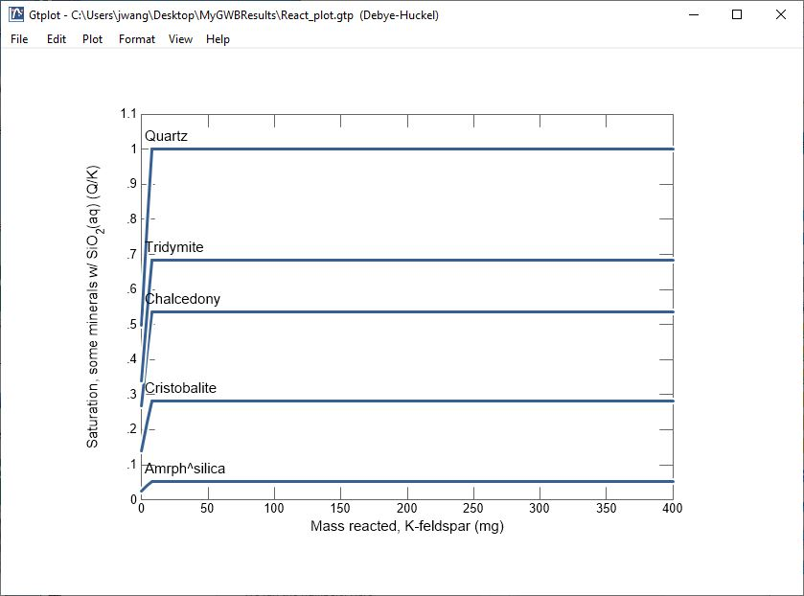
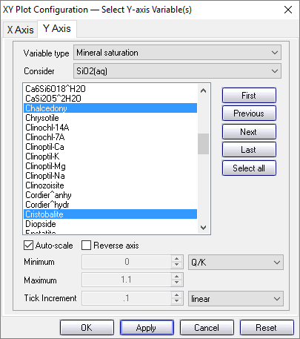
Set Variable type to “Mineral saturation” then Filter to SiO₂(aq).
Select desired silica-bearing minerals using Ctrl + C.

Slide 6
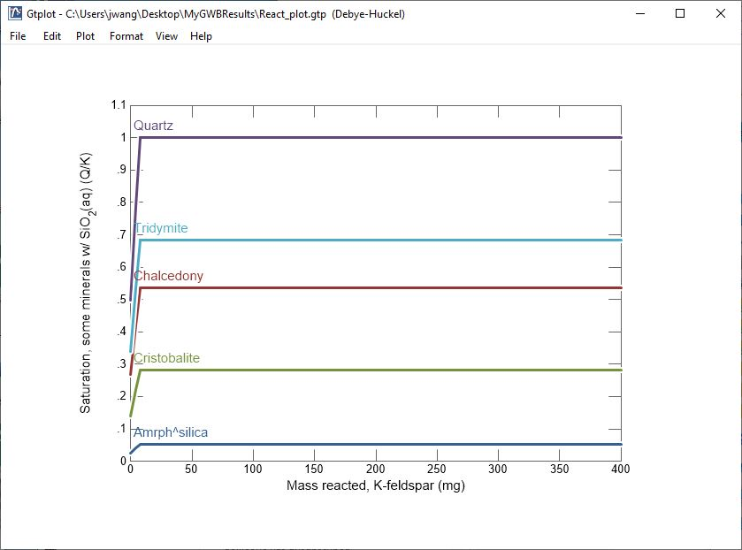
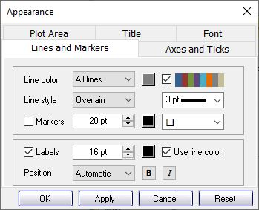
Double-click or right-click on plot elements to set appearance, or use the Format menu.
Right-click on line, choose “Edit Appearance…” to change line thickness, style, and more.
Set line colors individually or use the “autocolor” option.
Check to match label color to line color.

Slide 7
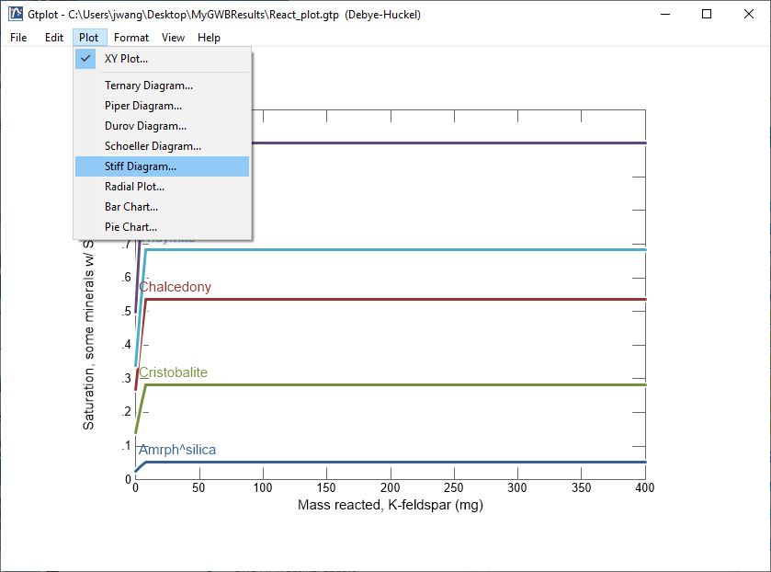
In addition to XY Plots, you can choose from a variety of special water chemistry diagrams.
Plot →
Stiff Diagram…

Slide 8
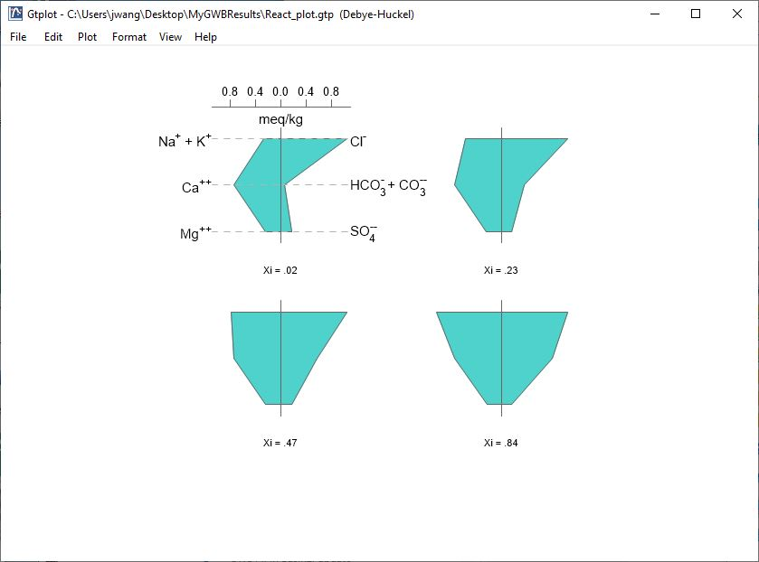
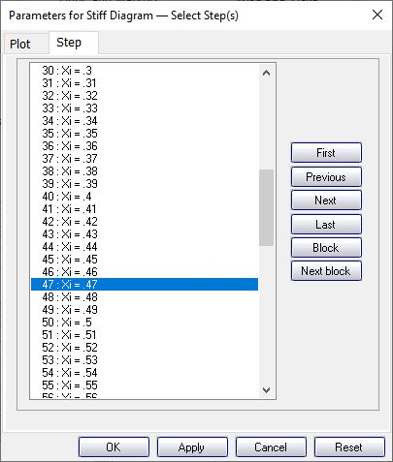
Control aspects of the plot, such as analytes, units, and scale.
Select calculation steps (or samples) to display.

