Slide 2
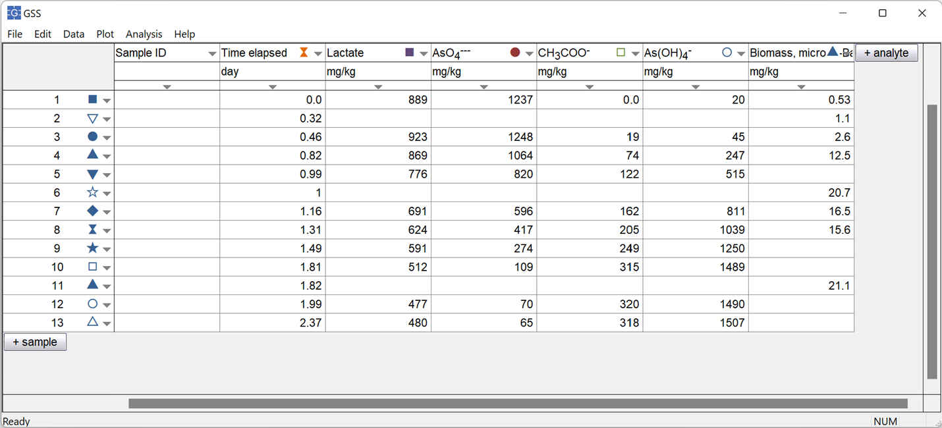
Start by making a GSS spreadsheet with the experimental data
You can set the marker color, size, and shape for analytes or samples.
Spreadsheet contains concentrations of substrates and reaction products sampled over time from a bioreactor.

Slide 3

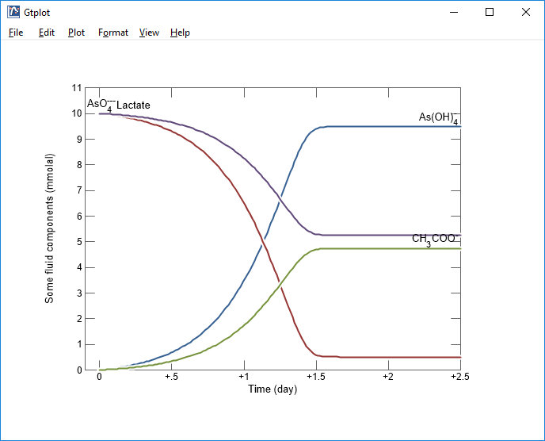
Left-drag the .gss file onto your plot...
…or, go to File → Open → Scatter Data… and browse to the .gss file.

Slide 4
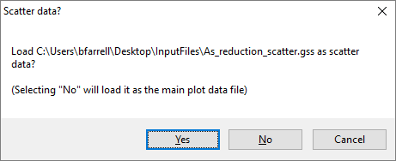
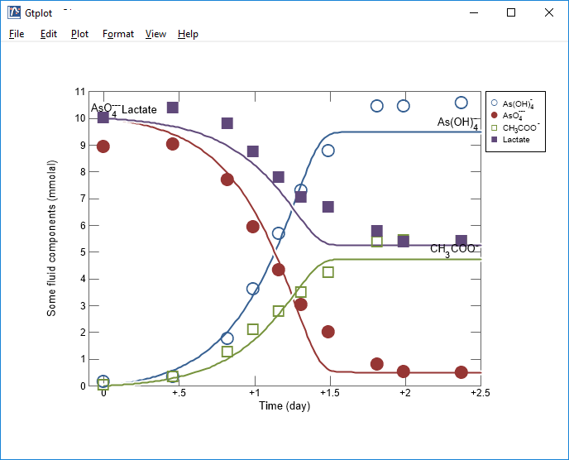
Scatter data can be added to Gtplot, P2plot, Xtplot, Act2, and Tact plots.

Slide 5
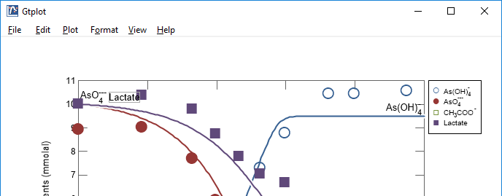
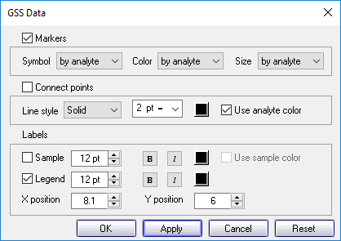
Format → GSS Data…
Turn scatter data on or off, and
choose marker symbol, color,
and size by analyte or by sample
We’ve set distinct marker colors for each analyte in this example.
Include sample labels or legends and add connecting lines.

Slide 6
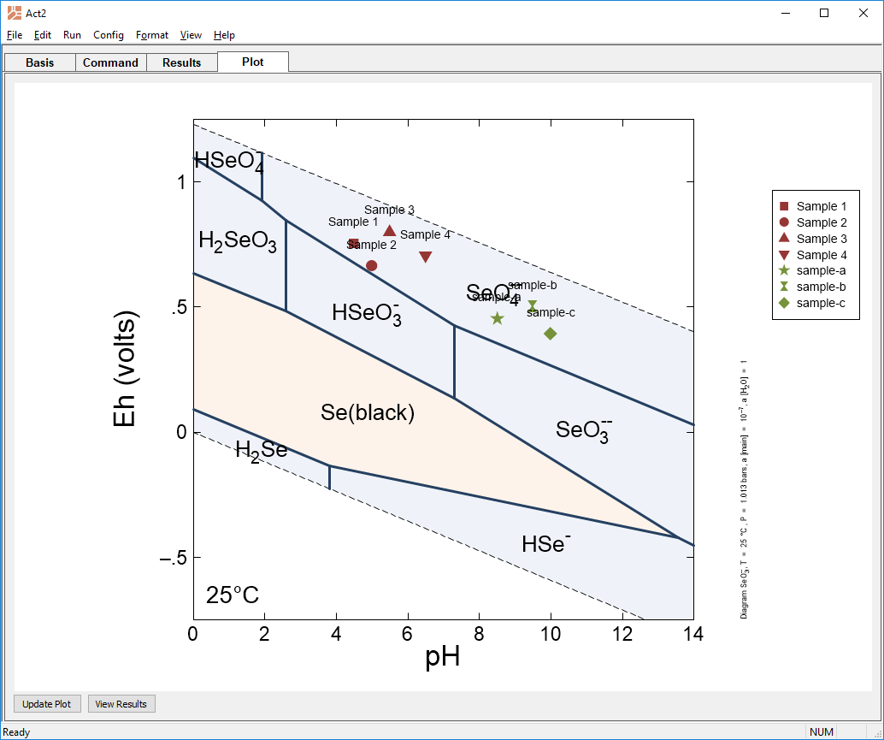
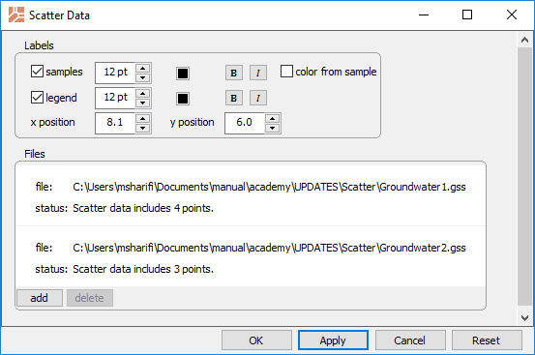
You can overlay multiple GSS datasheets on Act2 and Tact plots
Format → Scatter Data…
Two GSS files are loaded into Act2

