Slide 1
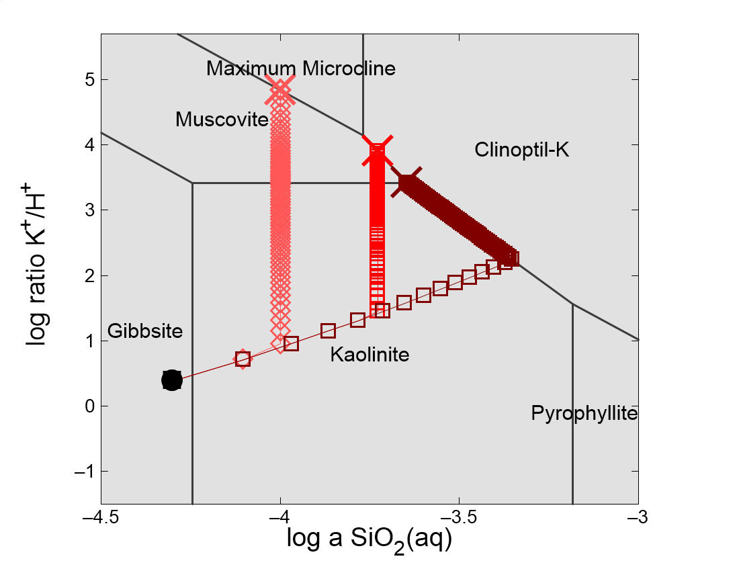

Slide 2
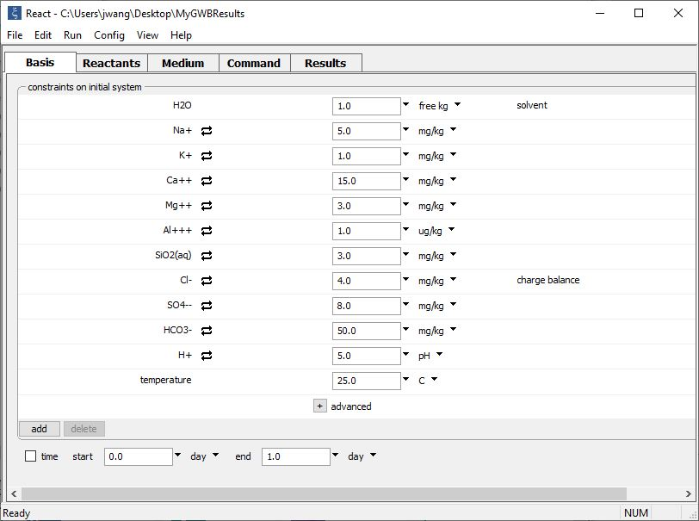
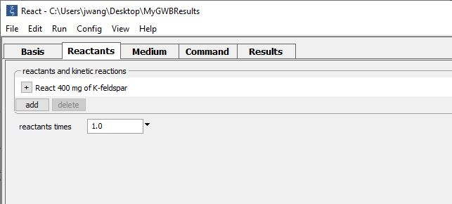
The trace of a reaction path calculated in React can be overlain on Act2 or Tact diagrams.
The working directory, where calculation results will be saved.
In the model, K-feldspar is titrated into an acidic fluid.

Slide 3
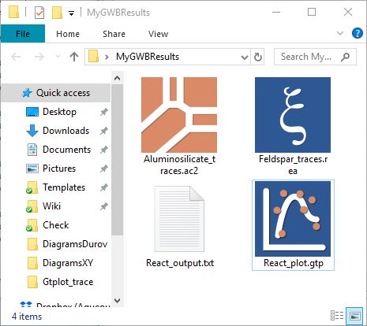
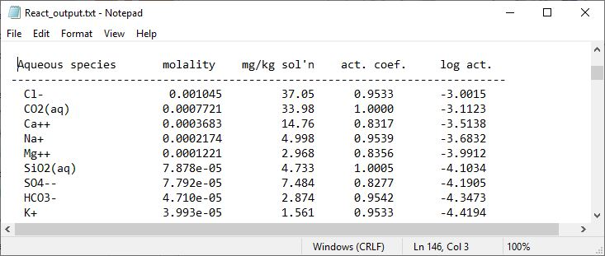
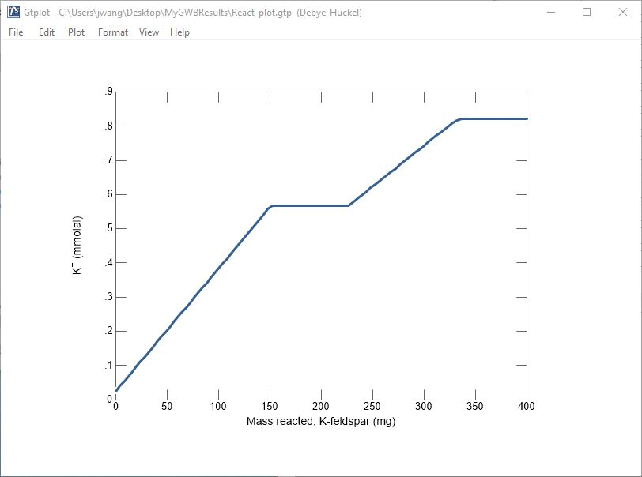
React runs and generates text format (React_output.txt) and plot format (React_plot.gtp) output files in the specified working directory.

Slide 4
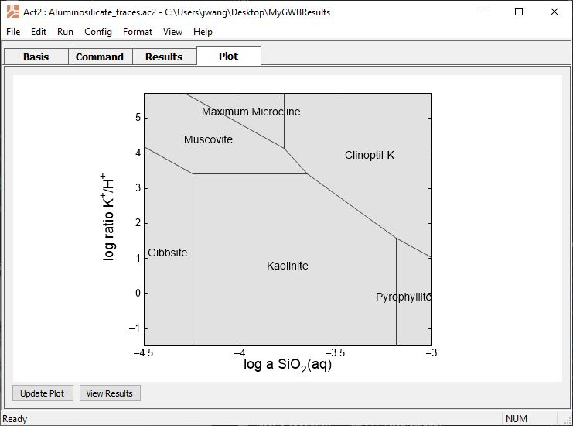
Create an Act2 or Tact diagram, then left-drag the .gtp file onto it…
…or, go to File → Open → Reaction Trace… and browse to the .gtp file.

Slide 5
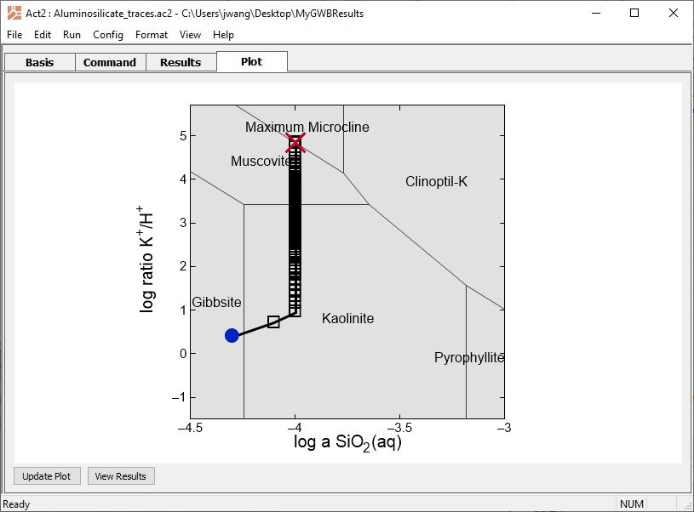
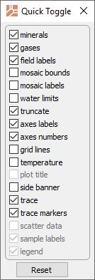
Reaction trace shows how mineral stability and fluid chemistry evolve as K-feldspar dissolves into the system.
End of simulation
Start of simulation
Check to show markers. Each represents an addition of K-feldspar to the system.

Slide 6
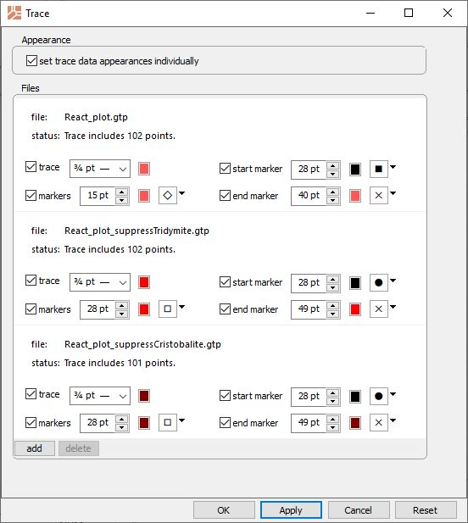
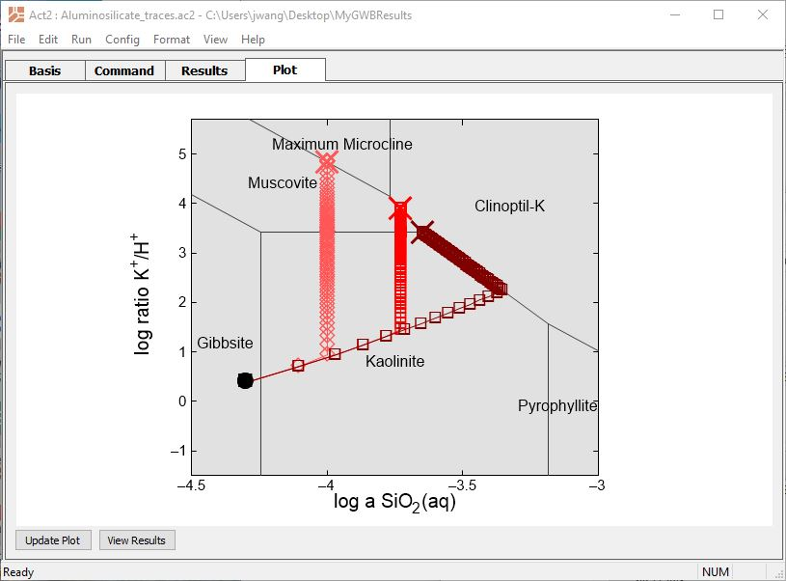
In GWB12, you can overlay multiple reaction traces on Act2 or Tact diagrams.
Customize markers and lines for each reaction trace.
Each assumes a different silica polymorph forms, which affects stable mineral assemblages.
Click ‘add’ and select the desired .gtp files from React simulations.

