Slide 1
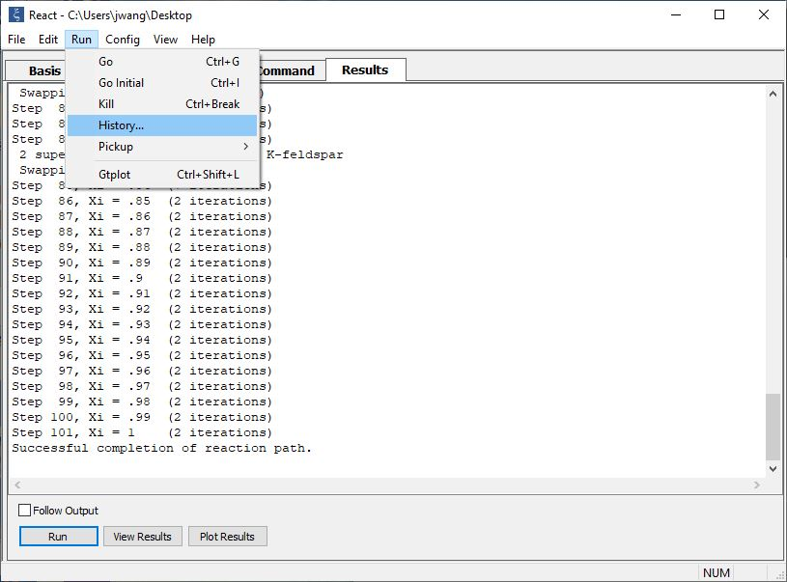
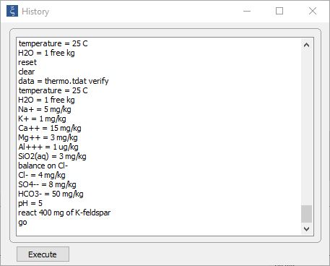
Command History

Slide 2
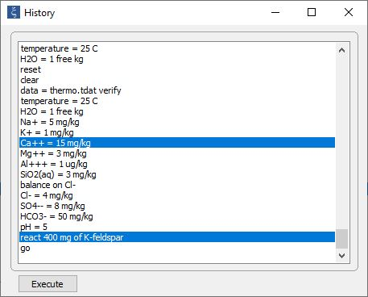
Previously executed commands are stored in the user’s profile directory
Run → History…
Select one or more commands and click to re-execute

Slide 3
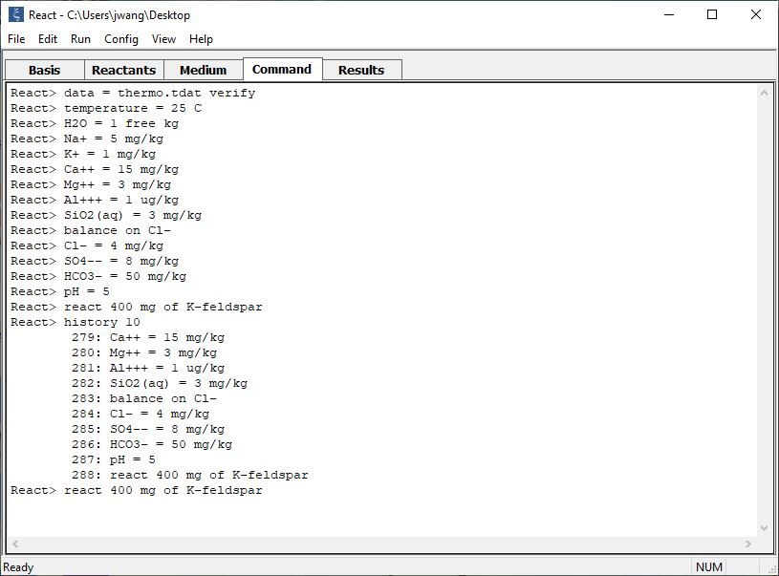
Type “history 10” to list previous 10 commands.
Touch Ctrl+p to bring up the previous command in your history list. Ctrl+n scrolls forward to the next command.

Slide 4
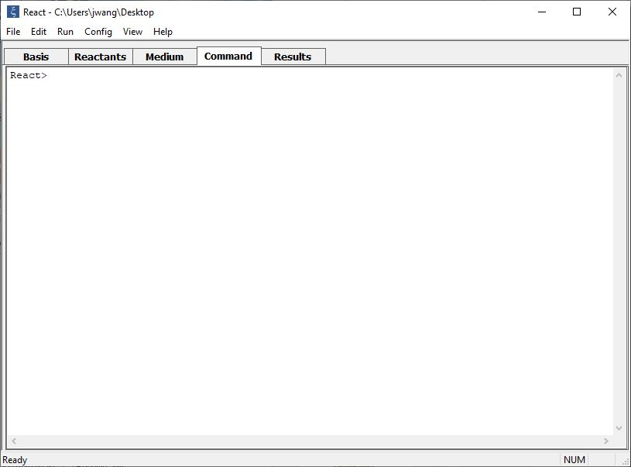
Type the following history substitution functions in the command line:
!! → Re-execute the previous command
!10 → Re-execute command number 10
!swap → Re-execute the last command that began with “swap”
!HCO3 → Re-execute the last command that contained the string “HCO3”
^string1^string2 → Replace “string1” with “string2” in the previous command
!10-15 → Re-execute commands 10 through15

Slide 5
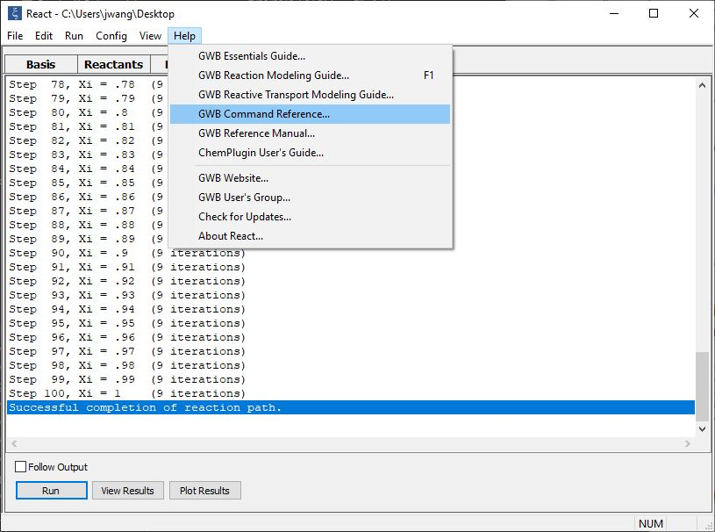
For a comprehensive list of GWB commands,
refer to the GWB Command Reference.

