Slide 1
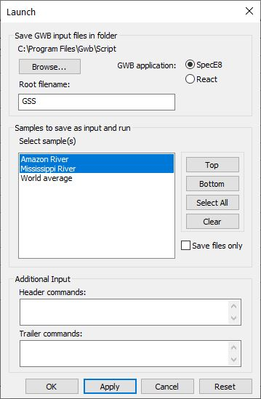
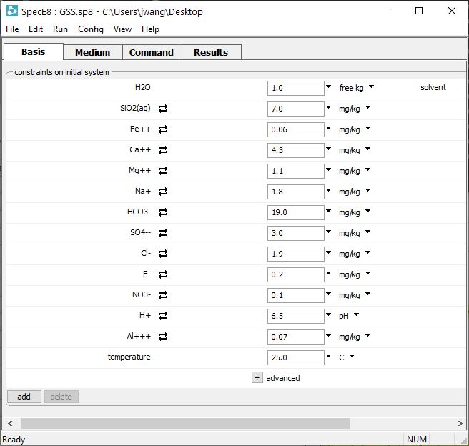
Launch SpecE8 and React from GSS

Slide 2
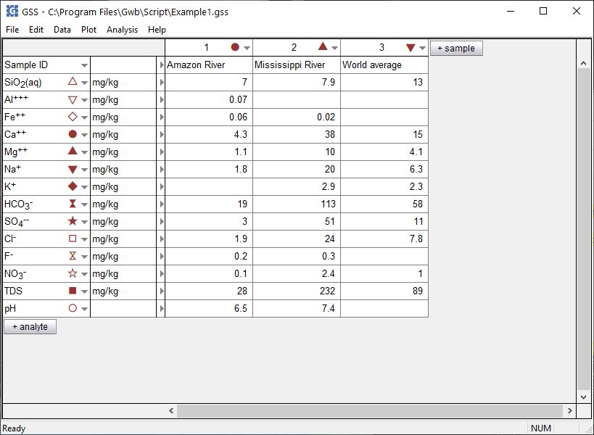
You can use the chemical analyses in a GSS data sheet to set up and run SpecE8 and React calculations.
Analysis → Launch…

Slide 3
Choose SpecE8 or React
Select directory for SpecE8 or React input and results files
Select samples
You can add additional commands to the SpecE8 or React script generated by GSS.

Slide 4
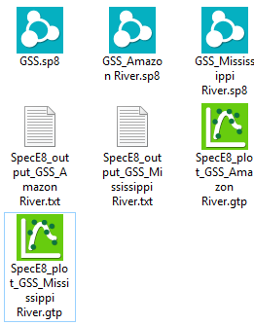
An instance of SpecE8 is launched configured with values from the first sample.
For all samples selected, SpecE8 generates input, text output, and plot file.
Amazon River sample.

