Slide 1
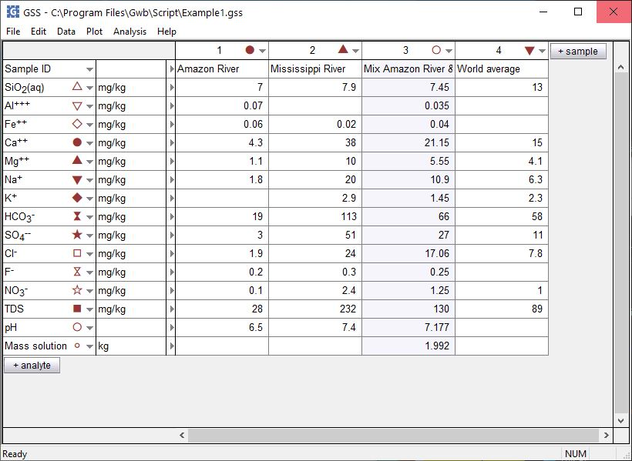
SmartMix

Slide 2
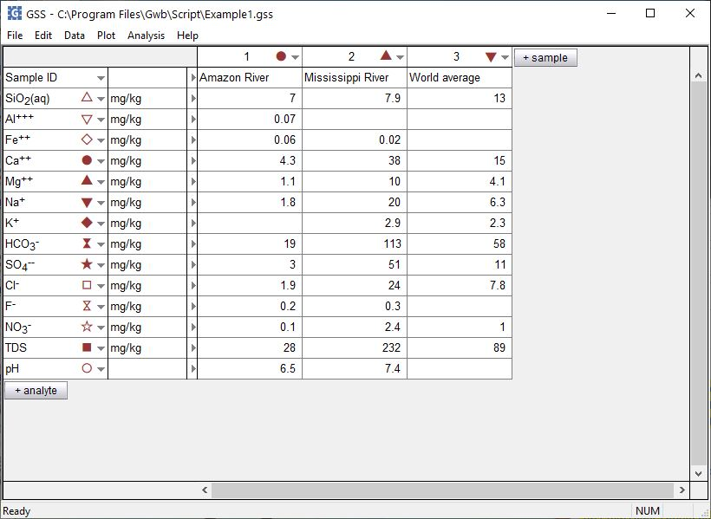
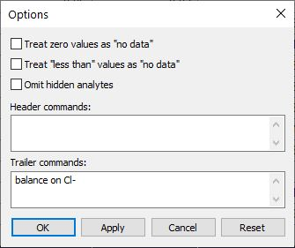
Set constraints for the mixing calculation before mixing samples.
Analysis → Options…
Options for missing data, non-detects, hidden analytes
Additional constraints. Use SpecE8 commands from the GWB Command Reference.

Slide 3
Analysis → Mix Samples… launches the SmartMix wizard.
Store your samples in GSS, then mix any number of them together, in any proportion.

Slide 4
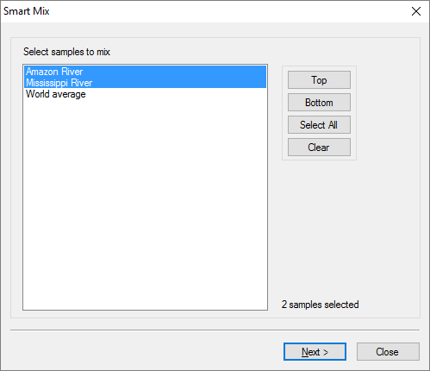
Choose the
samples to mix
Select 2 or more samples in the spreadsheet, then click Next

Slide 5
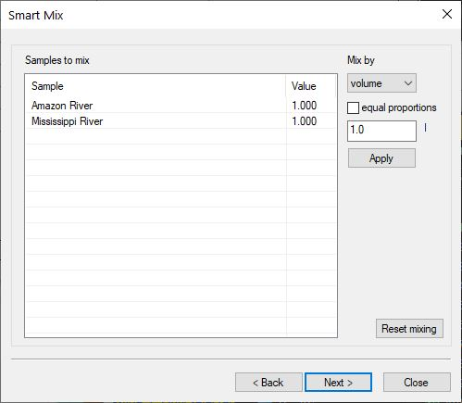
Specify amount of each sample to mix.
Mix by mass or volume
Uncheck “equal proportions” to set the mass (kg) or
volume (l) of individual samples

Slide 6
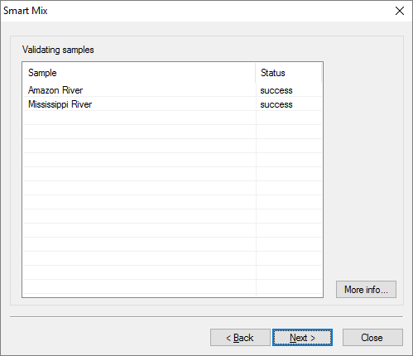
Each sample is equilibrated in SpecE8
Select a sample, then click “More info” to see the input sent to SpecE8

Slide 7
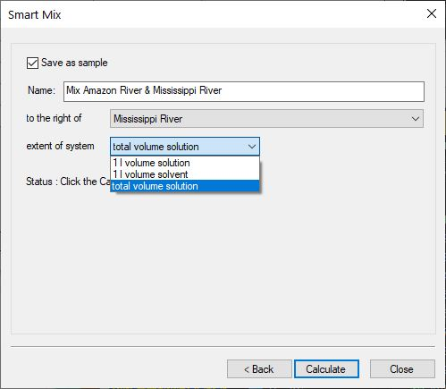
Manage your newly mixed sample
Save mixture as a new sample in the spreadsheet.
Sample ID and location within the spreadsheet
Save your sample as it is, or scale it down to size
Calculate applies your settings to the GSS spreadsheet, then click Close

Slide 8
New mixed sample
Concentrations, pH, etc. all calculated automatically.
1 liter of each of Amazon and Mississippi River water have been mixed and saved as a new sample.

