Slide 1
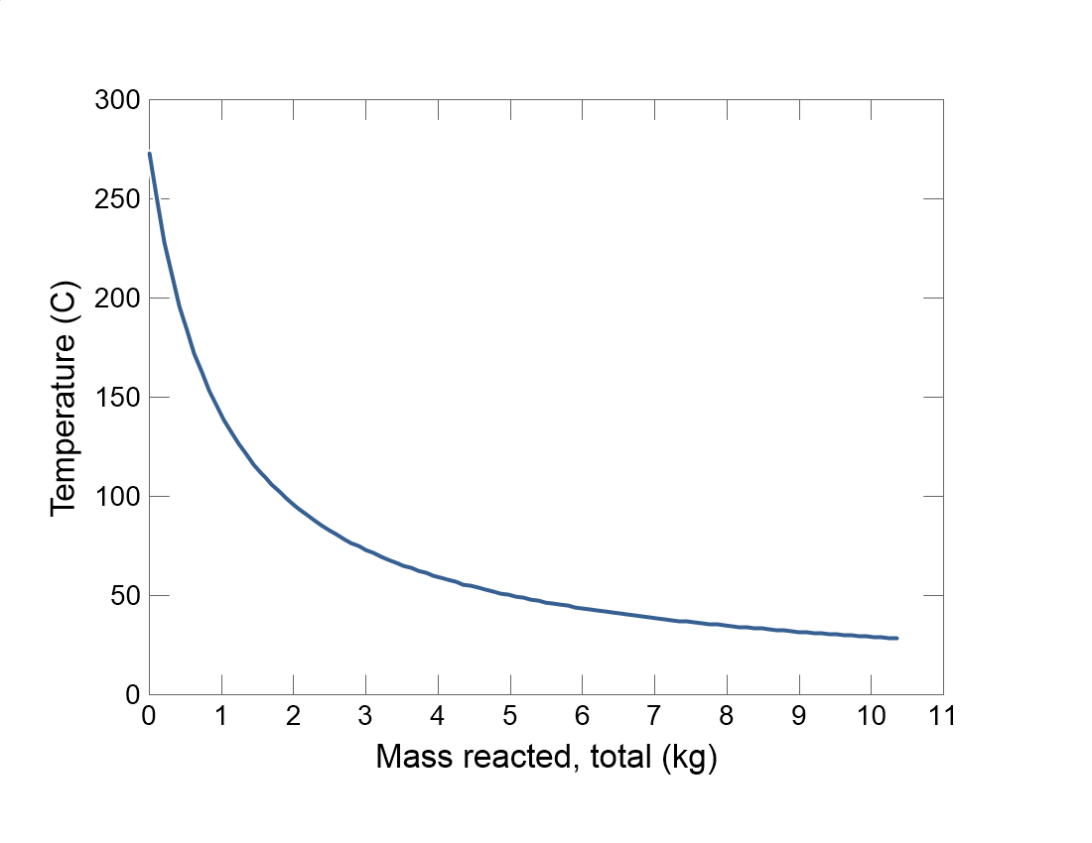

Slide 2
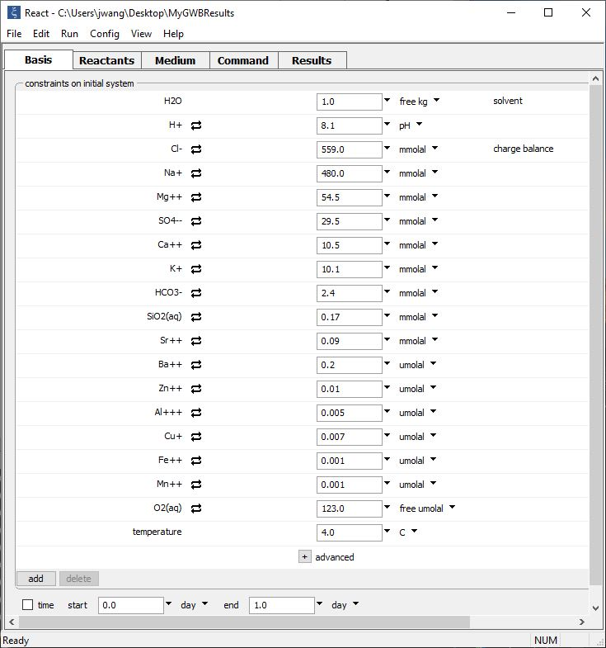
Fluid 1: Cold, oxygenated seawater
Specify fluid composition and T on the Basis pane
Run → Go to equilibrate the fluid
T = 4 °C
Add new species

Slide 3
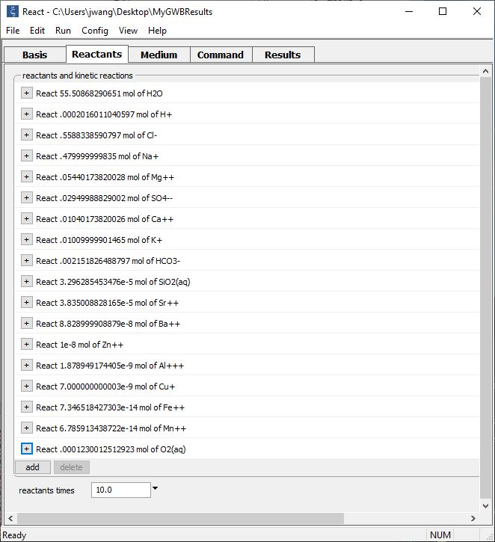
Run → Pickup → Reactants → Fluid moves the equilibrated fluid to the Reactants pane and vacates the Basis pane
Seawater: 1 kg solvent water plus solutes
React ~1 kg seawater 10x into the new Basis pane fluid

Slide 4
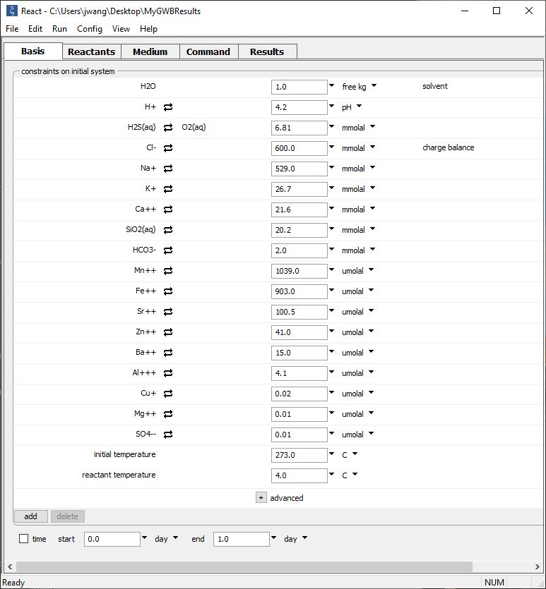
Fluid 2: Hot, reduced hydrothermal water
Open pulldown and select “reactant mixing” option
Set initial T (273 °C) and reactant fluid T (4 °C) to implement polythermal mixing
Run → Go
to mix the fluids

Slide 5
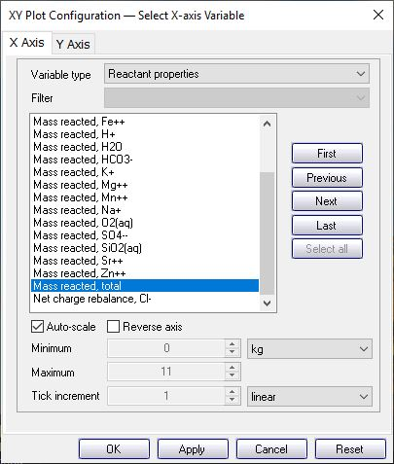
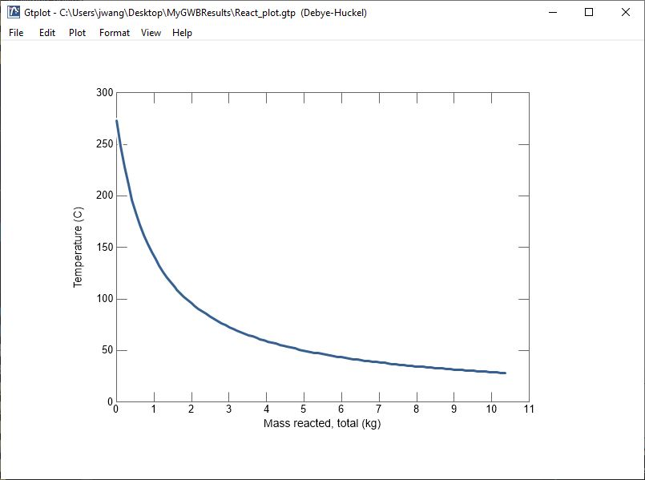
Entirely hot hydrothermal fluid
As 10+ kg cold seawater mixes with hydrothermal fluid, temperature of mixture decreases

Slide 6
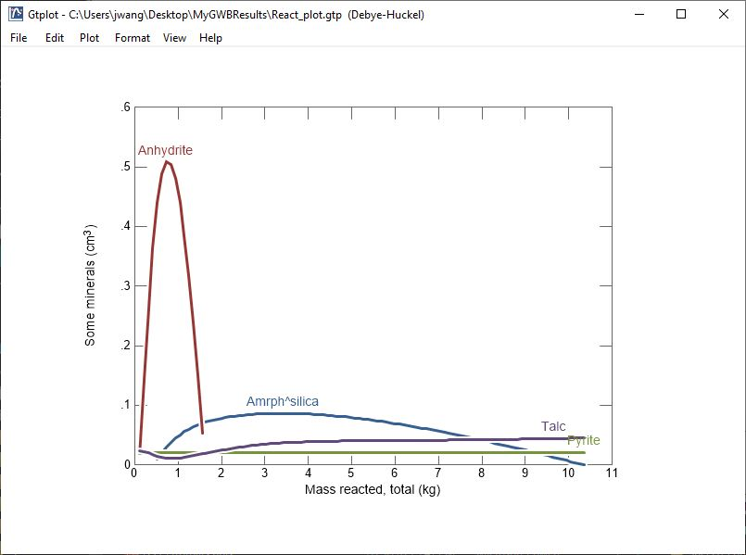
As cold seawater is mixed into hydrothermal fluid, mineral precipitation and dissolution is influenced by temperature and dilution effects.

