Slide 1
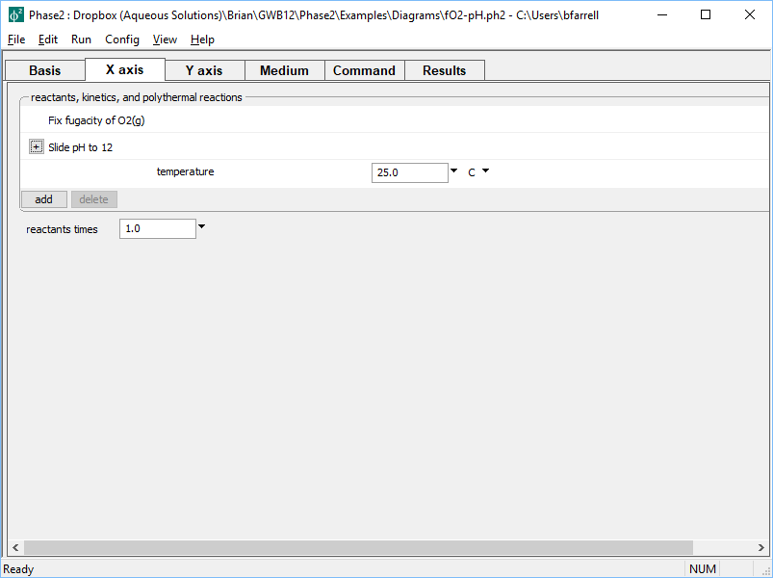
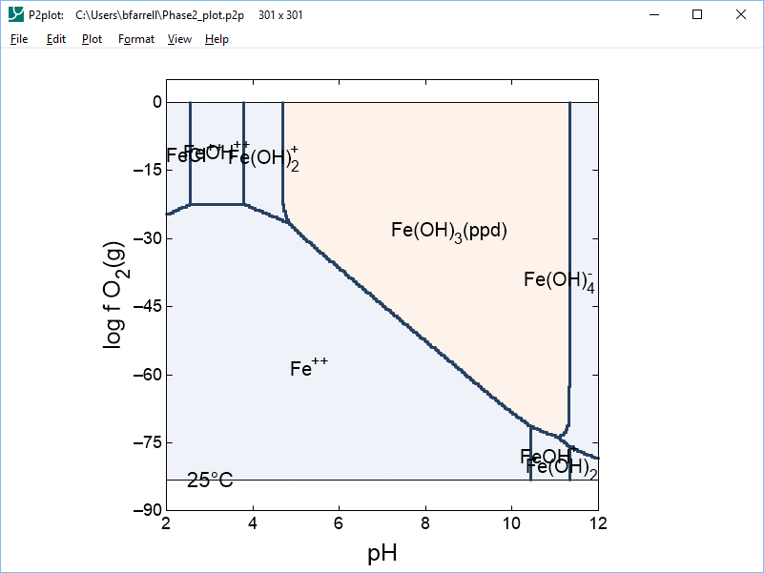
Traditional stability diagram axes
Slide pH along x axis while holding f O₂(g) constant
Set sliding pH, pe, Eh, species activity, gas fugacity, activity or fugacity ratio

Slide 2
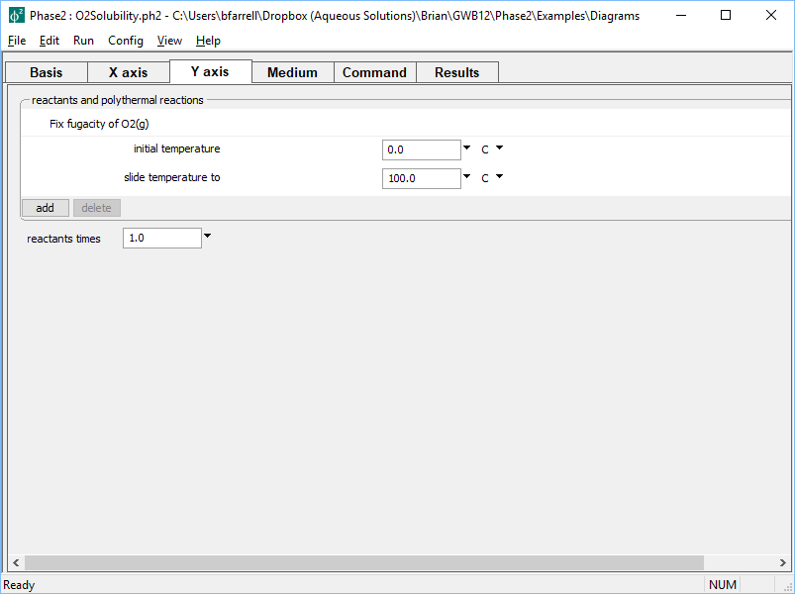
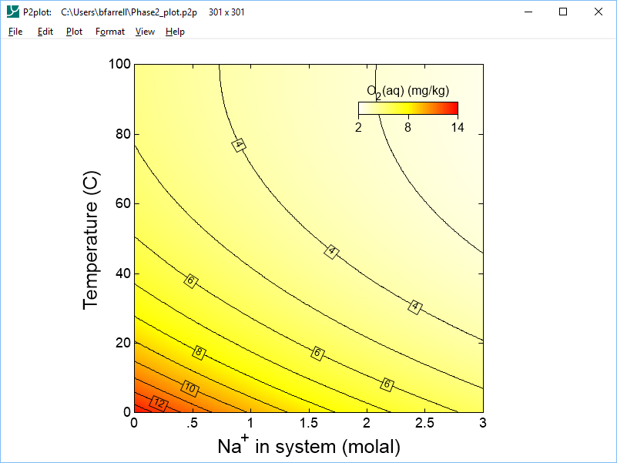
Use temperature as an axis variable
Vary temperature from 0–100°C along y axis

Slide 3
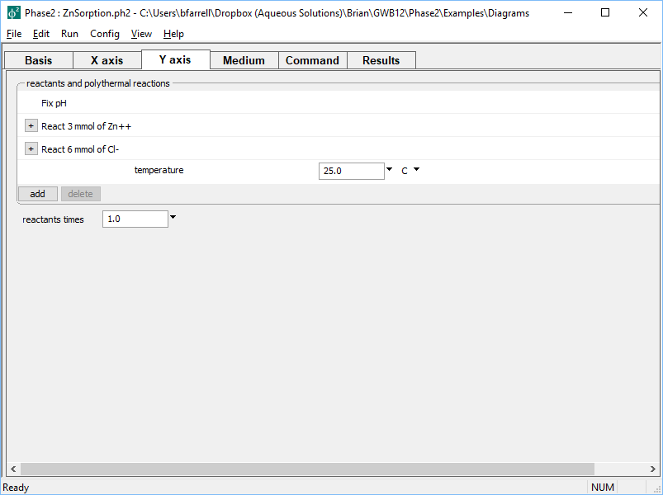
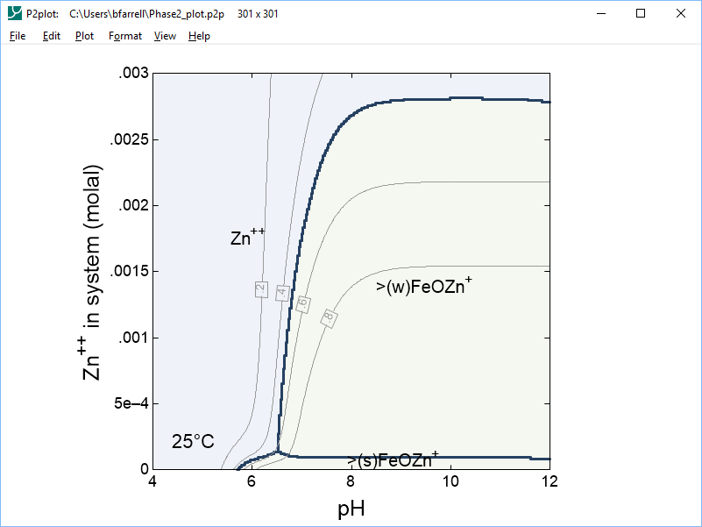
Use concentration as an axis variable
Add Zn⁺⁺ as a simple reactant along y axis

Slide 4
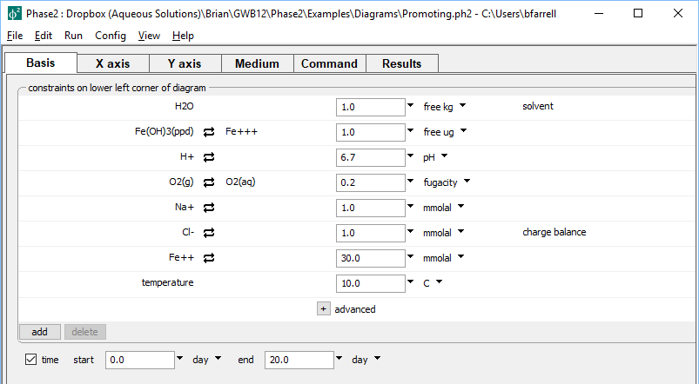
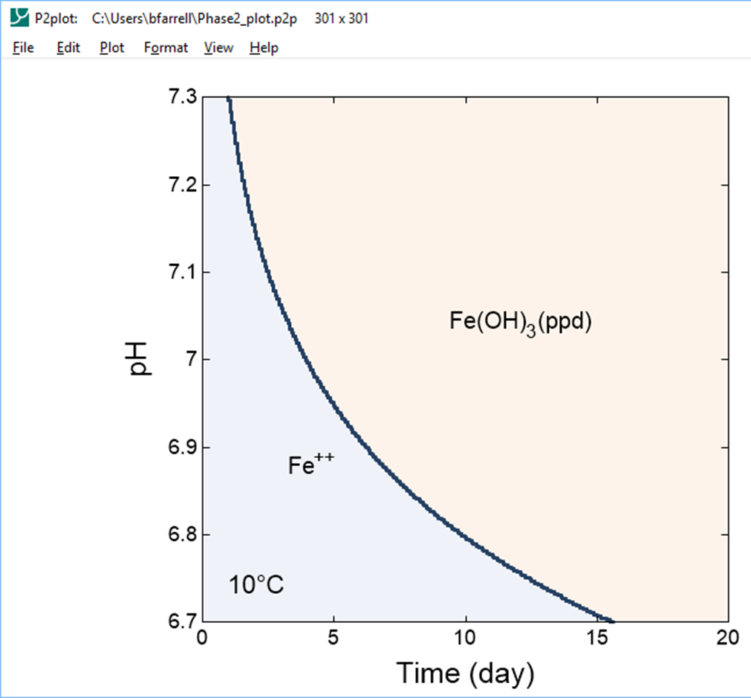
Use time as an axis variable
Set start and end times, then set kinetic processes on x axis
Reaction rate is pH-dependent

Slide 5
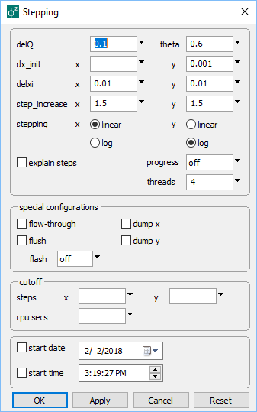
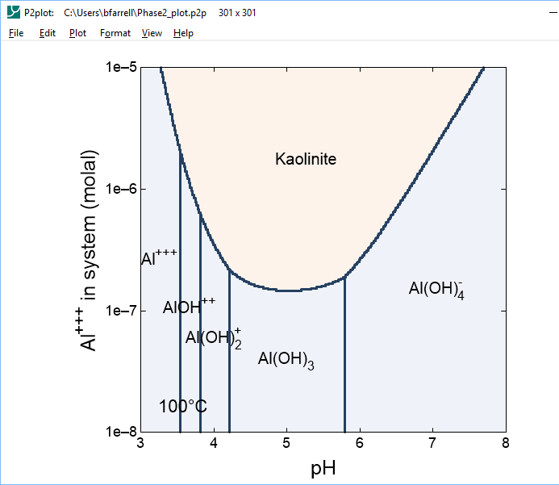
Use linear or log axes
Config → Stepping…
Set log stepping along y axis
Kaolinite solubility varies over several orders of magnitude

Slide 6
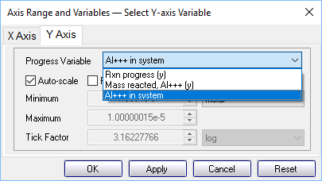
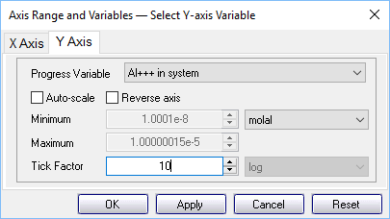
Configure your axes with a few clicks
Choose from list of valid variables
Set units,
tick increment

