Slide 2
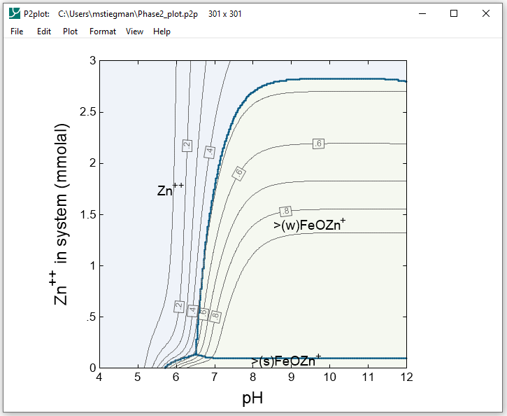
A cross-section can be made from any diagram in P2plot
Plot → Cross-section Plot…

Slide 3
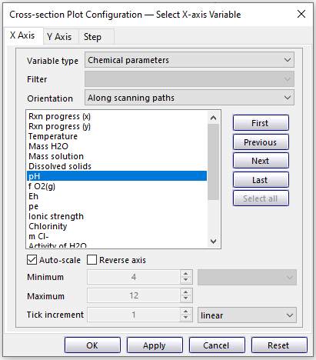
Orientation: along scanning paths (horizontal) or across (vertical)
pH was chosen as the scanning path variable

Slide 4
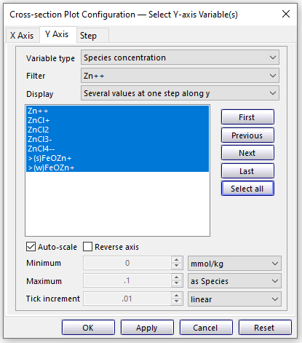
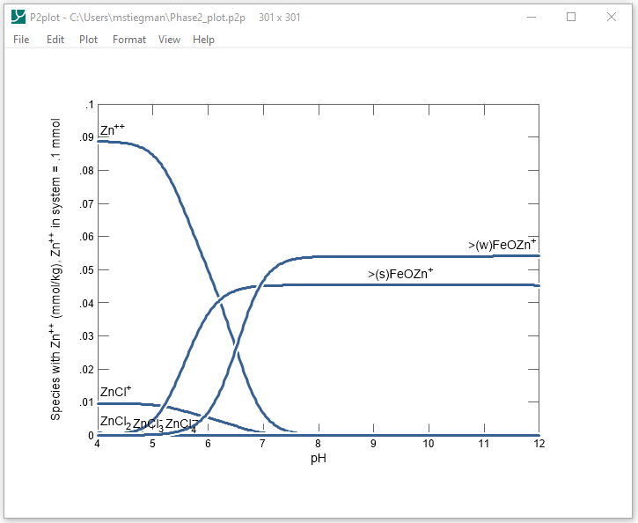
On step pane, set progress variable and step

Slide 5
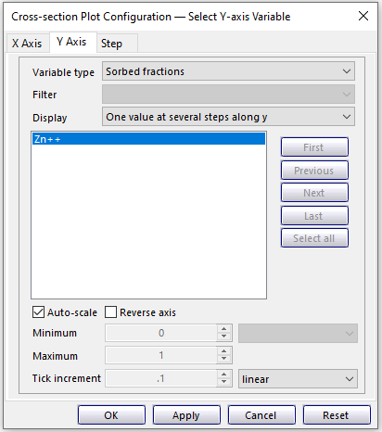
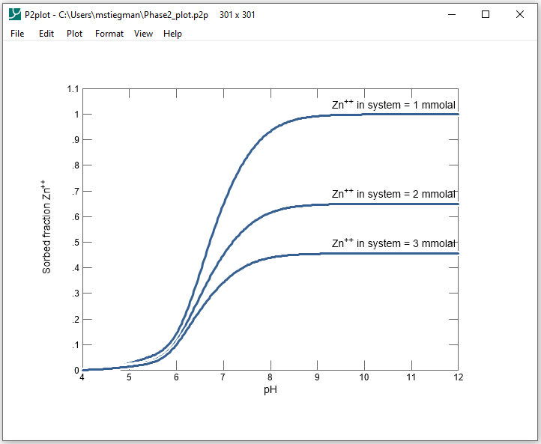
Stack a value from several scanning paths (set on step pane)
Cross-sections can also plot a variable at several points along the staging axis

Slide 6
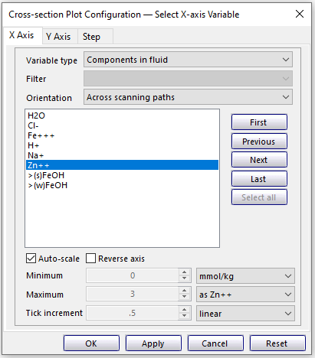
P2plot can make vertical cross-sections through a diagram

Slide 7
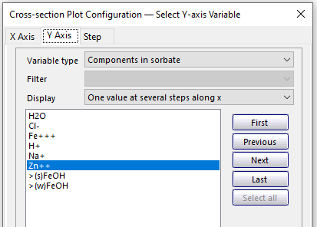
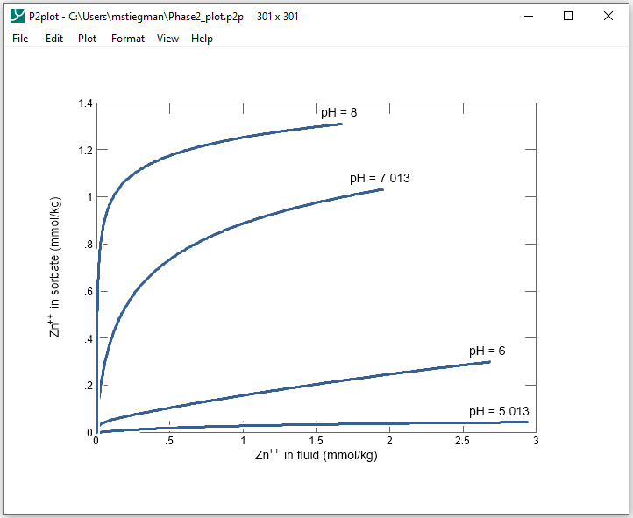
Select multiple pH values
Stacked vertical sections display the Zn++ sorption isotherms

