Slide 2
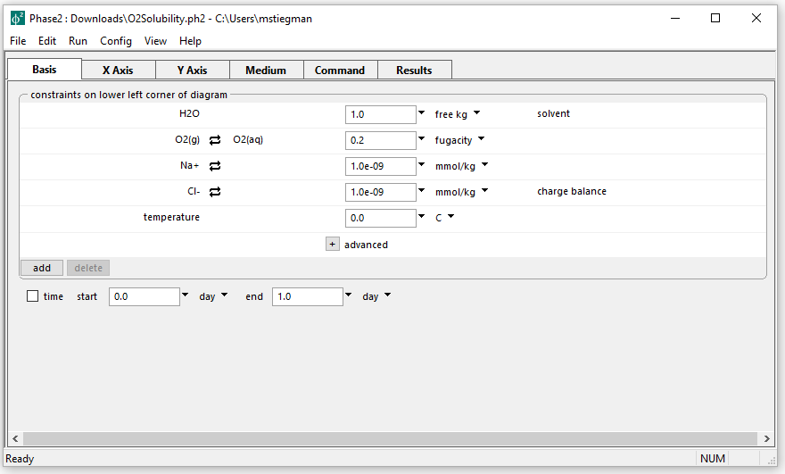
Initial parameters for Gas Solubility diagram
Oxygen is in equilibrium with atmosphere
Want to define the solubility of oxygen in water in terms of pH and salinity

Slide 3
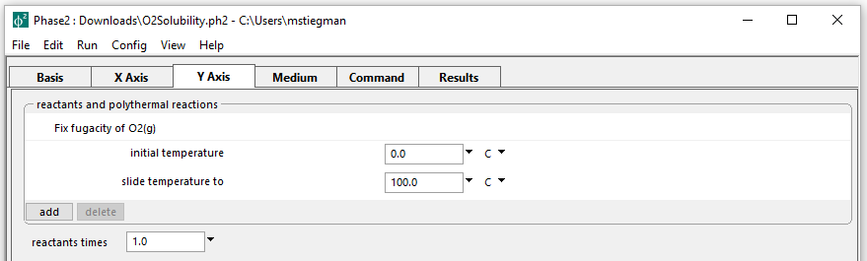
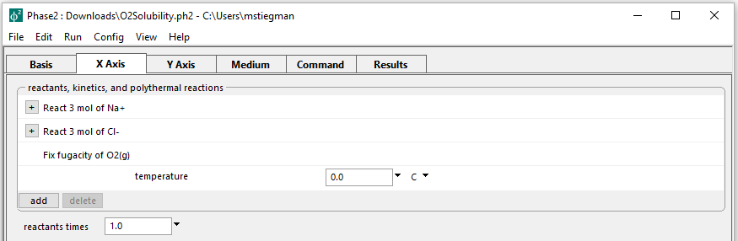
Oxygen fugacity is fixed on both axes
Slide the temperature along Y axis from 0⁰C to 100⁰C
Titrate with 3 mol of NaCl along the X axis
Run → Go → Plot Results

Slide 4
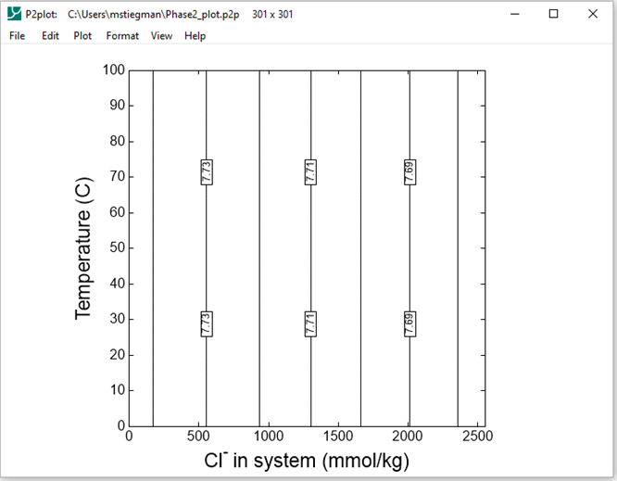
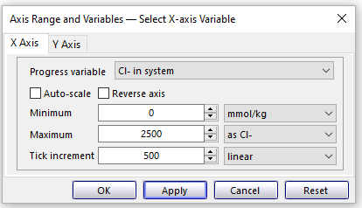
Format → Axis Range and Variables
Resulting output on P2plot
Set the X axis Progress Variable to Cl- in system

Slide 5
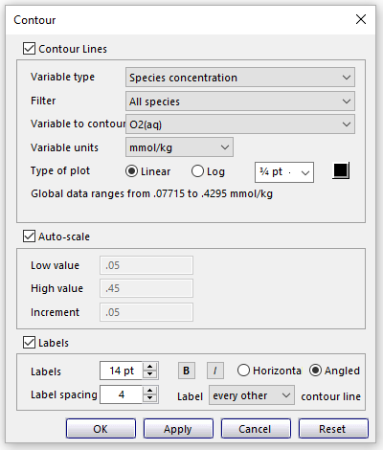
Format → Contour…
Set Variable type to Species Concentration and Variable to contour to O2(aq)
Change Type of plot to Linear

Slide 6
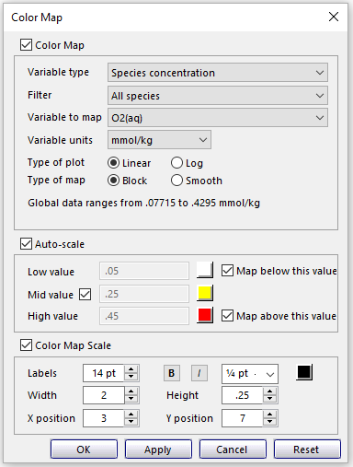
Format → Color Map…
Select same settings used in the Contour window

Slide 7
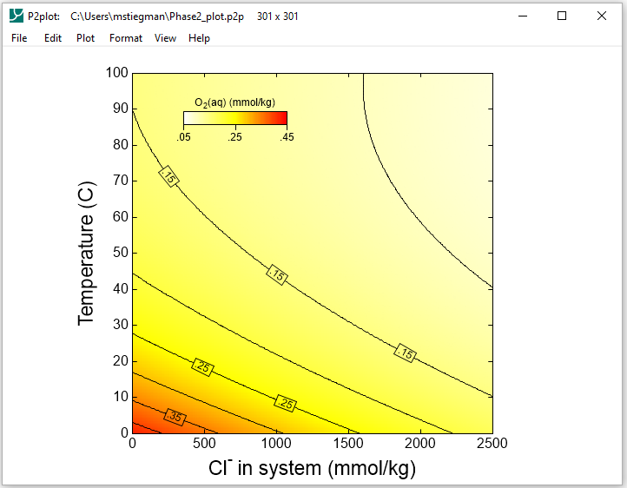
Gas Solubility diagram for O2(aq) in saline water
Reflects the decrease in the log K of the rxn between gaseous and aqueous oxygen with temperature
Activity coefficient of O2(aq) increases w/ ionic strength = “Salting Out” effect

