Slide 1
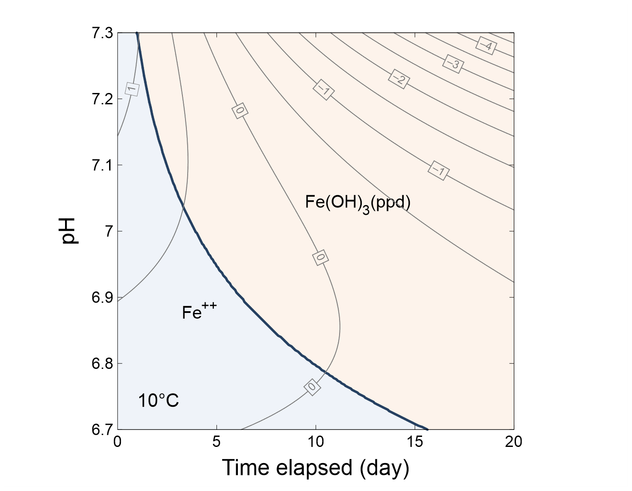

Slide 2
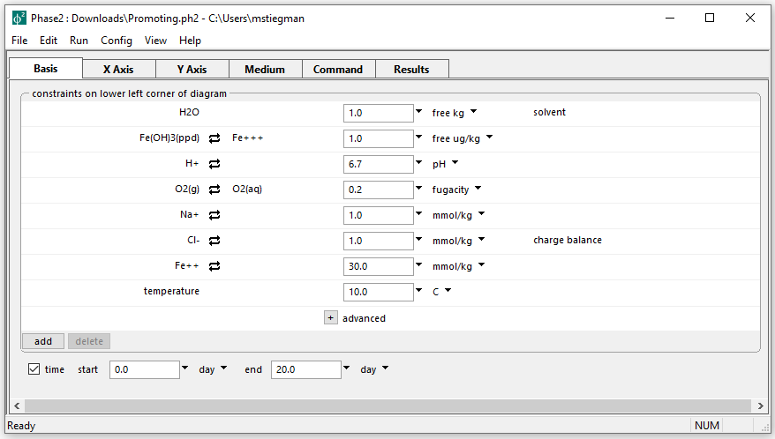
Initial parameters for Kinetic diagram
The goal is to create a diagram that shows how pH (which controls [OH-]) affects Fe oxidation

Slide 3
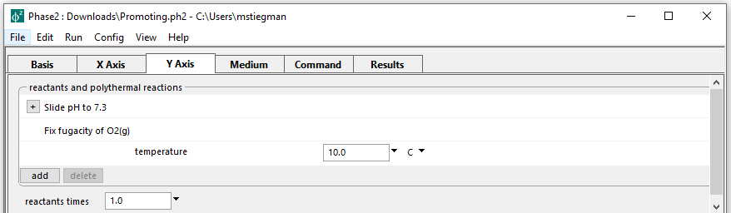
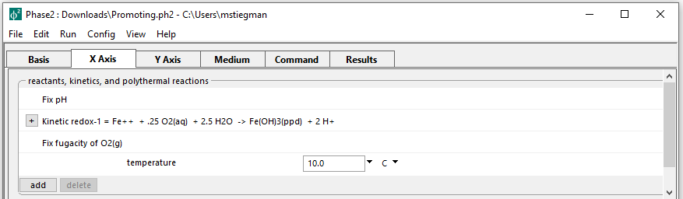
Setting up the staging and scanning paths
On the Y axis, pH is set to slide from the initial value to 7.3
Define a kinetic rate law on the X axis
Run → Go → Plot Results

Slide 4
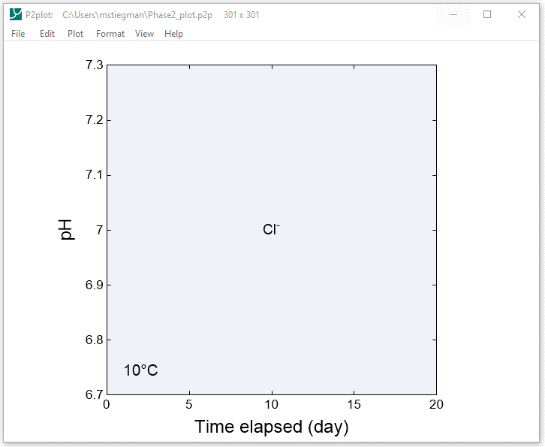
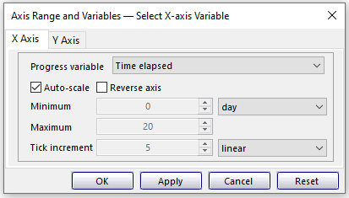
Format → Axis Range and Variables…

Slide 5
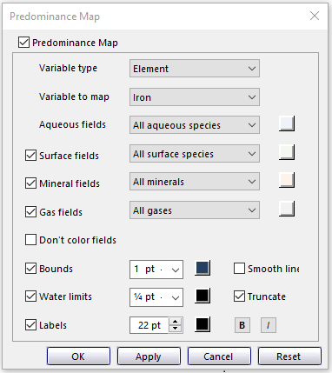
Format → Predominance Map…
Set Variable type to Element and Variable to map to Iron
These settings allow the diagram to show both Fe++ and Fe+++ species/minerals

Slide 6
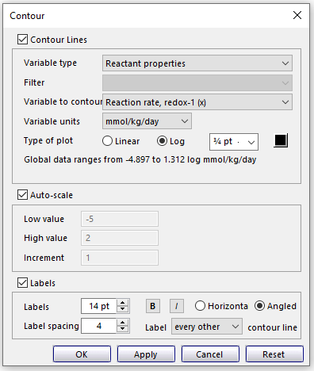
Format → Contour…
Set Variable type to Reactant properties and Variable to map to Reaction rate, redox-1 (x)
Set units of mmol/kg/day and choose Log for Type of plot

