Slide 2
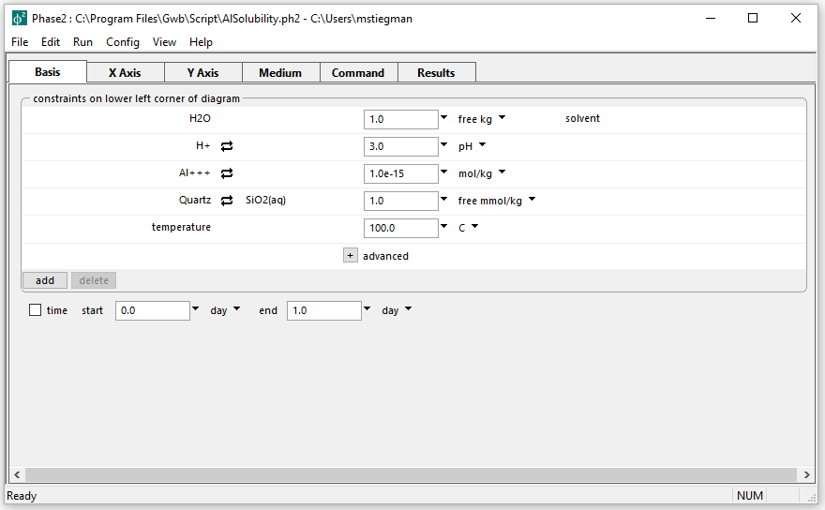
Initial parameters for Mineral Assemblage diagram
Initial Al+++ concentration is low

Slide 3
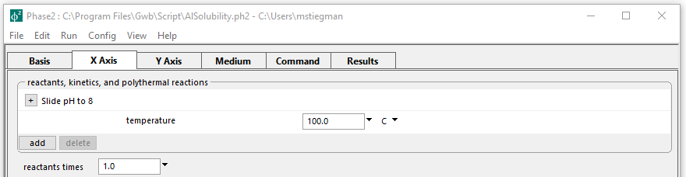
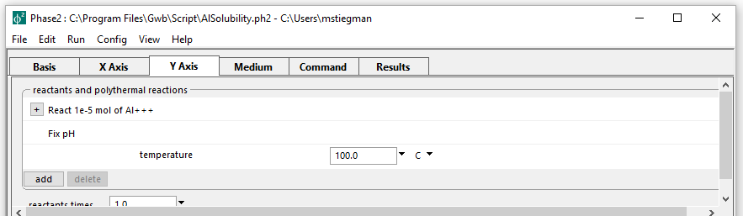
Setting up the staging and scanning paths
On the X axis, pH is set to slide from the initial value to 8
pH is fixed while adding Al to the system on the Y axis

Slide 4
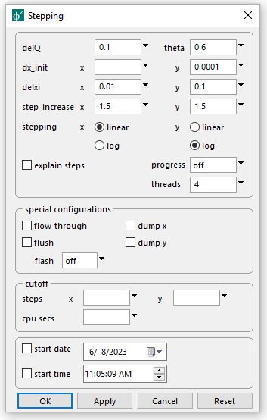
Config → Stepping
Set the Y axis initial step size to 0.0001
Set the Y axis to logarithmic stepping
Choosing Y axis for a log scale will add exponentially larger amounts of Al+++ with each step
Run → Go → Plot Results

Slide 5
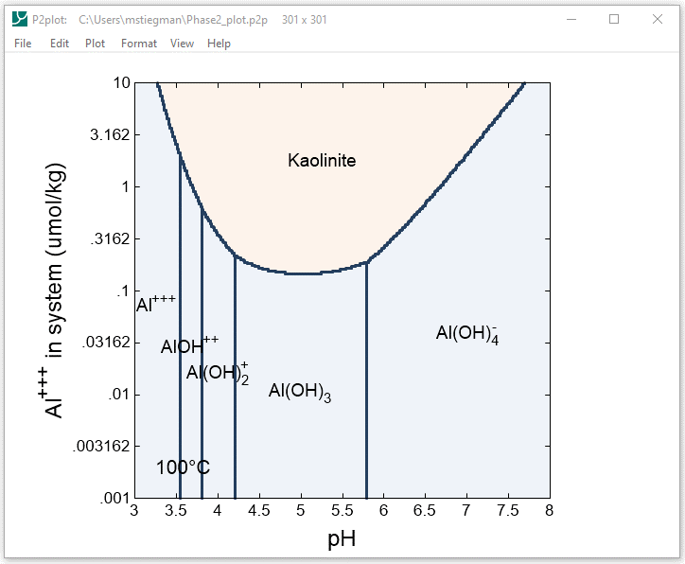
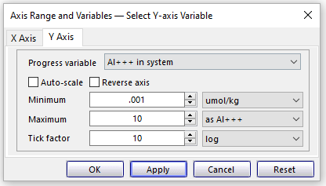
Format → Axis Range and Variables
Set Y axis variable to Al+++ in system and choose log scale

Slide 6
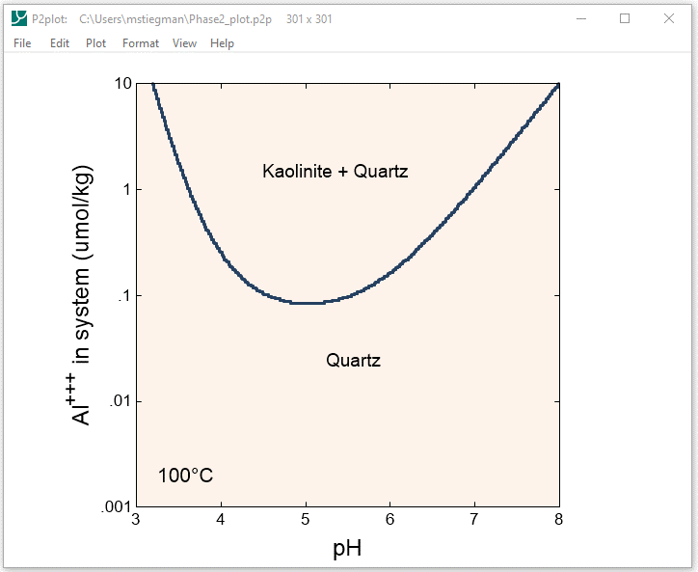
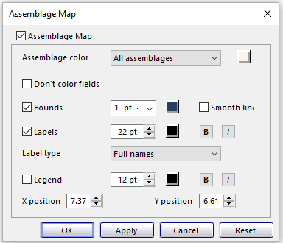
Format → Assemblage Map…
An Assemblage Map shows the fields where a mineral exists in the calculations from Phase2

