Slide 2
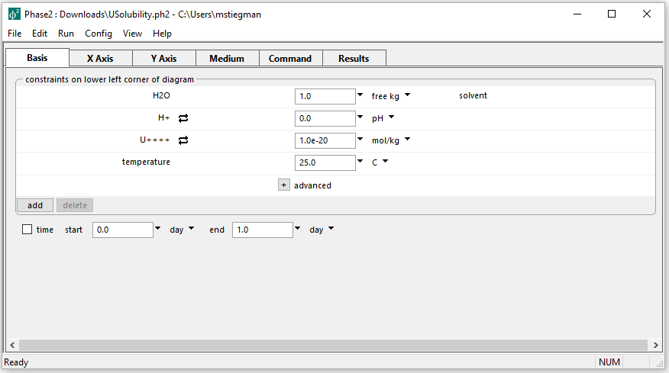
Initial parameters for Mineral Solubility diagram
Initial U(IV) concentration is low
Goal is to define the solubility of Uraninite in terms of U(IV) in the system and pH

Slide 3
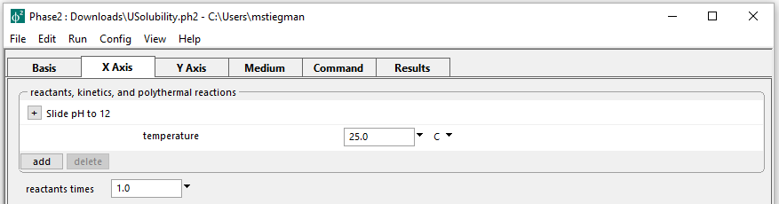
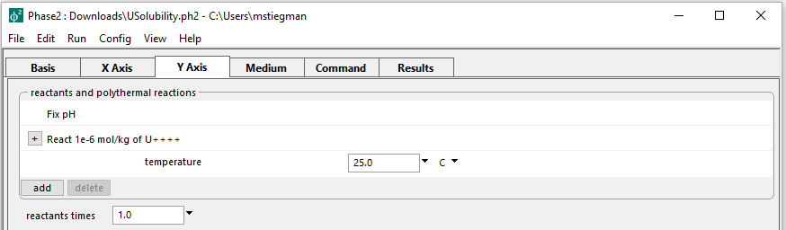
Setting up the staging and scanning paths
On the X axis, pH is set to slide from the initial value to 12
pH is fixed while adding U(IV) to the system on the Y axis

Slide 4
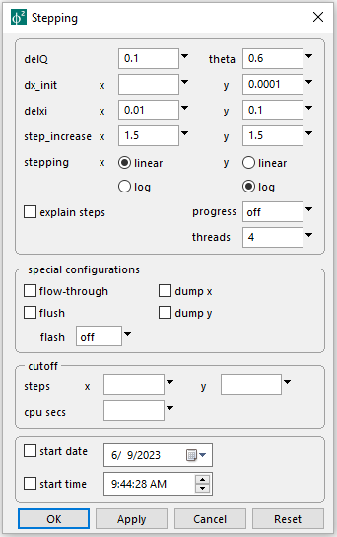
Config → Stepping
Set the Y axis initial step size to 0.0001
Set the Y axis to logarithmic stepping
Run → Go → Plot Results

Slide 5
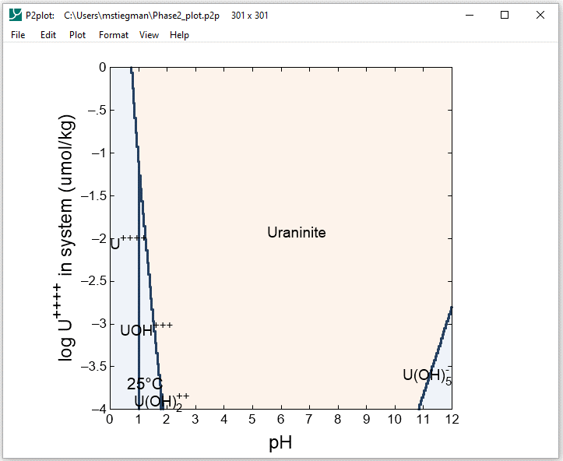
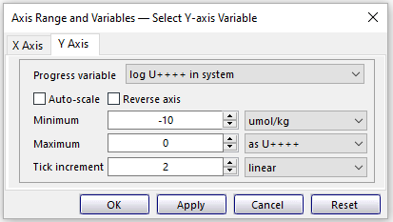
Format → Axis Range and Variables
Set Y axis variable to log U++++ in system and choose linear scale

Slide 6
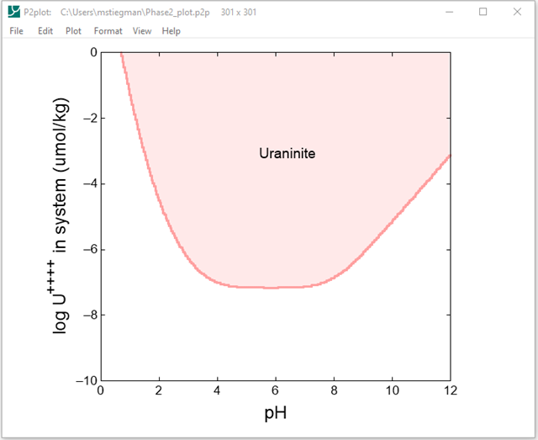
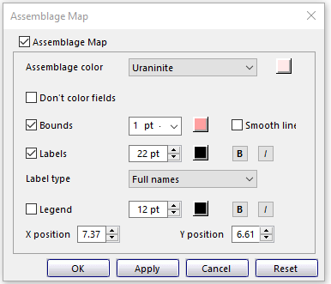
Format → Assemblage Map…

Slide 7
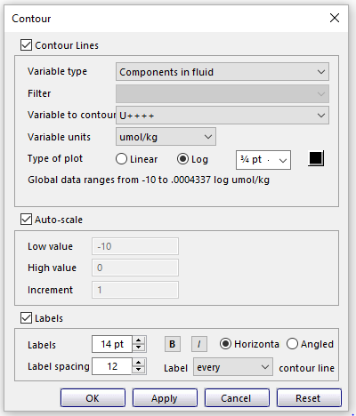
Format → Contour…
Set Variable type to Components in fluid
Set Variable to contour to U++++
Set Type of plot to Log

