Slide 1
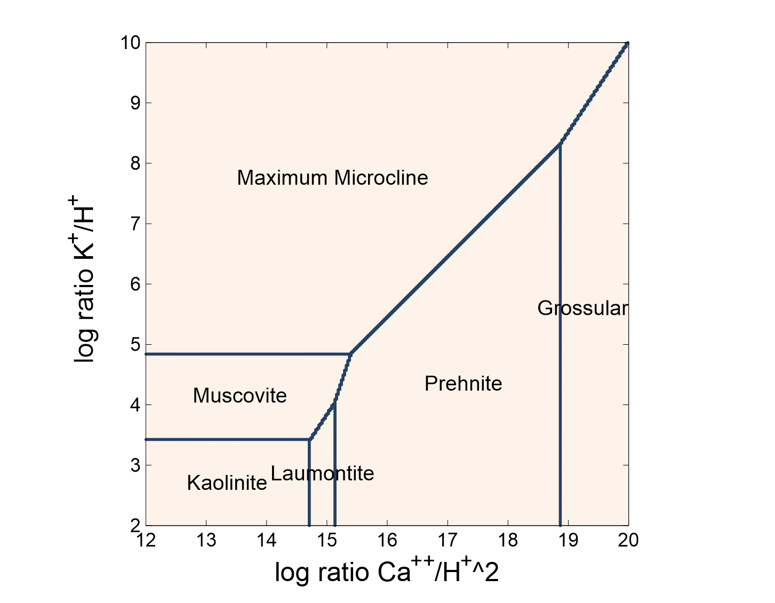

Slide 2
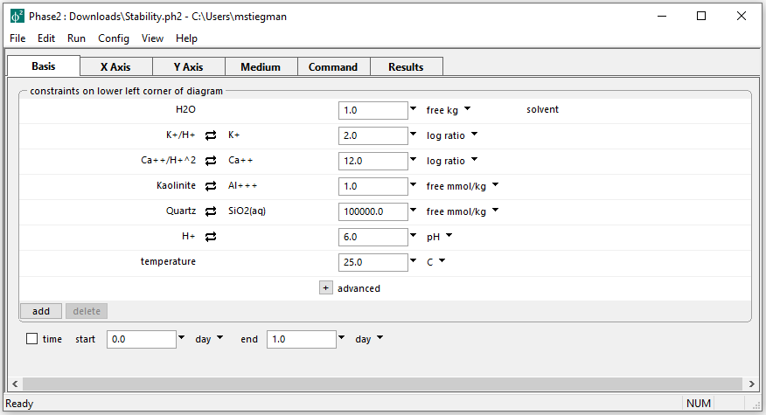
Initial parameters for Mineral Stability diagram
The goal is to create a diagram of mineral stability based on the Ca⁺⁺/H⁺^2 ratio and K⁺/H⁺ ratio

Slide 3
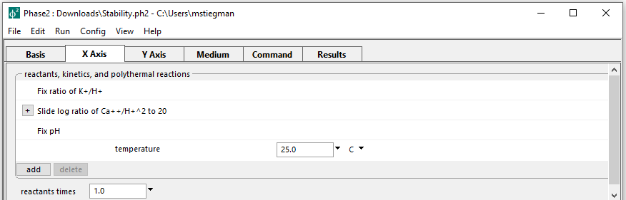
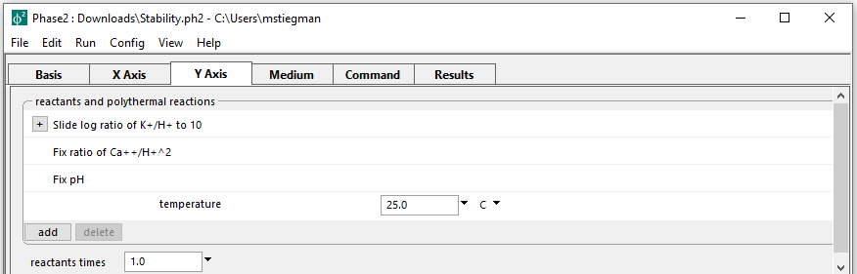
Setting up the staging and scanning paths
On the X axis, log ratio of Ca⁺⁺/H⁺^2 is set to slide to 20
On the Y axis, log ratio of K⁺/H⁺ is set to slide to 20

Slide 4
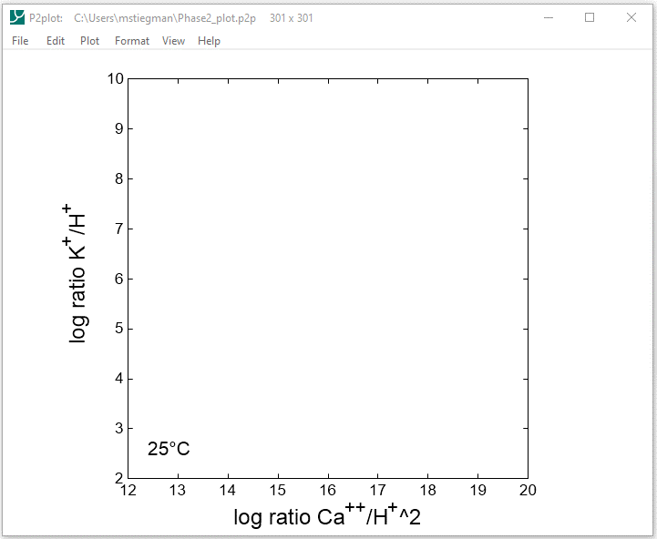
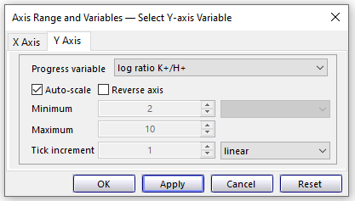
Format → Axis Range and Variables

Slide 5
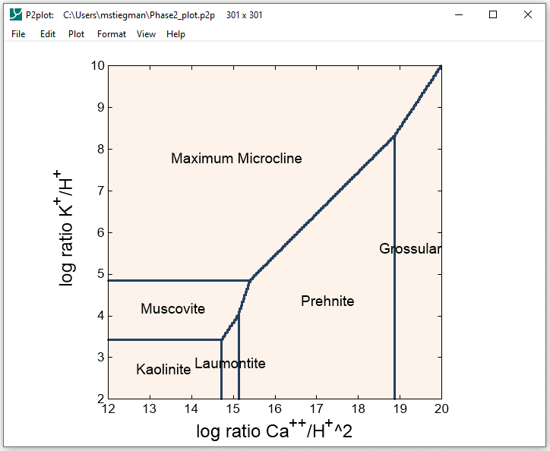
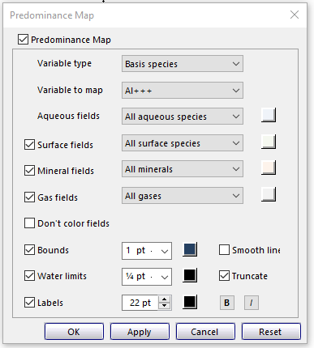
Format → Predominance Map…
Select Basis species for Variable type and Al+++ for Variable to map

