Slide 1
0
++
++
+
FeOH
FeCl
Fe(OH)
–
15
2
)
–
30
Fe(OH)
(ppd)
g
3
(
2
-
O
Fe(OH)
f
4
g
–
45
o
l
Fe
++
–
60
–
75
+
FeOH
Fe(OH)
25°C
2
–
90
2
4
6
8
10
12
pH

Slide 2
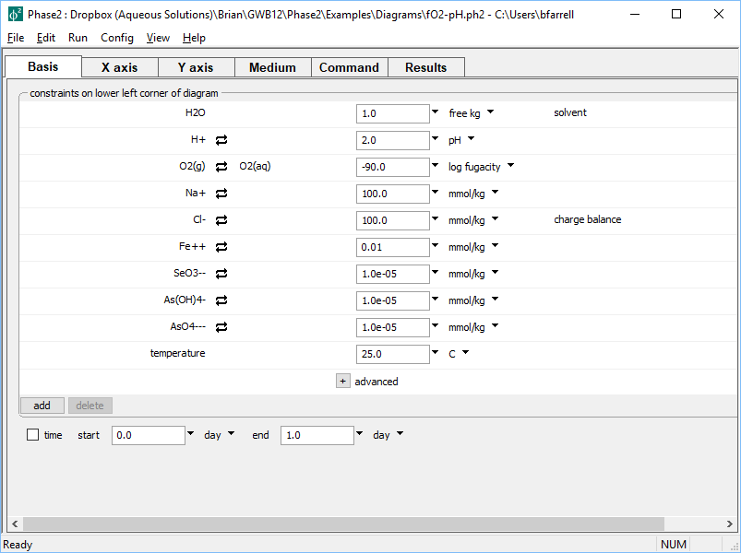
Set composition of lower left corner of diagram on the Basis pane
Acidic, reducing fluid
Choose from variety of units, including concentration

Slide 3
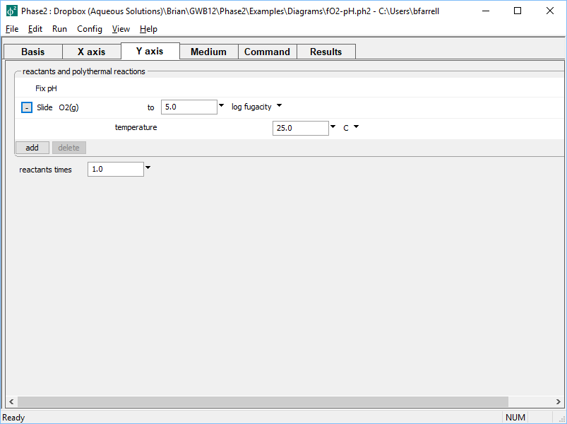
On the Y axis pane, set up a reaction path to stage the left edge of the diagram
Slide log O₂(g) fugacity;
pH is automatically fixed after our x axis setting

Slide 4
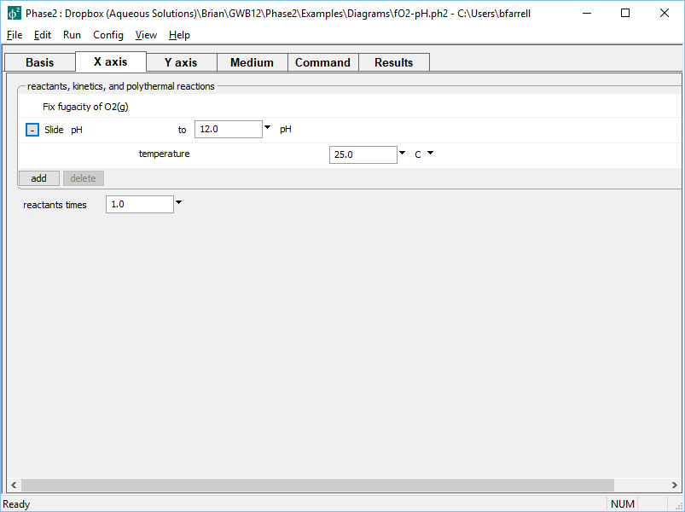
On the X axis pane, set a reaction path to scan across the diagram from left to right
Slide pH;
f O₂(g) is automatically fixed after our y axis setting

Slide 5
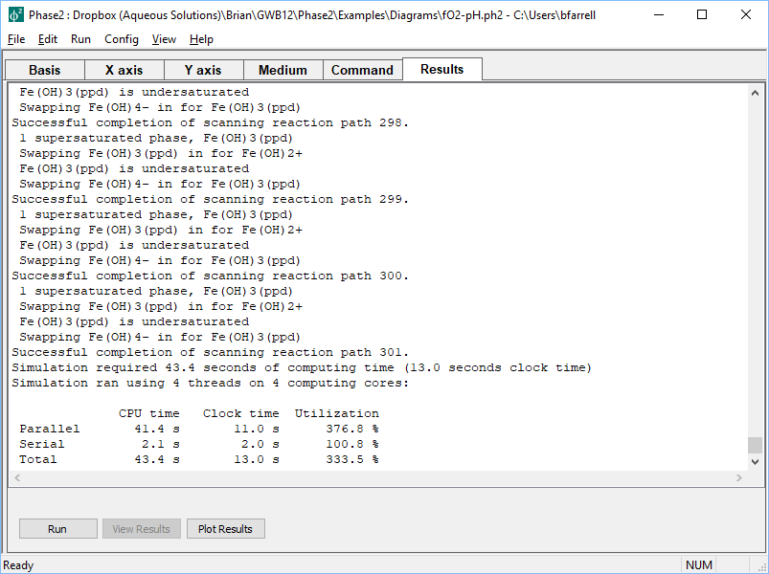
Run the calculation from the Results pane
Click to open results in P2plot

Slide 6
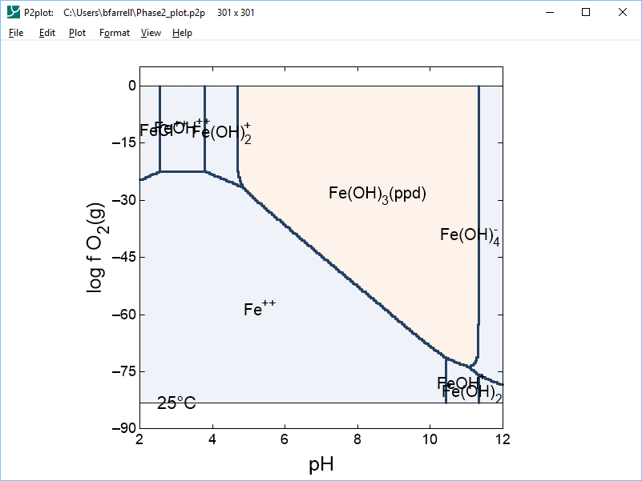
Plot your results in P2plot
Double-click to change basis entry or element to plot
Double-click to adjust axes

