Slide 2
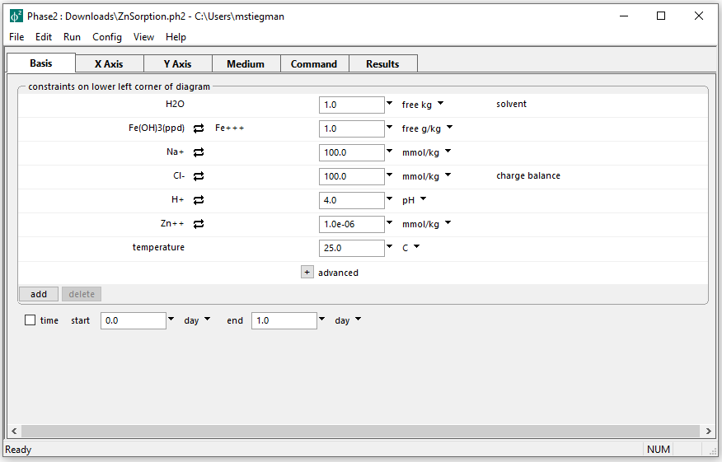
Initial parameters for Surface Complexation diagram
The Fe+++/Fe++ redox couple is disabled
This allows for the use of Fe+++ as a basis entry

Slide 3
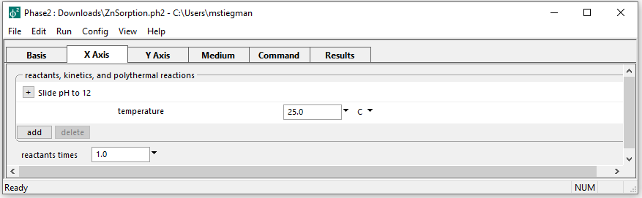
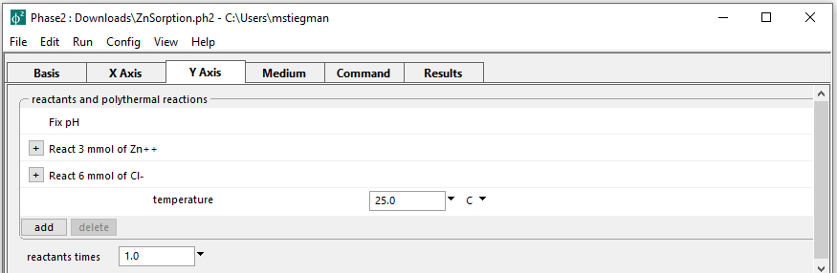
Setting up the staging and scanning paths
On the X axis, pH is set to slide from the initial value to 12
pH is fixed while adding Zn++ and Cl- to the system on the Y axis

Slide 4
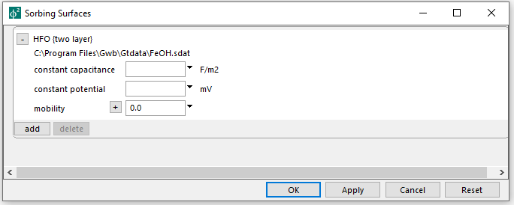
Config → Sorbing Surfaces…
Dataset for ion complexation with hydrous ferric oxide is loaded

Slide 5
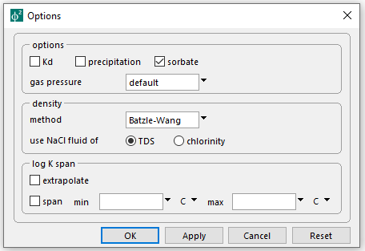
Config → Options…
Unchecking precipitation prevents new mineral formation
Sorbate specifies the starting Zn in the basis includes dissolved and sorbed masses
Run → Go → Plot Results

Slide 6
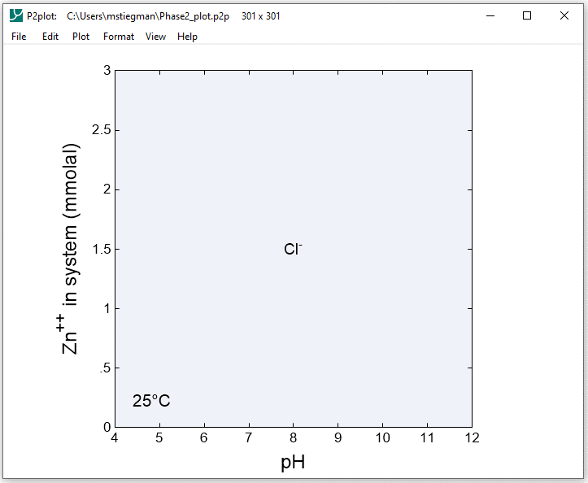
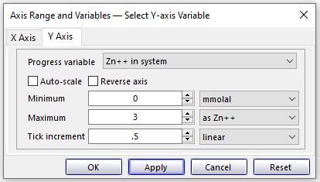
Format → Axis Range and Variables
Format → Predominance Map → Variable to Map → Zn++

Slide 7
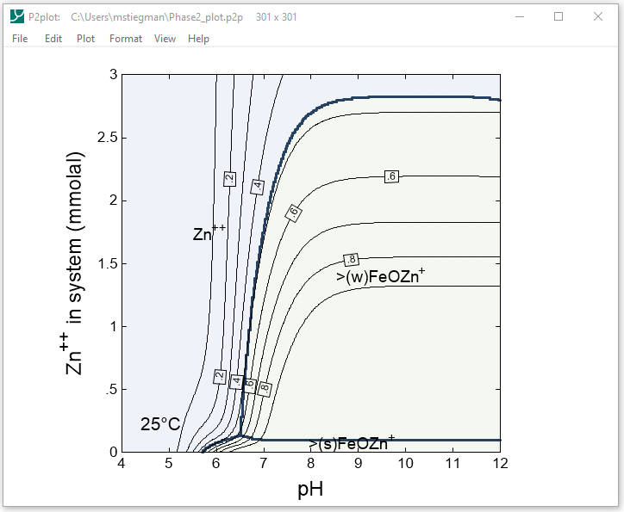
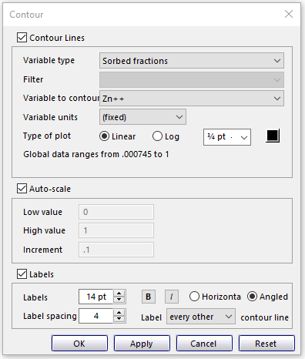
Format → Contour…
Select the above options and Linear plot type

