Slide 2
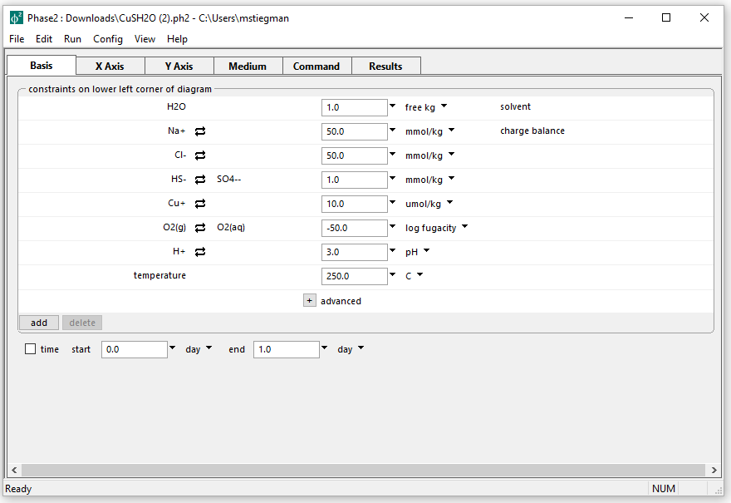
Starting basis for True Predominance diagram
Background electrolyte is 50 mmol/kg NaCl, includes S & Cu

Slide 3
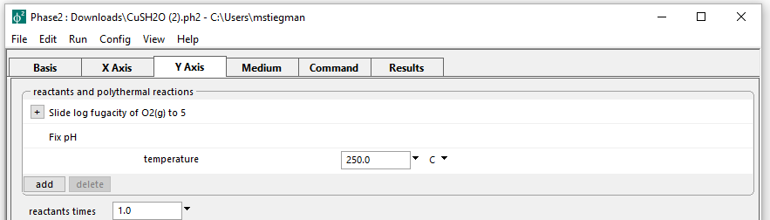
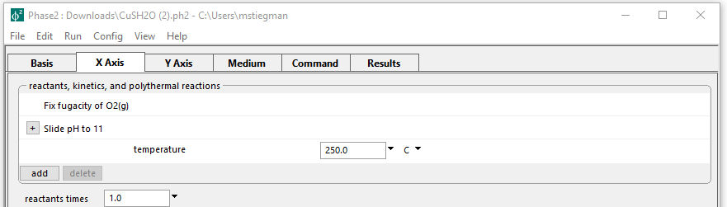
On Y axis, slide log fO₂
On X axis, slide pH
Run → Go → Plot Results

Slide 4
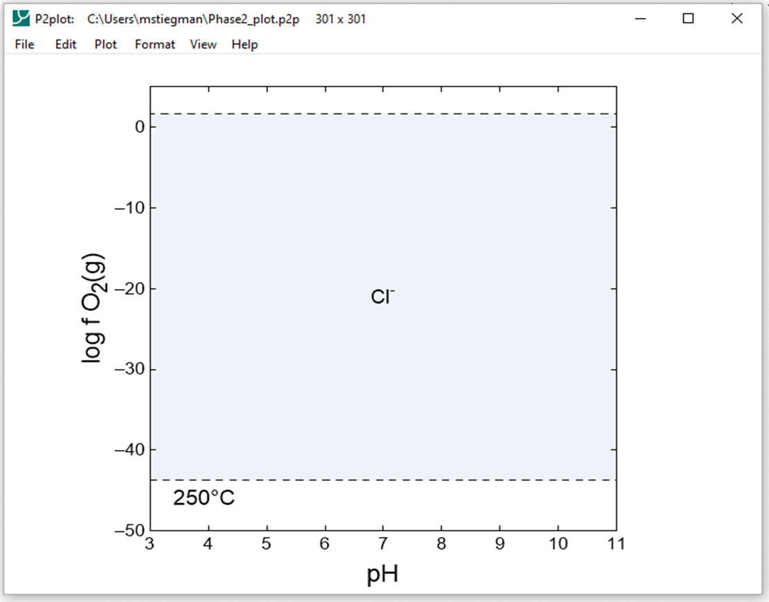
Resulting diagram
The diagram currently displays the Cl- species, want to display Cu+ species

Slide 5
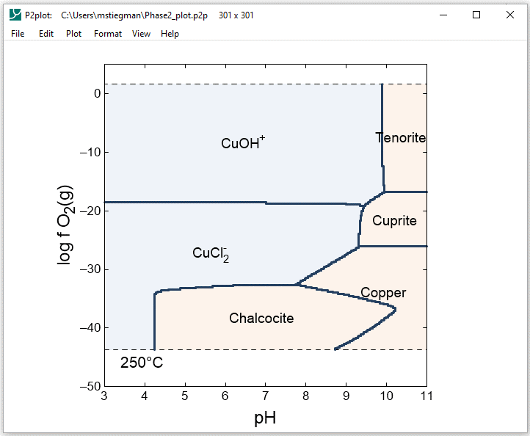
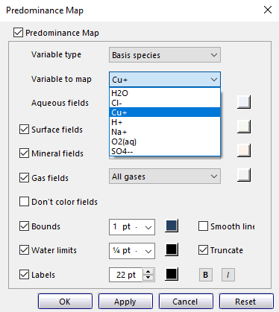
“True” predominance diagram
Set species of interest by: Format → Predominance Map → Variable to map
The upper and lower stability limits can be ignored by unchecking Truncate

