Slide 2
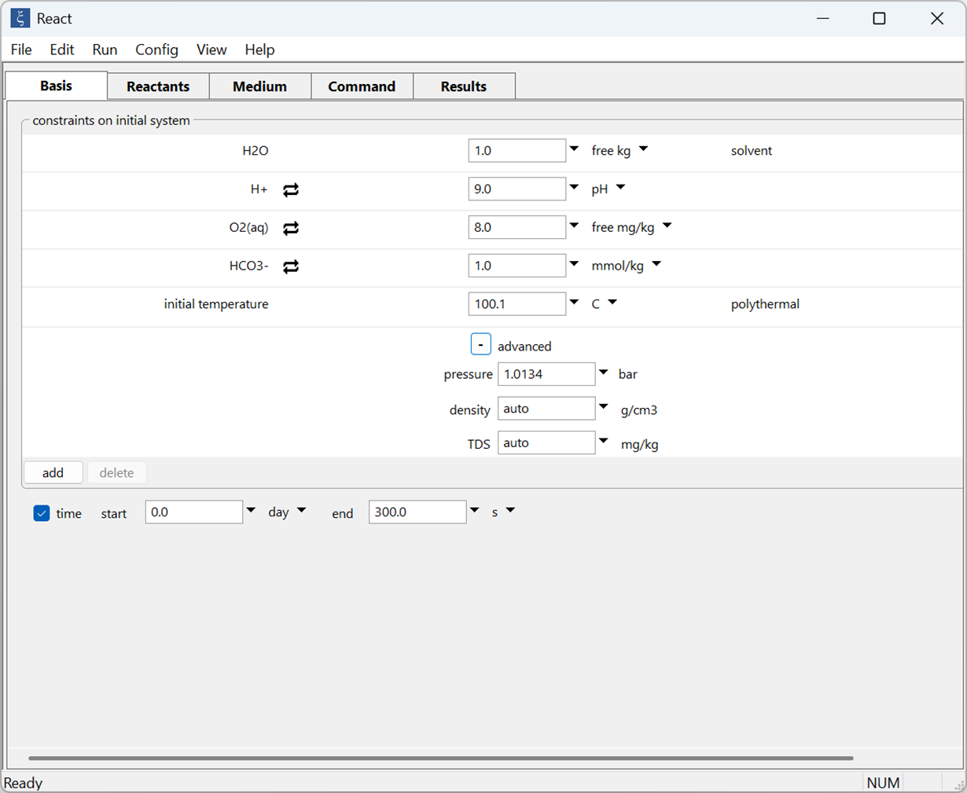
Select the “+” button to set confining pressure or leave on “auto” to follow the pressure profile specified in the thermodynamic dataset
Set initial fluid composition and constraints in the Basis pane

Slide 3
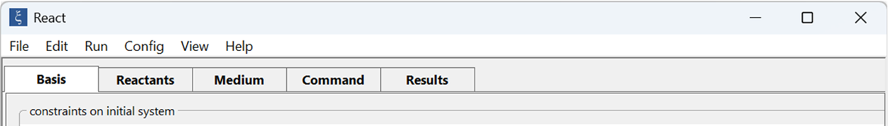
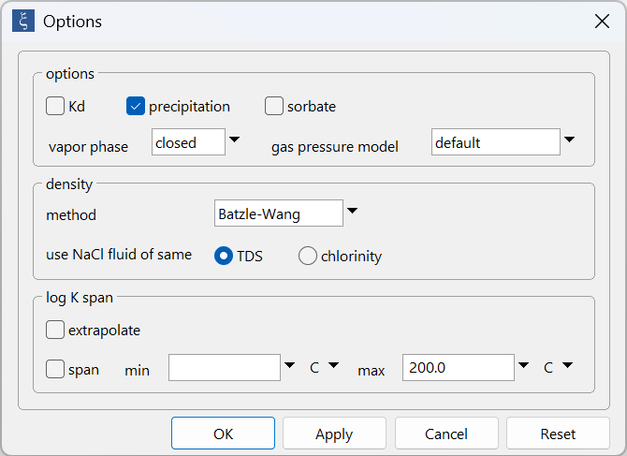
Config →
Options…
Set vapor phase to form in “closed” system.

Slide 4
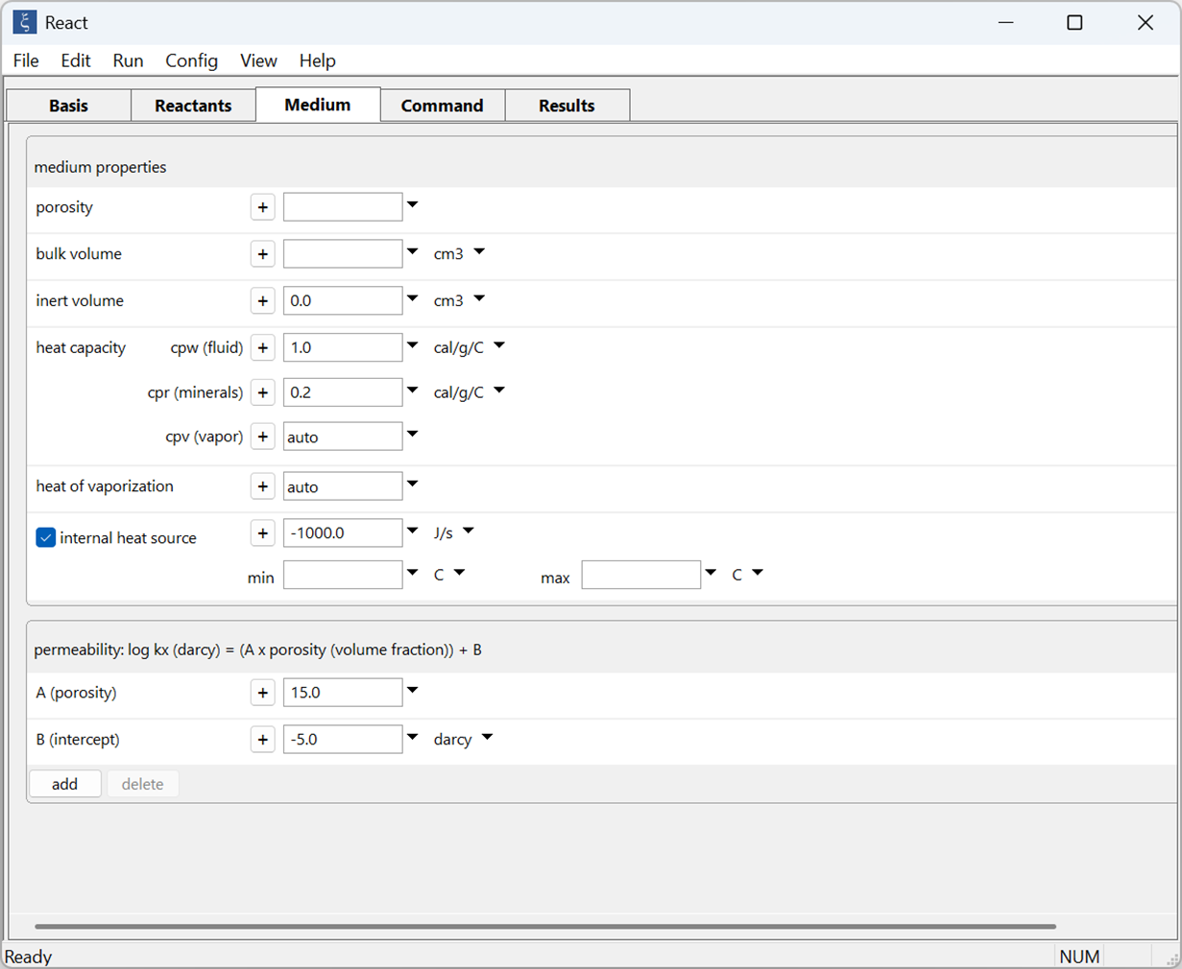
Set polythermal system on the Medium pane
Set a negative internal heat source to remove heat from the system

Slide 5
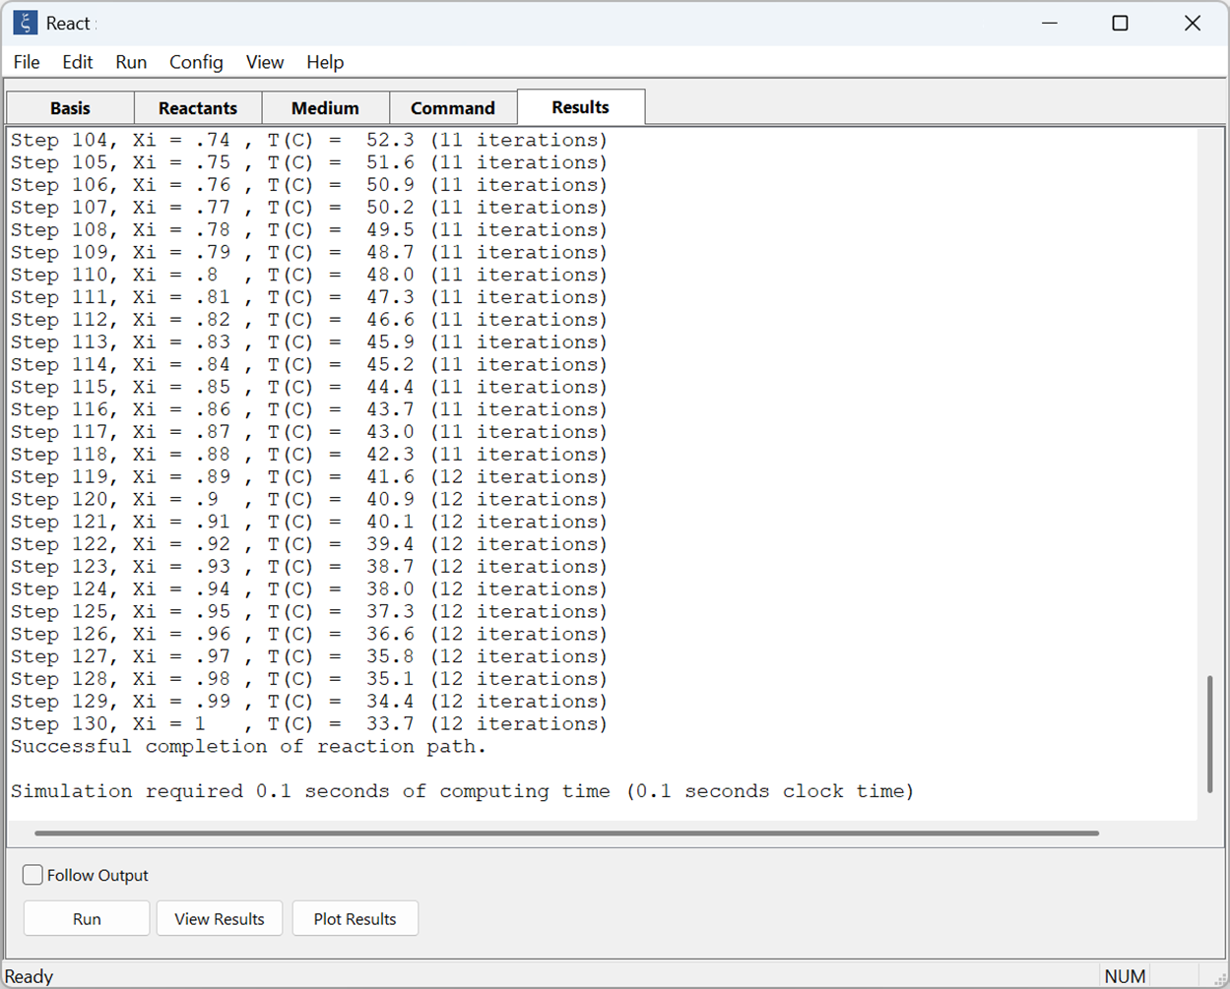
On the Results pane, click Run to execute the calculation.
Open results with Gtplot

Slide 6
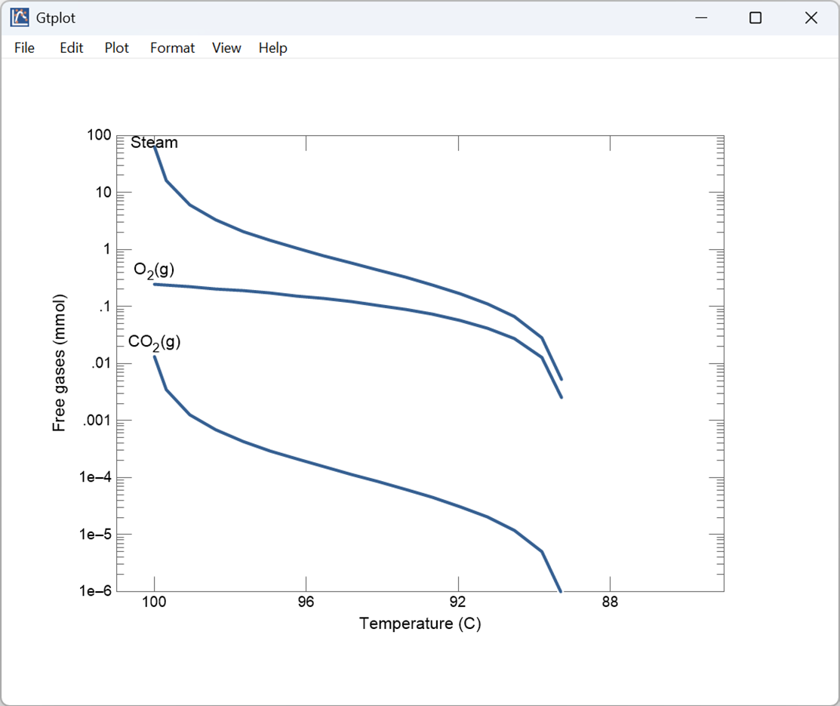
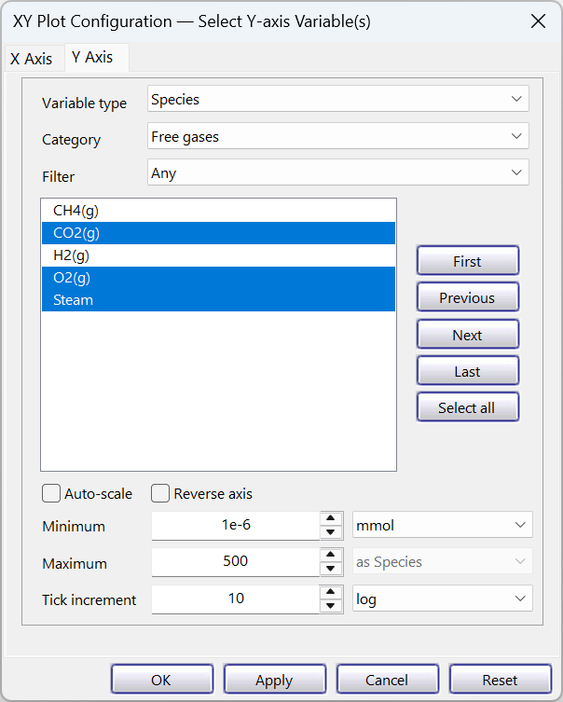
On the Y Axis, select “Species” for the “Variable type” and “Free gases” for Category
Select gas species to plot
Adjust plot variables
On the X Axis, set “Variable type” to “System” and plot variable “Temperature”

