Slide 1
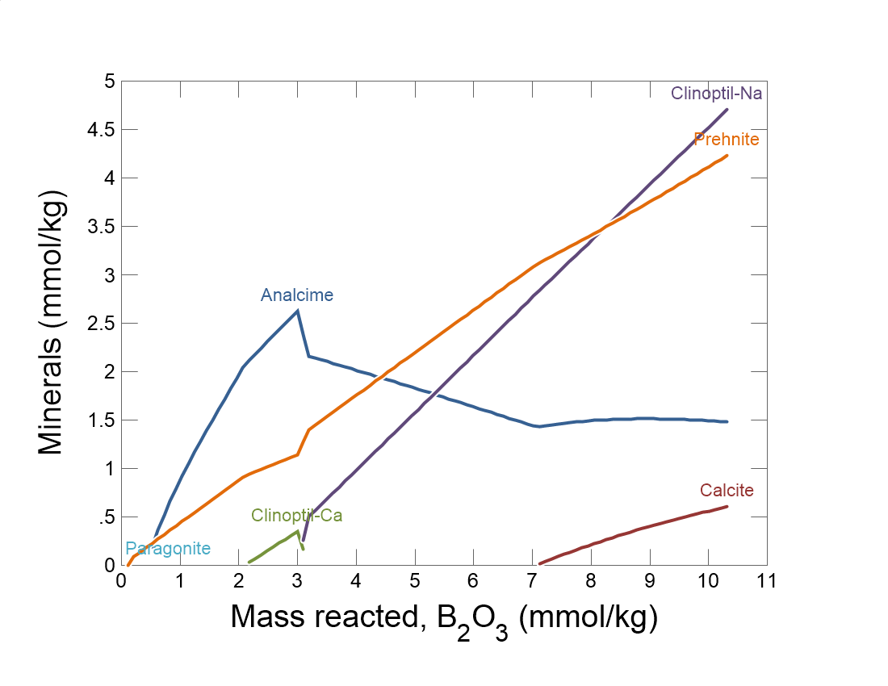

Slide 2
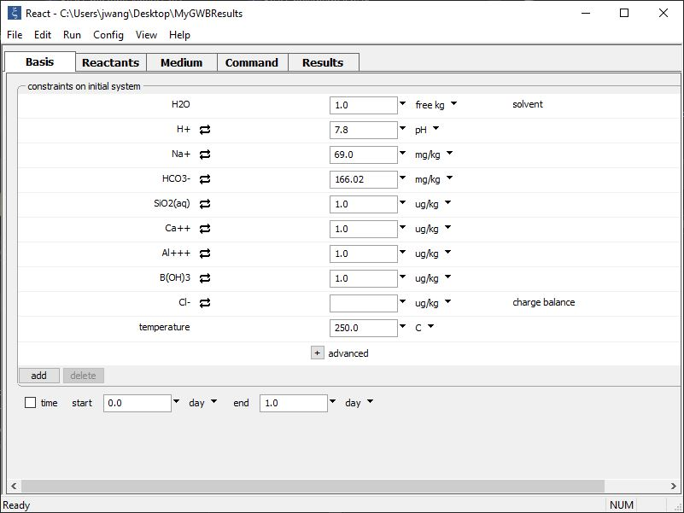
Set the composition of the initial fluid on the Basis pane.
pH 7.8 Na-HCO₃ water
250 °C

Slide 3
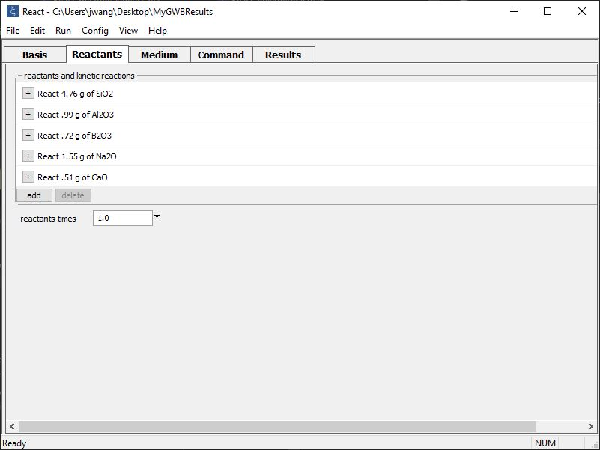
Set the oxide composition of the glass on the Reactants pane.
In our model, the glass dissolves completely into solution, then some secondary minerals precipitate as an altered layer.
add → Simple → Oxide… SiO₂
The oxides alter the composition of the system, but they have no thermodynamic stability.

Slide 4
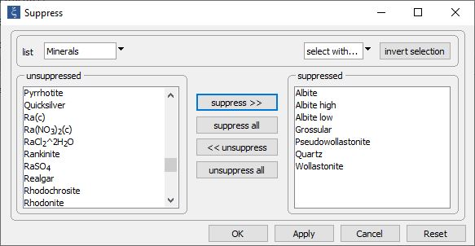
Config → Suppress…
Suppress minerals that are unlikely to form. Here, we suppress framework silicates, such as feldspars and quartz.
Run → Go
begins the calculation

Slide 5
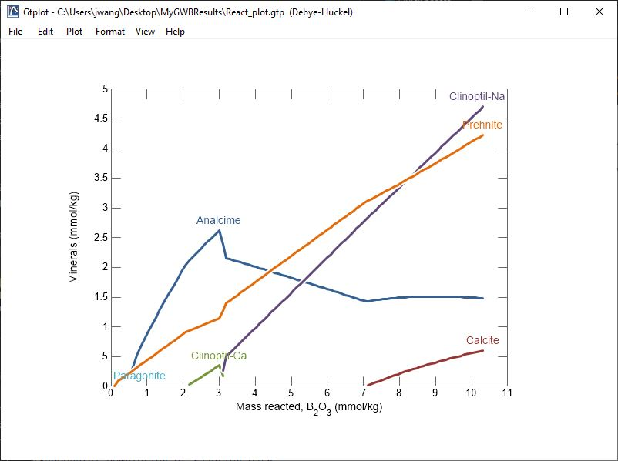
We assume that boron behaves as a conservative element, so its concentration in solution provides a measure of the amount of glass dissolved.
As the glass dissolves, secondary minerals form an altered layer.

