Slide 2
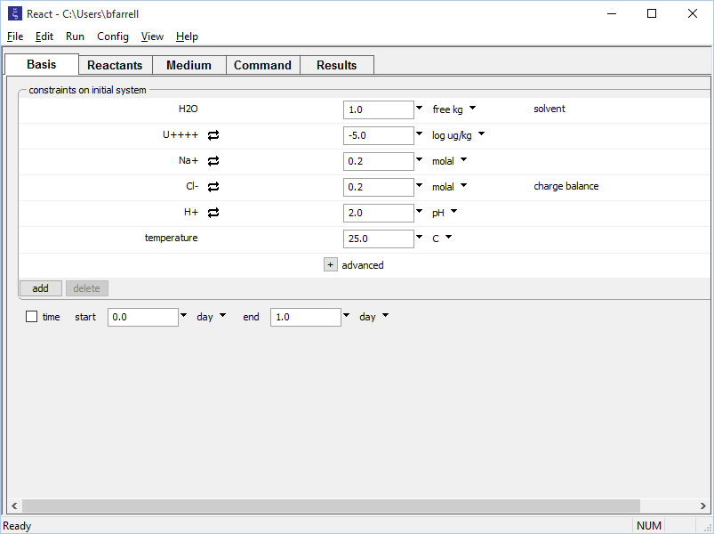
Set the initial fluid composition on the Basis pane.
pH 2, Na-Cl fluid with U
Click to add components to the fluid.

Slide 3
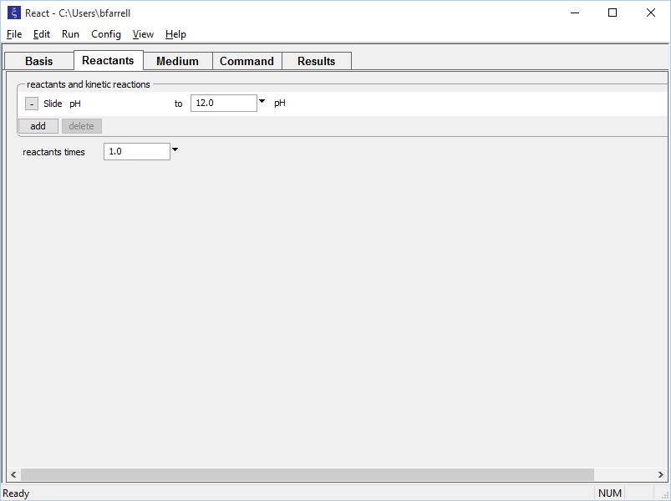
Set up a sliding activity path on the Reactants pane.
pH will be adjusted from initial value, 2, to the target value of 12 set here
add → Sliding → pH

Slide 4
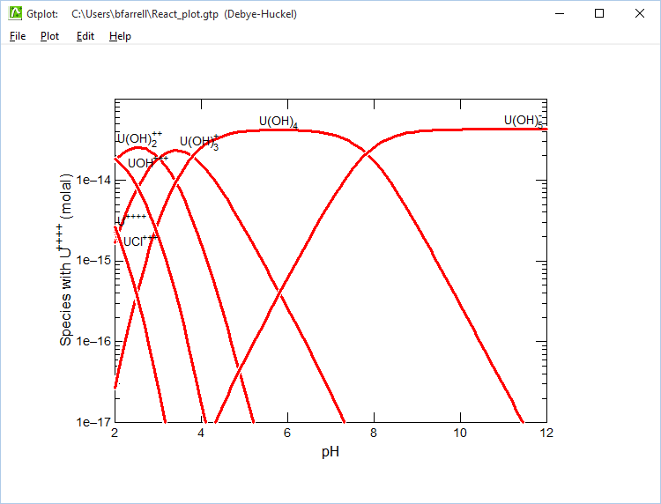
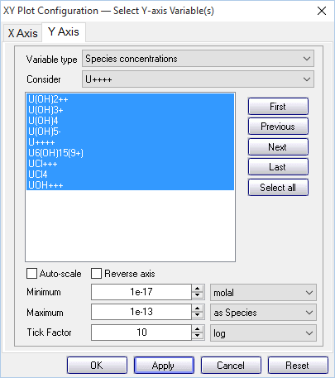
U(IV) is present as a free ion and as complexes with OH⁻ and Cl⁻
Choose “Species concentrations”, then display uranium species only by selecting “U++++” for “Consider”

