Slide 1
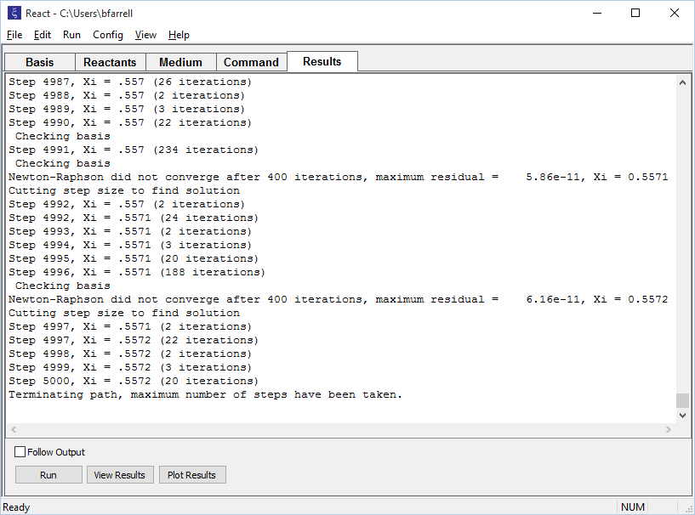
Set a cutoff

Slide 2
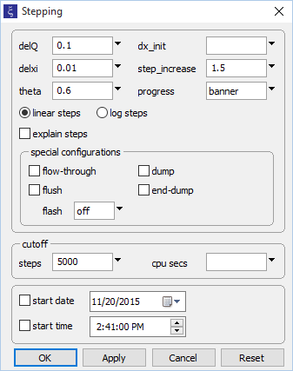
You can set a predetermined limit to the number of steps React, Phase2, X1t, or X2t will take to solve a problem
Go to Config → Stepping to implement a cutoff.
Stop the simulation if it reaches 5000 steps

Slide 3
Simulation stopped after reaching 5000 step cutoff

Slide 4
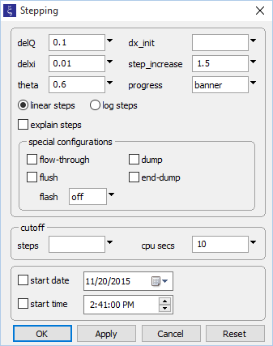
You can also limit the computing time allowed by React, Phase2, X1t, or X2t
Go to Config → Stepping to implement a cutoff.
Stop the simulation if it takes more than 10 seconds

Slide 5
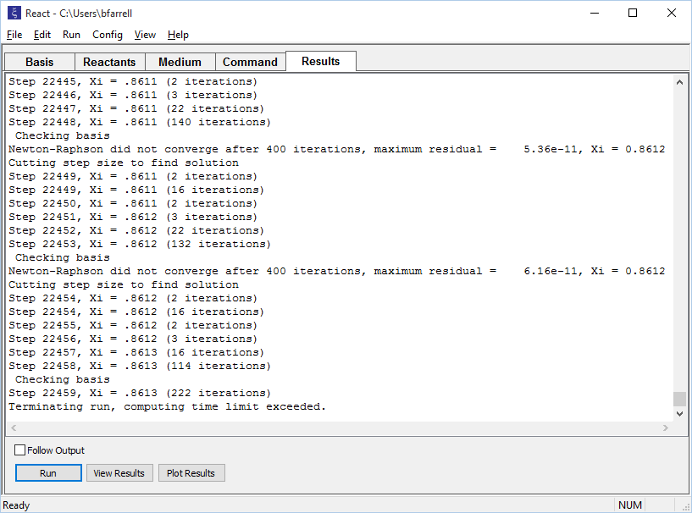
Simulation stopped after reaching 10 seconds

