Slide 1
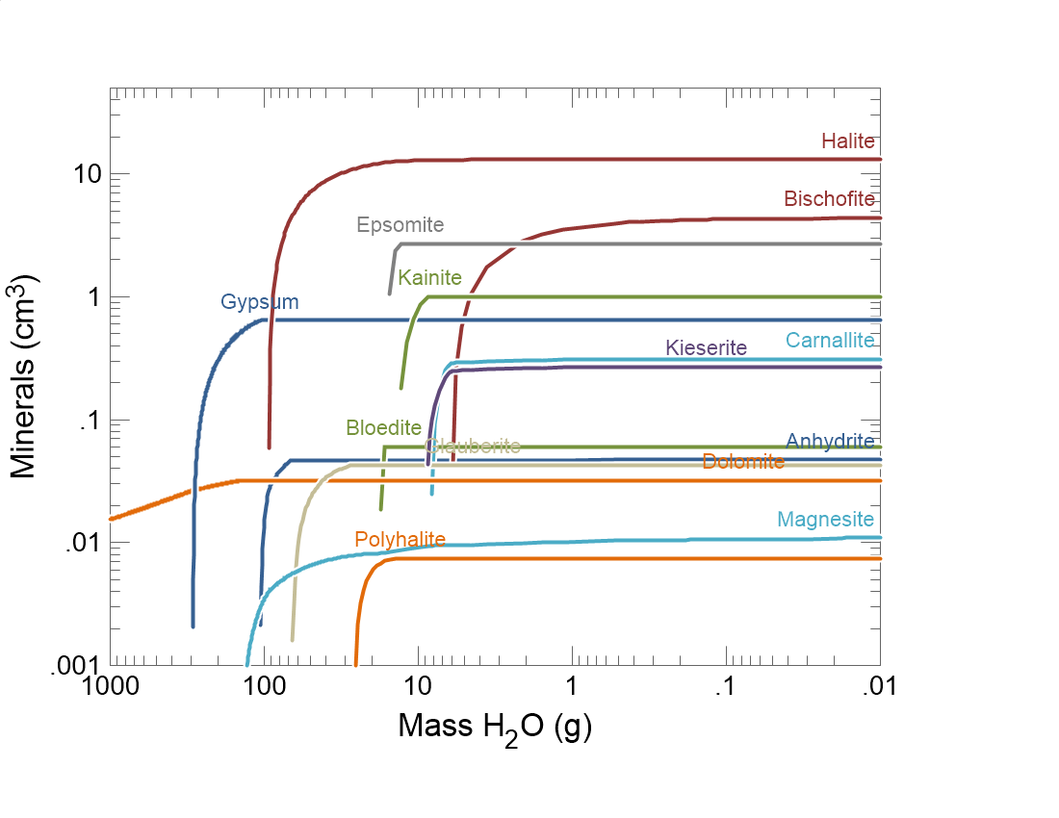

Slide 2
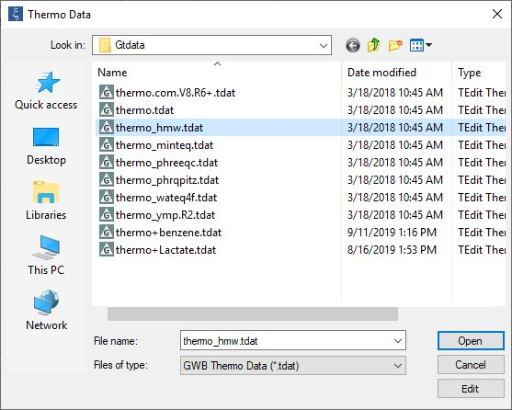
When dealing with concentrated fluids, it’s a good idea to use a thermo dataset utilizing the Pitzer equations.
File → Open →
Thermo Data…
thermo_hmw.tdat is the Harvie-Moller-Weare formalism of the Pitzer equations.

Slide 3
Set the composition of the initial fluid on the Basis pane.
1 kg solvent water plus solutes define seawater
Initial fluid is equilibrated with CO₂ in the atmosphere

Slide 4
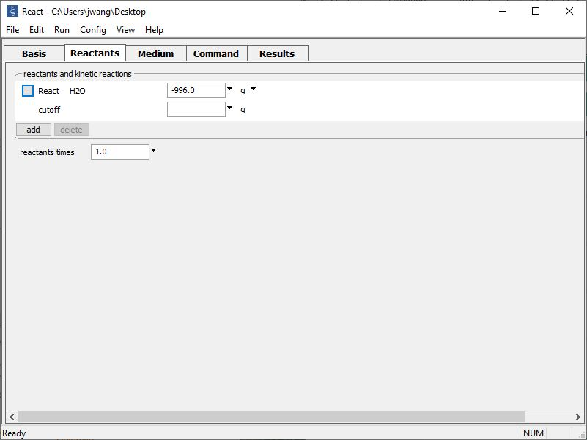
Set up a titration path on the Reactants pane.
Simulate evaporation by removing solvent water from the system (react a negative mass)
add → Simple → Aqueous… H₂O

Slide 5
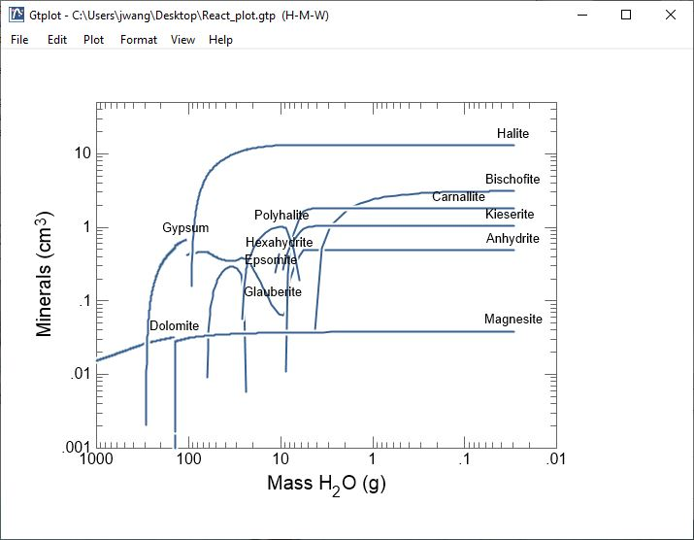
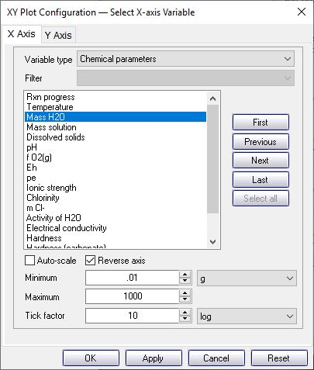
Minerals precipitate and dissolve during the evaporation of seawater.

Slide 6
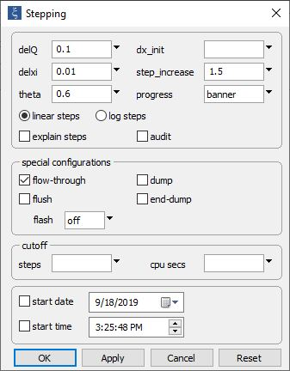
Repeat assuming fractionation of the precipitated minerals
Config →
Stepping…
Flow-through option doesn’t allow precipitated minerals to dissolve back into the fluid

Slide 7
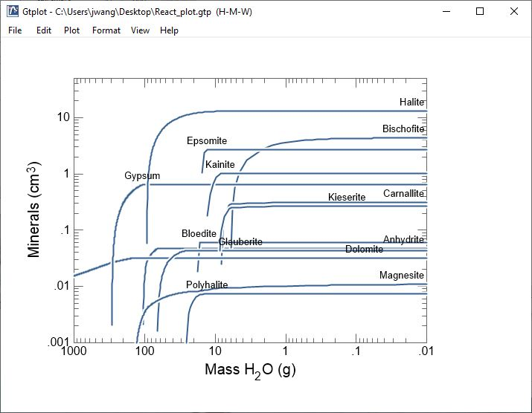
Minerals that precipitate are not allowed to dissolve back into the evaporating seawater.

