Slide 2
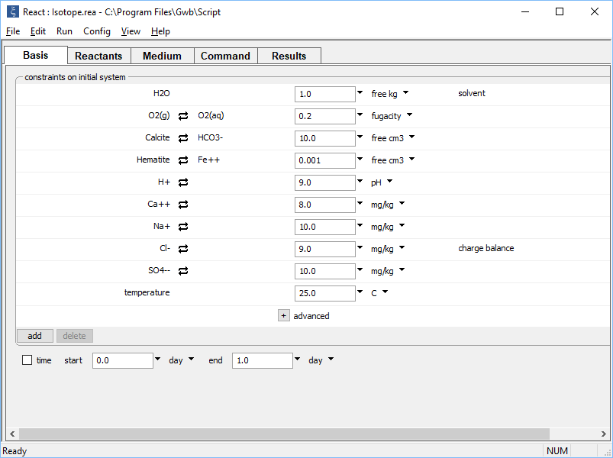
Set the chemical composition of initial system on the Basis pane.
Oxygenated fluid in equilibrium with calcite and hematite

Slide 3
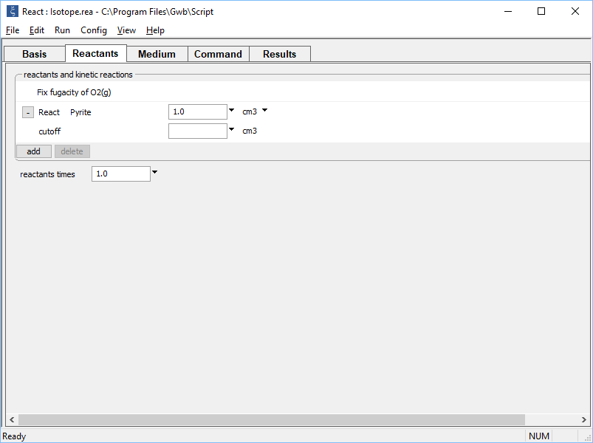
Set up a titration path on the Reactants pane.
Pyrite addition will cause calcite to dissolve and gypsum to precipitate

Slide 4
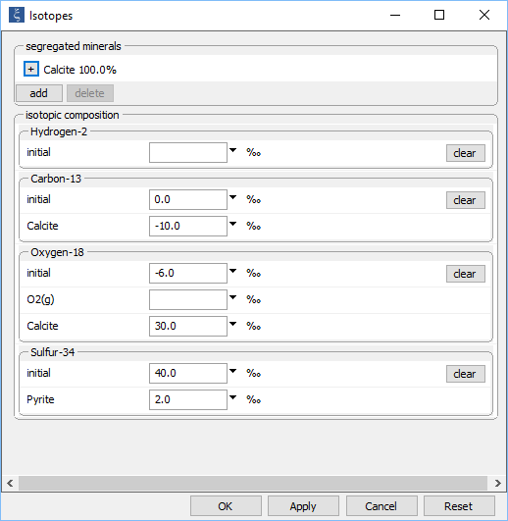
Config → Isotopes…
Calcite is in chemical equilibrium with water, but segregated isotopically
Specify the isotopic composition of the initial fluid, reactant mineral pyrite, and calcite

Slide 5
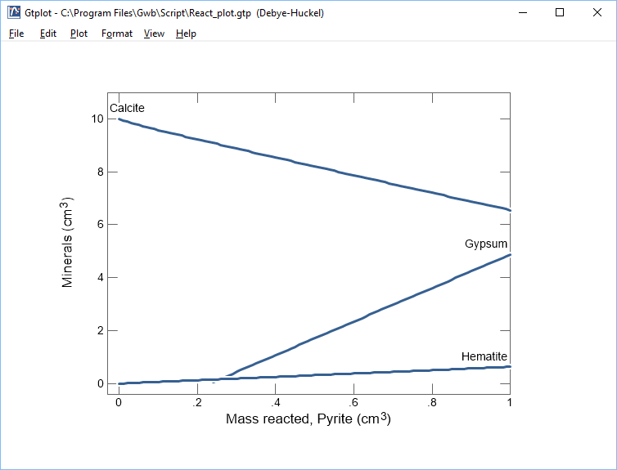
Pyrite addition causes calcite to dissolve and hematite and gypsum to precipitate

Slide 6
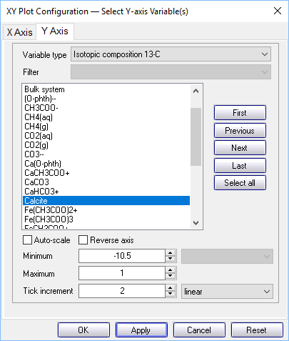
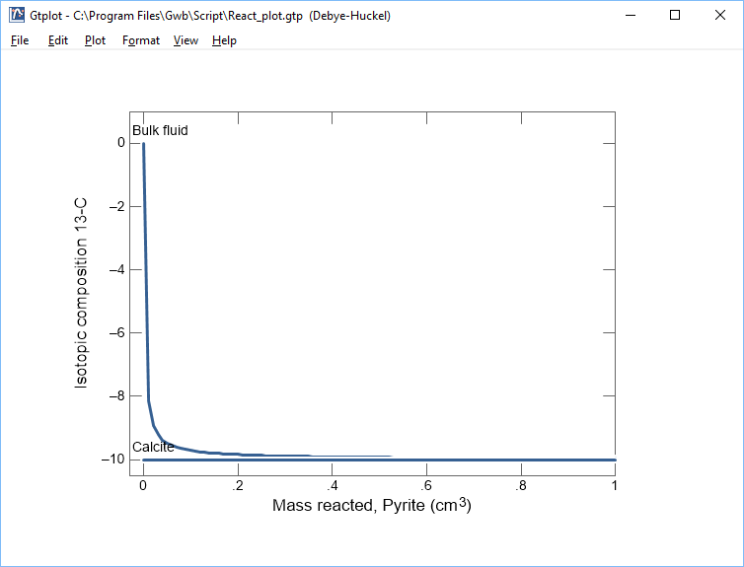
Fluid’s ¹³C composition varies from initial value toward that of the dissolving calcite

Slide 7
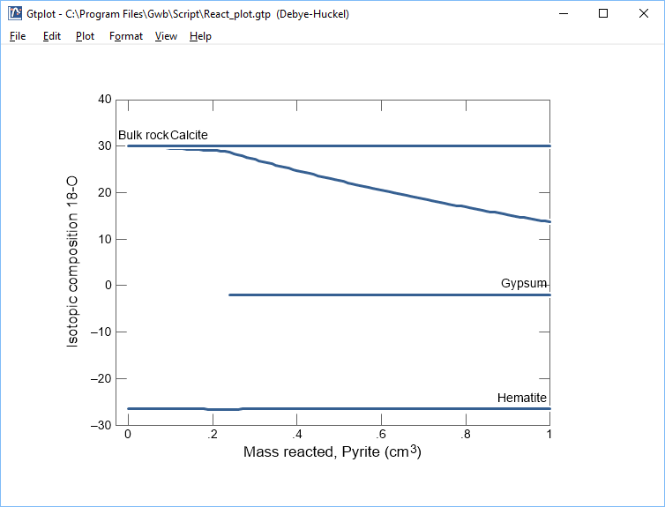
¹⁸O of bulk rock shifts from calcite’s value towards gypsum’s, reflecting change in mineral abundances
¹⁸O composition of gypsum reflects influence of calcite composition

Slide 8
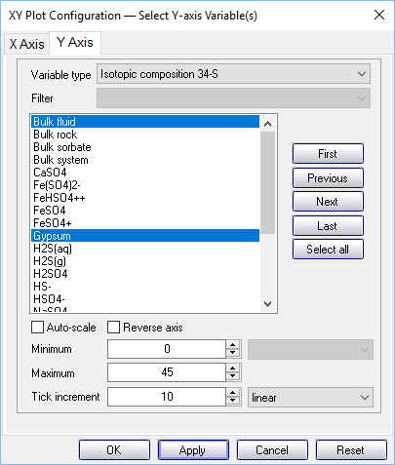
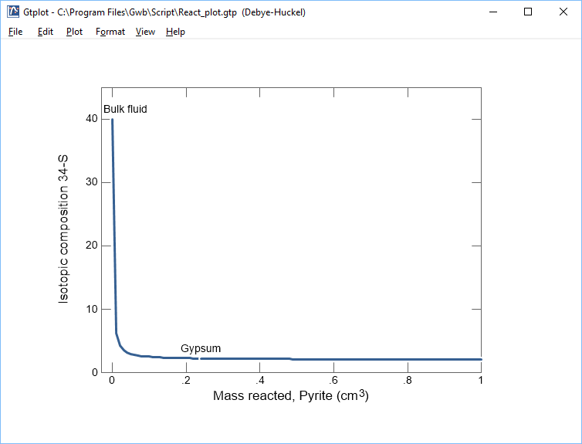
Fluid’s ³⁴S value decreases toward the pyrite composition (+2 ‰)
Precipitating gypsum also influenced by pyrite composition

