Slide 1
Chain together kinetic reactions

Slide 2
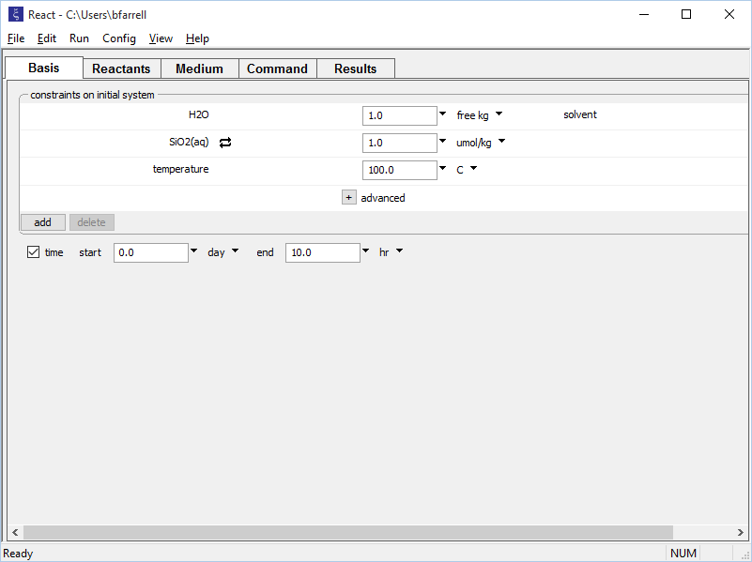
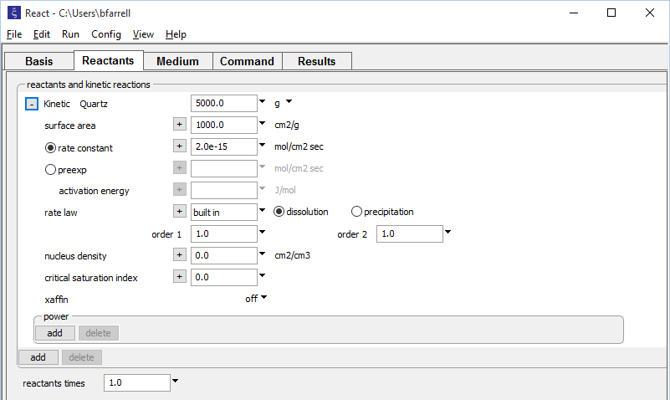
Kinetic reaction paths can be chained together using the improved pickup command.
Rate law for Quartz dissolution
Initial mass, rate constant
Run → Go traces the path

Slide 3

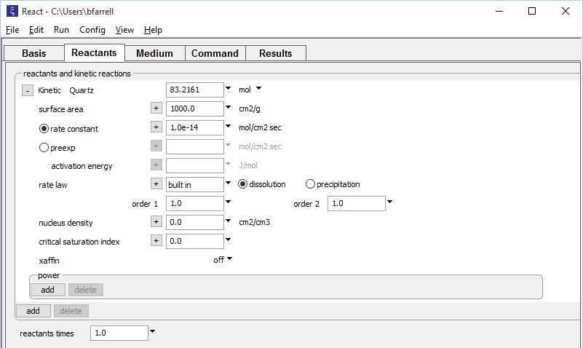
Run → Pickup → System → Entire resumes from the end of the last run
SiO₂ concentration retained from endpoint
Run starts at previous endpoint
Quartz mass retained from endpoint
User can increase rate constant to reflect reaction promoter
Run → Go traces the second path

Slide 4
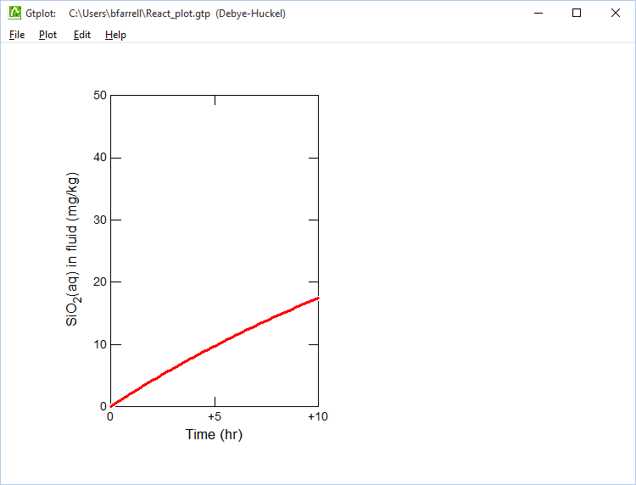
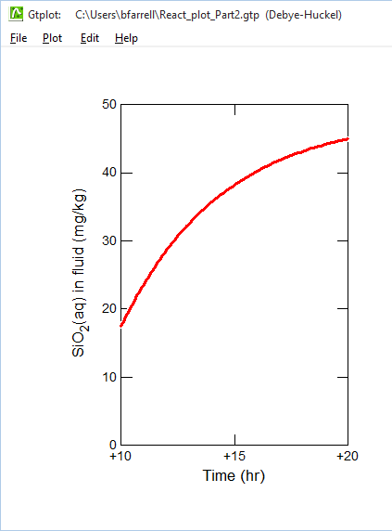
Endpoint concentration used as starting point for new calculation

Slide 5
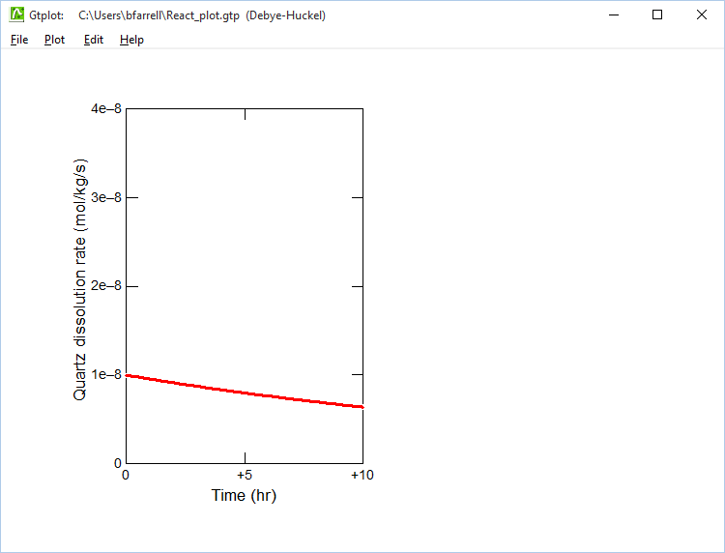
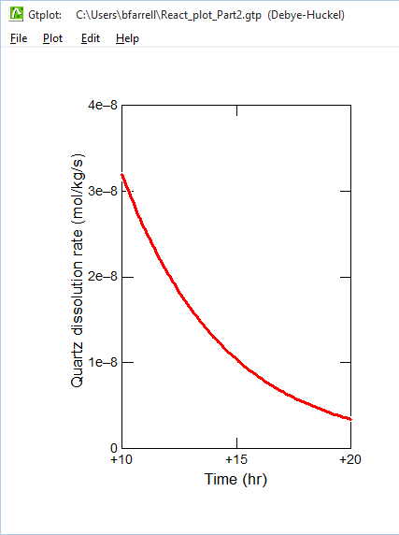
The promoter added after 10 hours increases the rate at which Quartz dissolves into the fluid.

