Slide 1
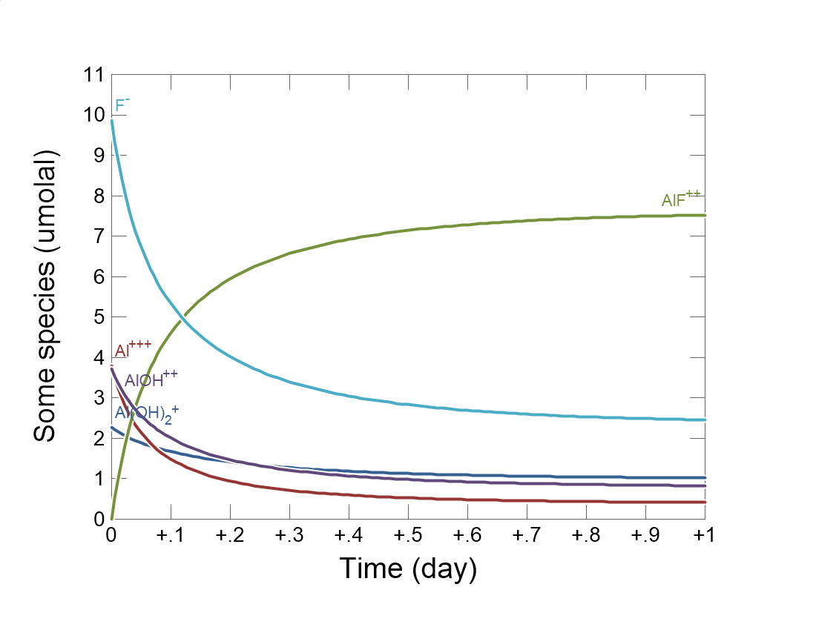

Slide 2
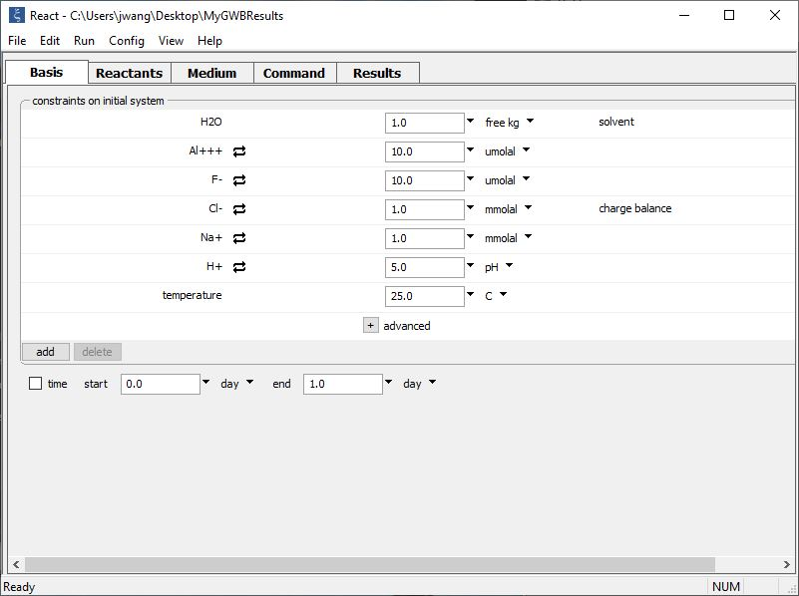
Set the composition of the initial fluid on the Basis pane.
Bulk composition of initial fluid
Set the simulation’s duration

Slide 3
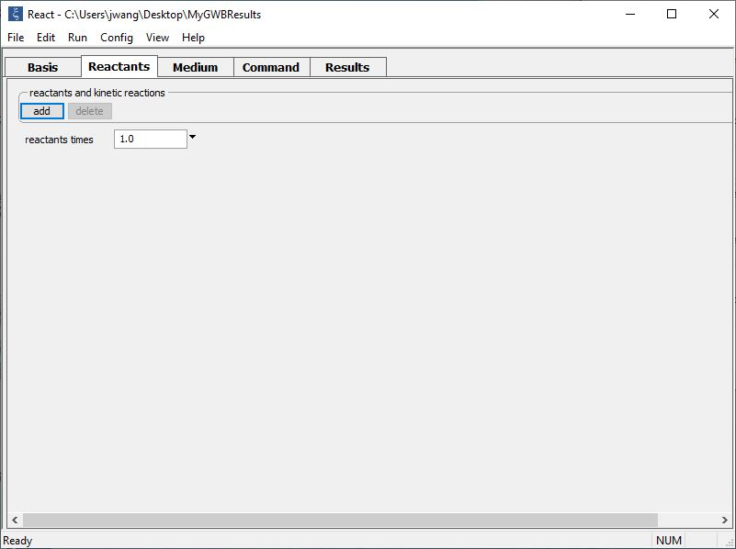
Set up a kinetic rate law on the Reactants pane.
add → Kinetic → Aqueous complex… AlF++

Slide 4
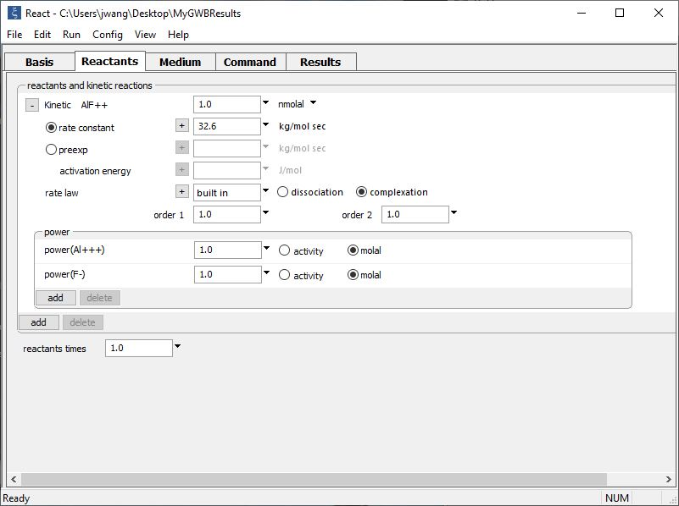
Supply kinetic parameters
Initial concentration of the complex
Rate constant
Al⁺⁺⁺ and F⁻ ions promote the rate of reaction

Slide 5
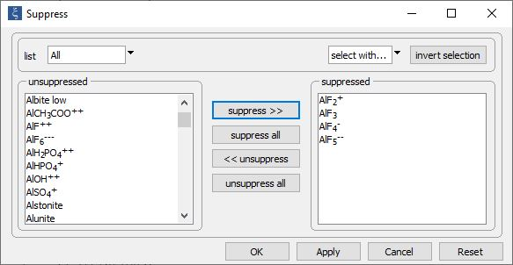
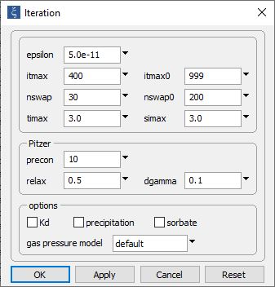
We’ll simplify this example by ignoring precipitation and a few complexes of aluminum and fluoride.
Config → Iteration…
Config → Suppress…
Uncheck to disable precipitation

Slide 6
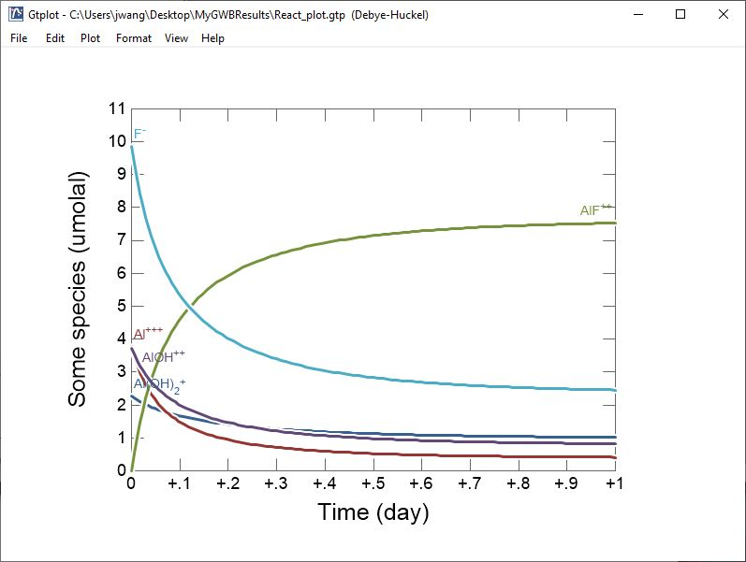
Al⁺⁺⁺ and F⁻ react to form AlF⁺⁺ complex

