Slide 1
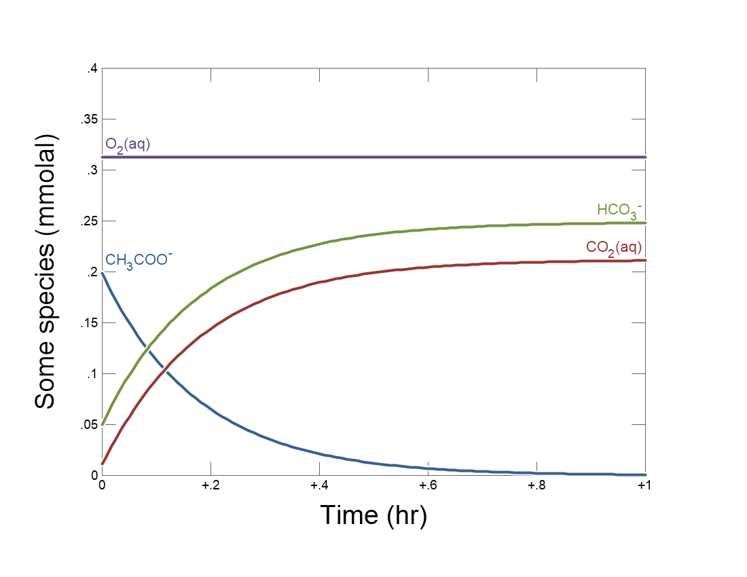

Slide 2
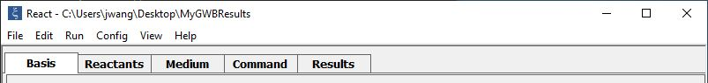
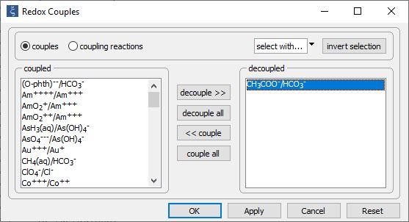
Config→
Redox couples…
Decouple reaction between acetate and inorganic carbon to enable disequilibrium

Slide 3
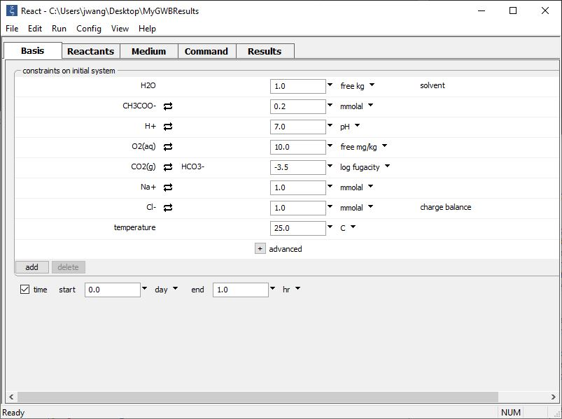
Set the initial fluid composition on the Basis pane.
Fluid contains CH₃COO⁻ substrate, is in contact with the atmosphere
Set the simulation’s duration

Slide 4
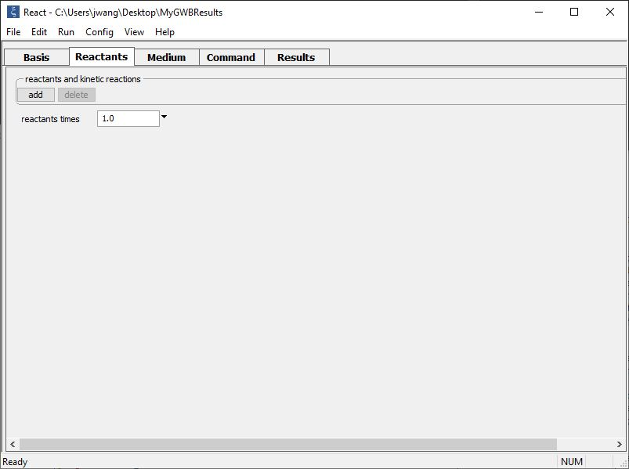
Buffer oxidation state and set up a kinetic rate law on the Reactants pane.
add → Fixed → Aqueous… → O2(aq)
add → Kinetic →
Redox reaction

Slide 5
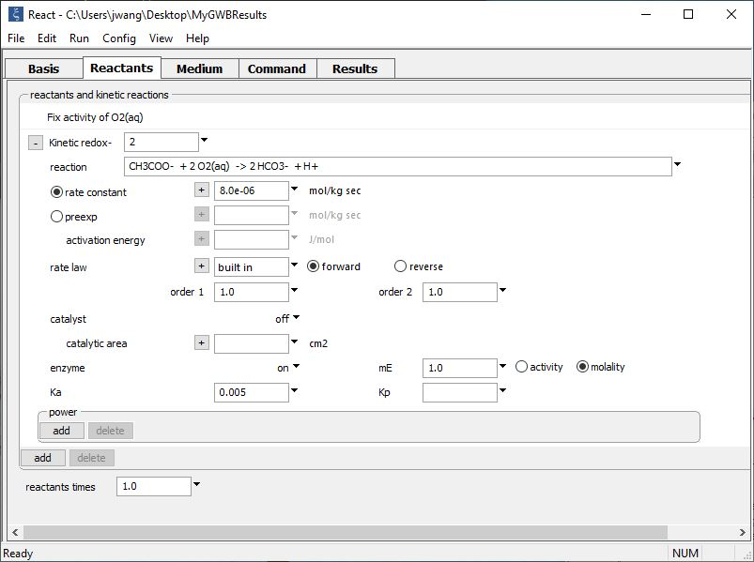
Supply kinetic parameters
Oxidation state buffered to initial value
Type out redox reaction
Set enzyme function to “on” and enter rate constant, half-saturation constant, and enzyme concentration

Slide 6
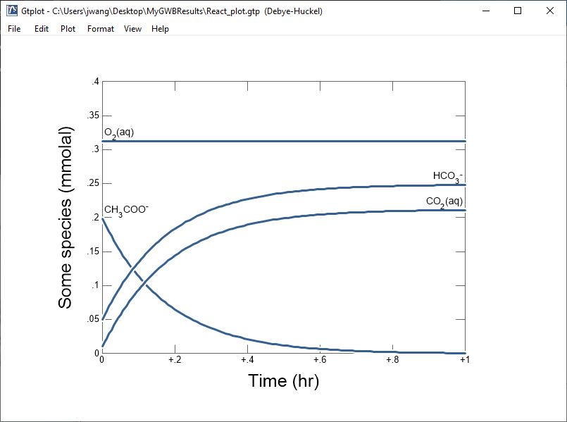
CH₃COO⁻ is consumed within an hour

