Slide 2
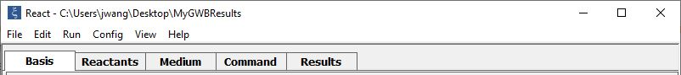
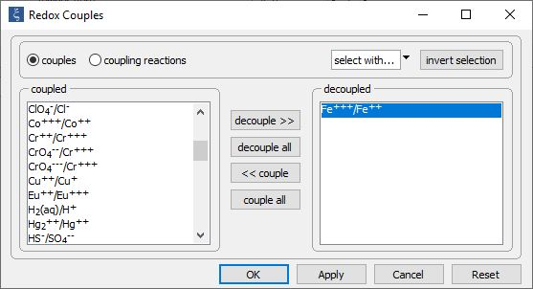
Config→
Redox couples…
Decouple reaction between ferric and ferrous iron to enable disequilibrium

Slide 3
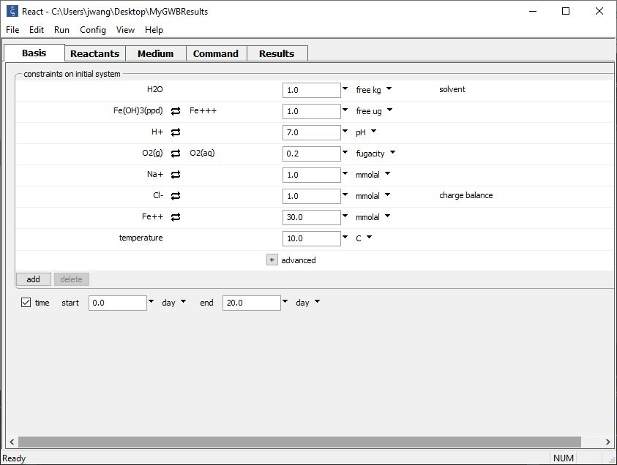
Set the initial fluid composition on the Basis pane.
Iron in the initial system is mostly ferrous. Fluid is in contact with the atmosphere.
Set the simulation’s duration

Slide 4
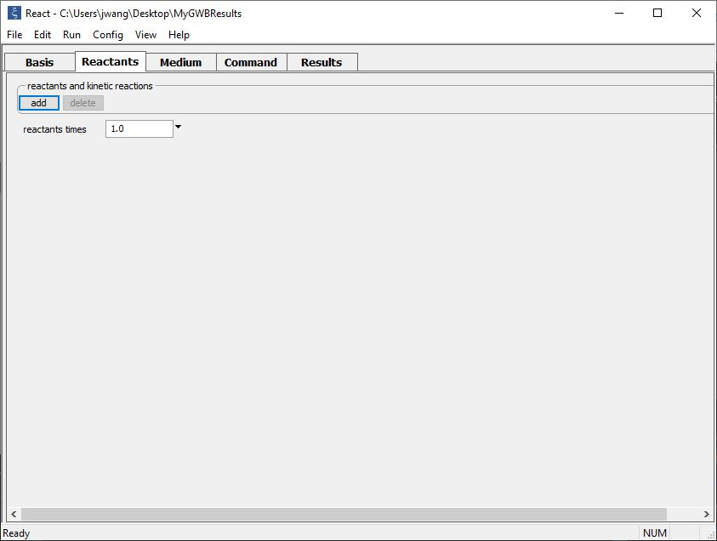
Buffer pH and oxidation state and set up a kinetic rate law on the Reactants pane.
add → Fixed → pH
add → Fixed → Gas… → O2(g)
add → Kinetic →
Redox reaction

Slide 5
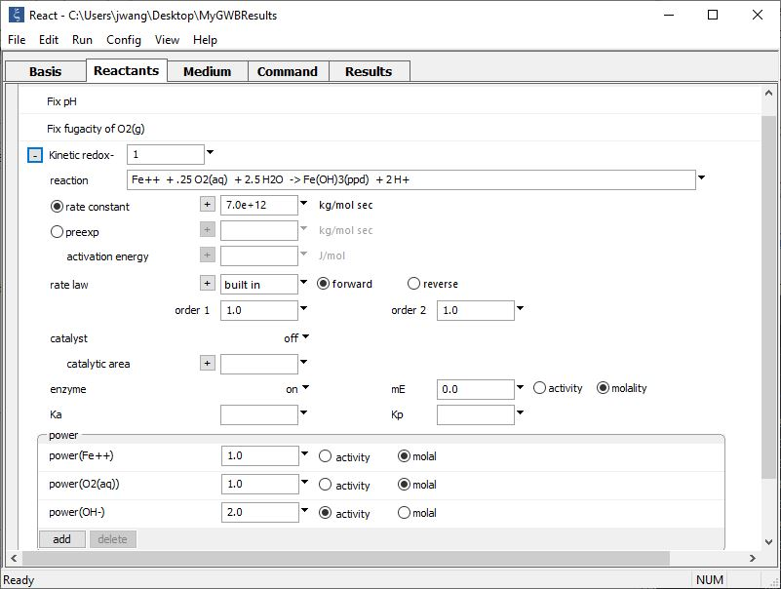
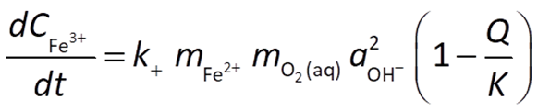
Supply kinetic parameters
pH and oxidation state buffered to initial value
Type out redox reaction
Set power of promoting species Fe⁺⁺, O₂(aq), & OH⁻, according to the rate law

Slide 6
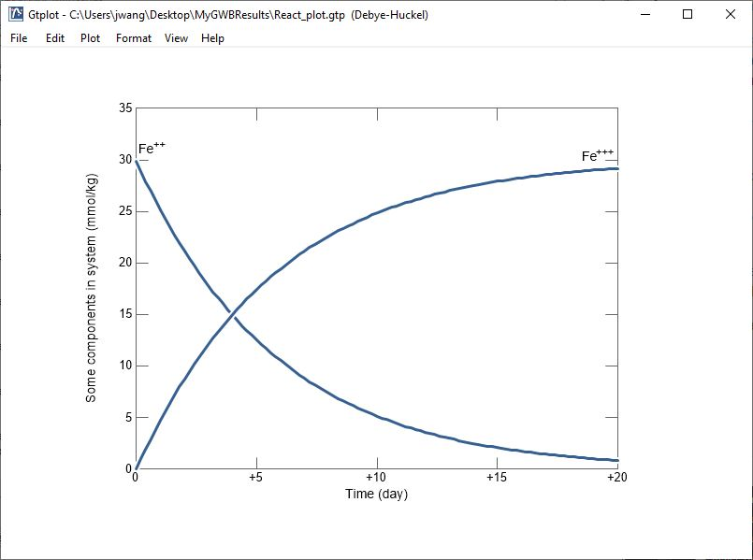
Fe⁺⁺ is oxidized to Fe⁺⁺⁺

