Slide 1
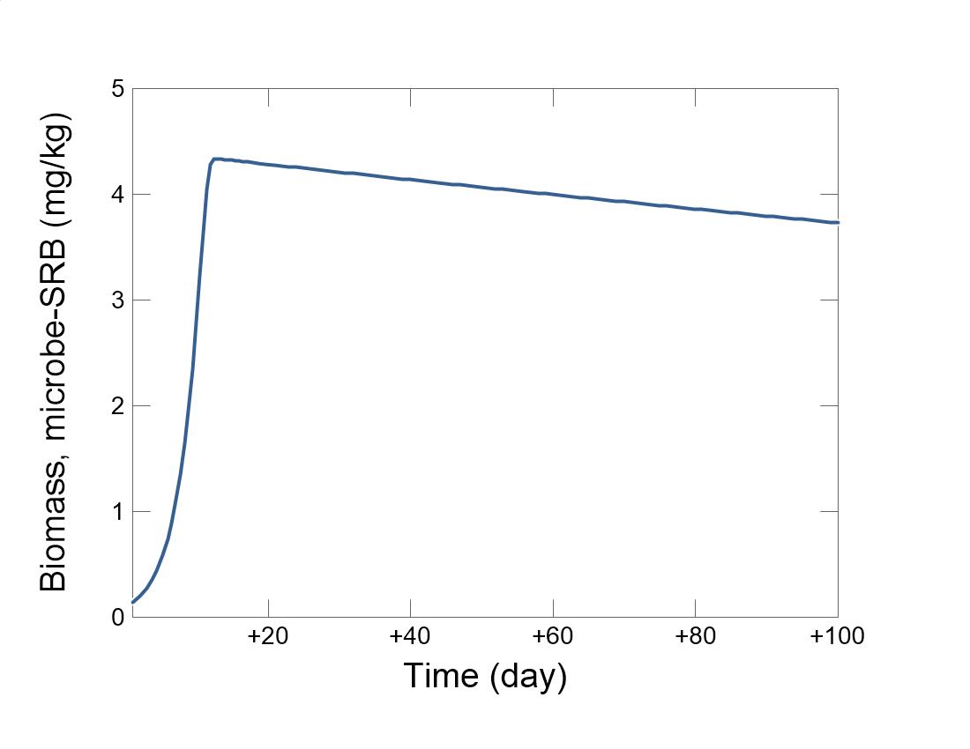

Slide 2
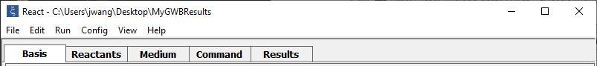
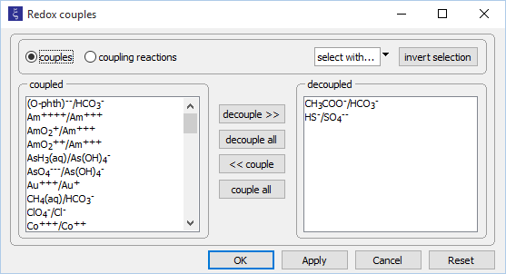
Config →
Redox couples…
Decouple redox pairs for electron donating and accepting half reactions

Slide 3
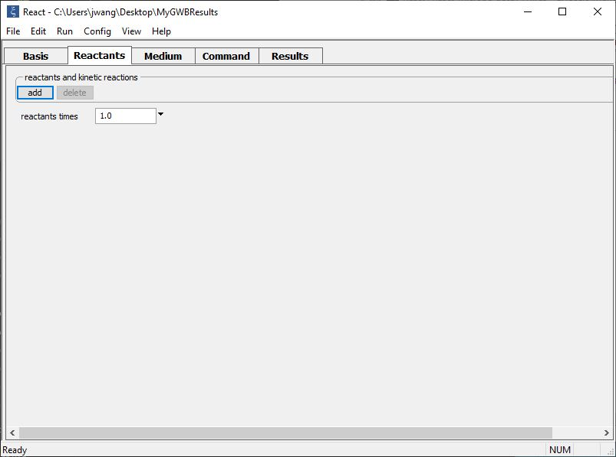
Set up kinetics of microbial metabolism on the Reactants pane.
add → Kinetic →
Microbial reaction
add → Fixed → pH

Slide 4
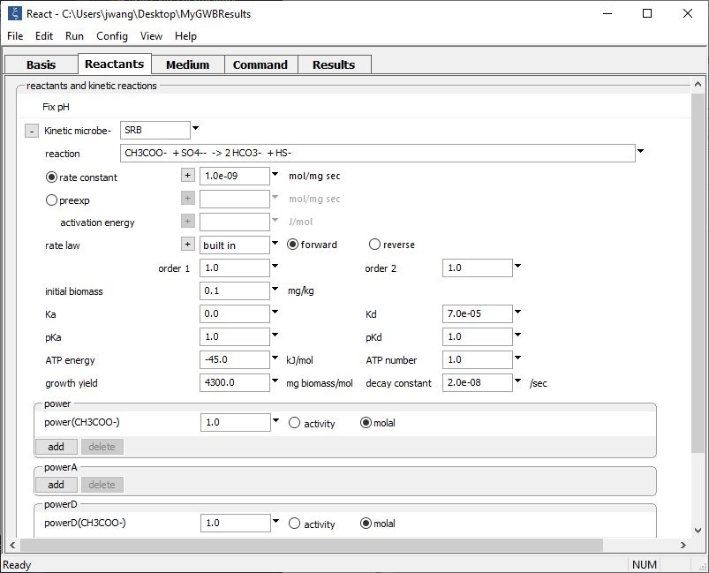
Supply kinetic parameters
Variables affecting growth include the initial biomass, growth yield, and decay constant

Slide 5
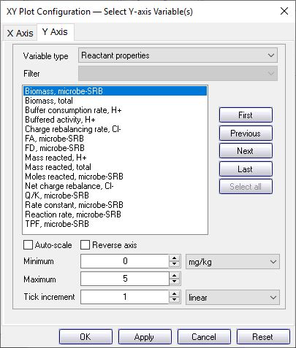
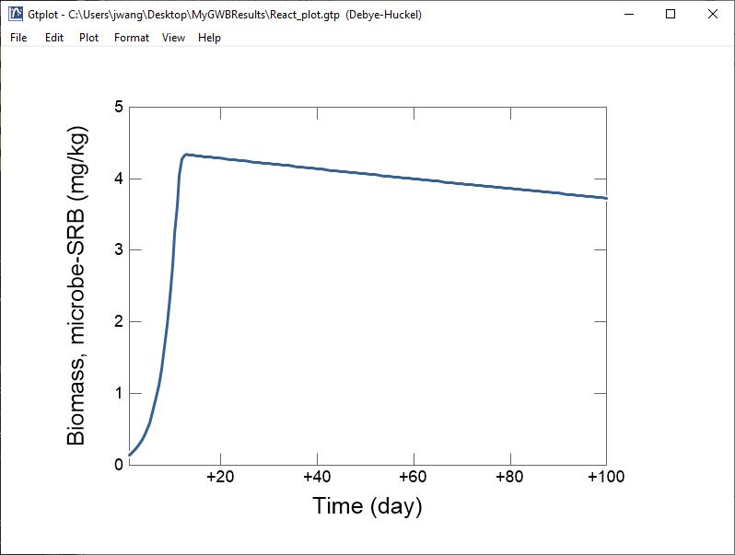
Biomass increases rapidly, then slowly declines as decay outpaces growth

