Slide 1
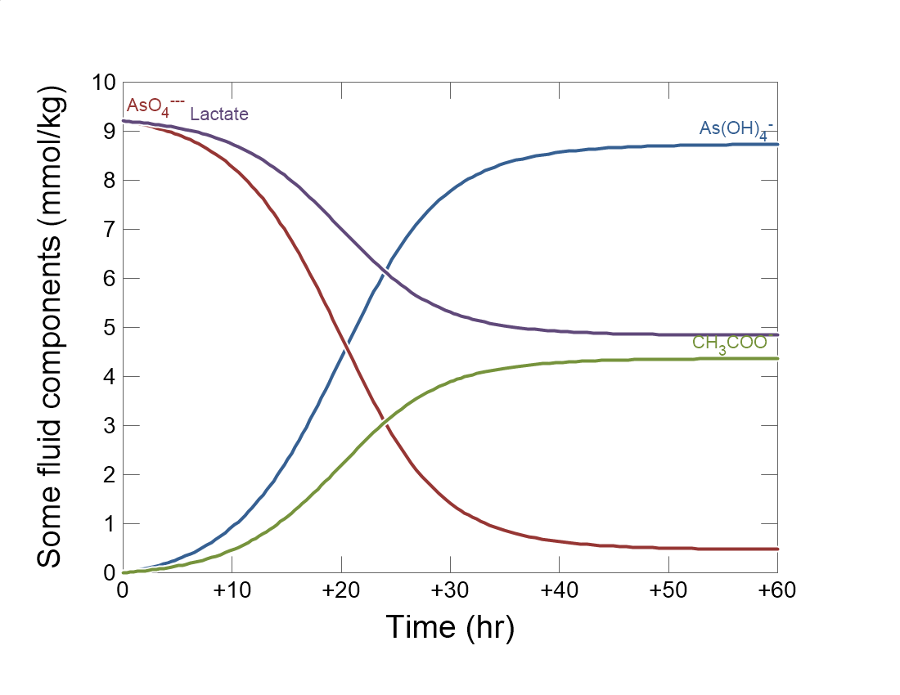

Slide 2
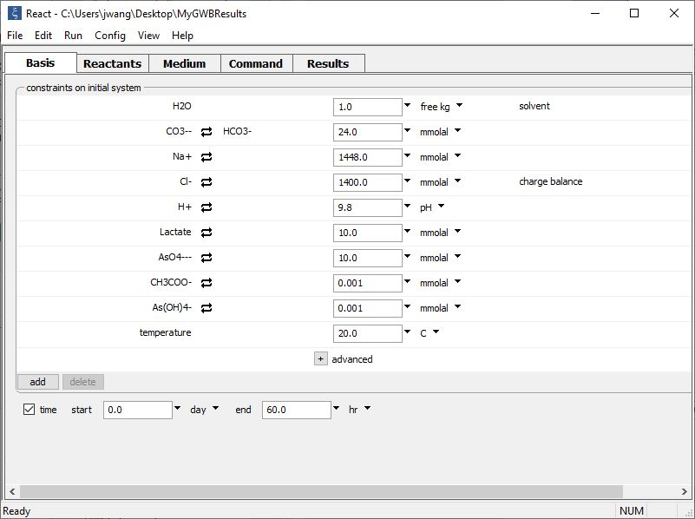
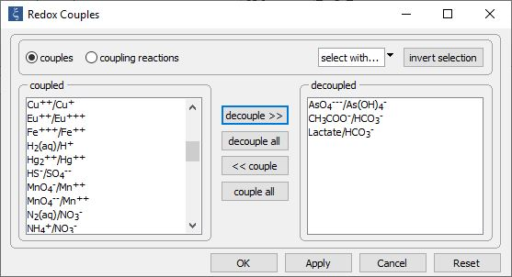
Config→
Redox couples…
Decouple redox pairs for electron donating and accepting half reactions

Slide 3
Set the initial fluid composition on the Basis pane.
Define initial fluid composition, including electron donor and acceptor and small amounts of reaction products.
Set the simulation’s duration

Slide 4
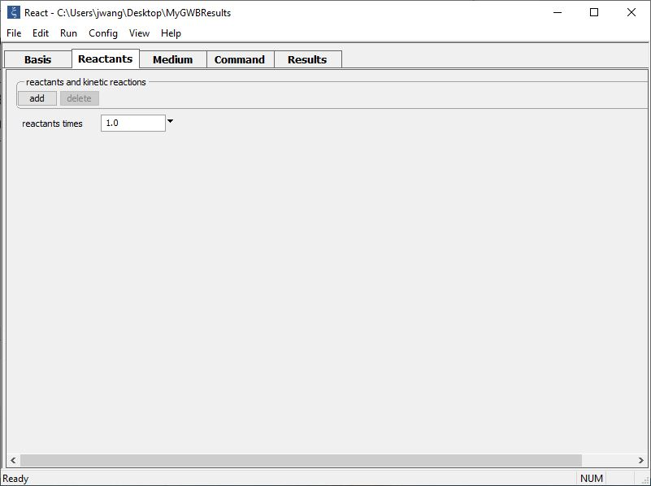
Buffer pH and set up a kinetic rate law on the Reactants pane.
add → Fixed → pH
add → Kinetic →
Microbial reaction

Slide 5
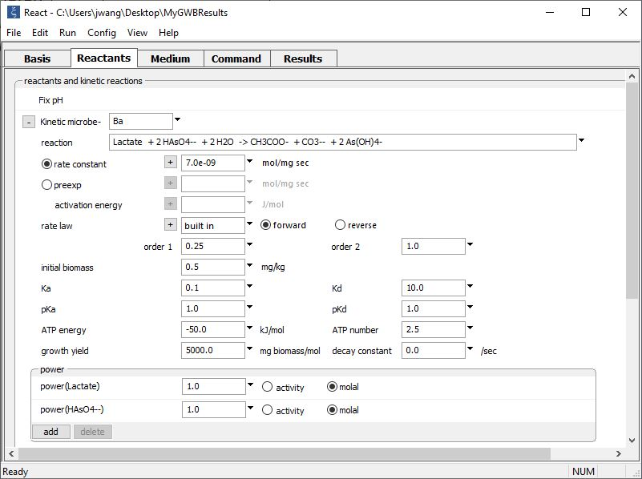
Supply kinetic parameters
pH buffered to initial value
Type out redox reaction catalyzed by the microbe
Enter thermodynamic constraints and kinetic parameters

Slide 6
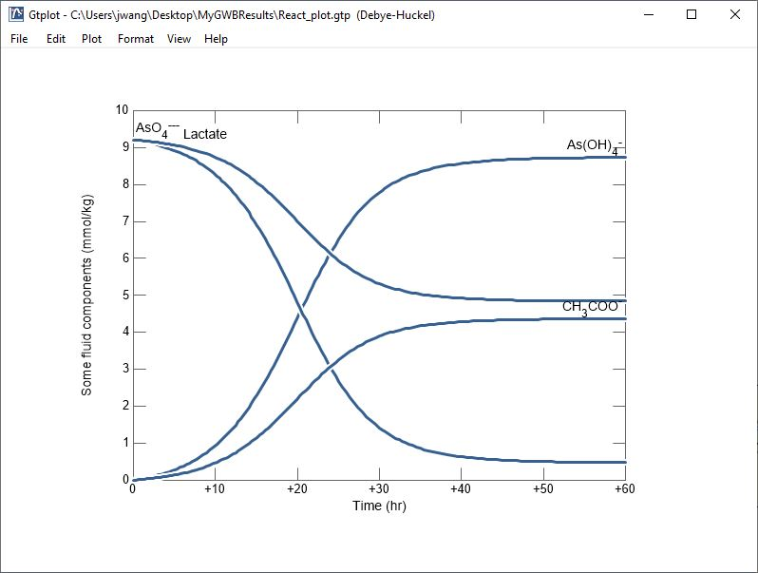
Rate is initially biomass limited, but increases with biomass growth until thermodynamic and kinetic limitations develop.

